Slide 1
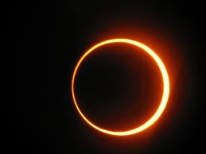
Out Of This World
Space Careers…
Notes:
Ice Breaker – what is this a picture of?
What is a Solar eclipse? It is when the moon crosses in between the sun and the earth, thus blocking the light of the sun.

Slide 2
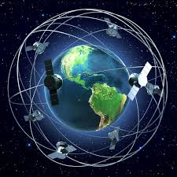
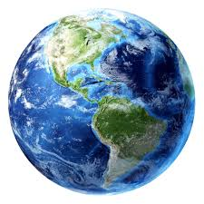
Question:
How many people do think in this country are employed within the Space sector?
95,000 Full Time Employees
Notes:
Teachers: We tend to think of space being a very small sector but it is actually quite big and growing because of the commercial flight and space industry which is expected to take off.
Question: Ask pupils to guess how many people in the UK they believe are working in the space industry. The answer is over 95,000 (full time members of staff)
Further information you could share: The space sector is currently worth about 10 billion to the UK economy but they are hoping to grow this to over 40 billion by 2030 (this is at the time when they will be beginning their careers.
The Rosetta Mission: This was the very recent and successful mission and this is a picture of ‘JUST’ the mission control team but try and convey to pupils how many people would have worked across the years on the Rosetta Mission and how many people are working on and contributing to other missions like Mars One for example?
Extension: You could extend this further by discussing Rosetta, Mars One or the current ISS space mission which has a female astronaut on board (Sam Cristoforetti – featured on slide 13)

Slide 3
Space Careers
“I thought they only needed astronauts in Space?”

Slide 4
Activity:
Think of 3 careers which are connected to the Space sector.
Notes:
Teachers: Ask pupils to write down three jobs that they can think of which are connected to the space sector.
Write these jobs up on the board so pupils can see the jobs that have been discussed.
Ask pupils if they know anyone or can name someone carrying out these jobs
Extension Activity: To extend this activity ask pupils to list the types of qualifications that you need to carry out these jobs.
Ask pupils to pick one of the jobs mentioned and what courses they may need to study to become qualified to apply for the job.
Reveal: There are lots of jobs connected to the space sector we really though only hear about a small percentage and not all the jobs that make spaceflight happen.

Slide 5
There are lots of fantastic jobs which are linked to space. For example:
Astrobiologist: looks for and investigates life and future life outside of planet earth. This may include looking at habitable worlds in and outside of the solar system which also includes humans living on other planets.
Aerospace Engineer: There are many jobs within this sector and includes research, design, development, construction, testing, science and the technology of aircraft and spacecraft.
Notes:
On the next few slides you can introduce pupils to future careers in space.
Some careers they may of mentioned, others not considered or linked. Explanations are simple.
Extension: As pupils to think about what subjects they would need to study and courses they would need to take in the future, drawing their attention to A level, Vocational and Apprenticeship routes.

Slide 6
There are lots of fantastic jobs which are linked to space. For example:
Astrophysicist: investigate the physics of the universe and might specialise in studying planets, stars, galaxies, the sun and how the universe started (the Big Bang).
Software developer: spacecraft, satellites, the curiosity rover all have to be programmed. Software programmers will design implement an oversee space missions.
Notes:
On the next few slides you can introduce pupils to future careers in space.
Some careers they may of mentioned, others not considered or linked. Explanations are simple.
Extension: As pupils to think about what subjects they would need to study and courses they would need to take in the future, drawing their attention to A level, Vocational and Apprenticeship routes.

Slide 7
There are lots of fantastic jobs which are linked to space. For example:
Geologists: Scientists who study and investigate solid and liquid matter of the earth. You can also specialise in Space Geology to investigate solid and liquid matter of other planets and rocks such as comets.
Satellite Engineers: develop satellites and design programs that direct orbiting satellites and create satellite command systems that remotely control activities from ground stations and missions.
And don’t forget… Researchers, Astronomers, Astronauts, electrical engineers, propulsion engineers, 3D print designers and many more.
Notes:
On the next few slides you can introduce pupils to future careers in space.
Some careers they may of mentioned, others not considered or linked. Explanations are simple.
Extension: As pupils to think about what subjects they would need to study and courses they would need to take in the future, drawing their attention to A level, Vocational and Apprenticeship routes.

Slide 8
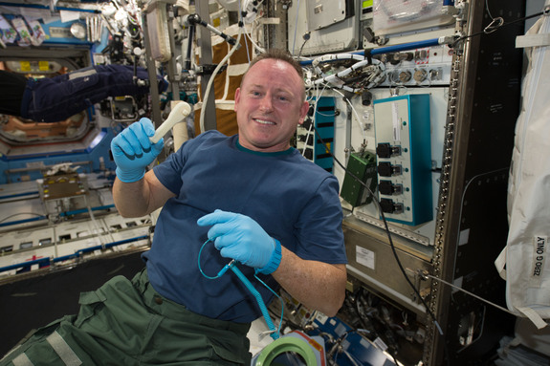
3D Printing… Really???
Courtesy of Space.com: The first 3D Printed Space tool
Why would we need to use 3D Printers in Space?
10 ways how 3D printers are important to the space sector
Check out the company that made this happen:
Made in Space: A Cool Company
Notes:
3D printing: 3D printing is set to take off universally - inside and outside of our world.
The first downloaded, or is it in space ‘uploaded’ tool was printed in December. This bring obvious advantages which you could ask your pupils to explore. (link to read more above picture)
Why 3D printing in space: instead of taking a load of parts to space, take materials and a 3D printer thus saving on space, and weight. This also reduces costs.
Explore how 3D is changing space by looking at the 10 ways link
And check out Made in space. It is a really interesting website that shows a company focusing on 3D print and space. They also have a careers section which you could look at to show the types of jobs available in this area.
Another 3D printing company you could explore is 3D Systems and the download website: http://cubify.com. This is an exciting future area for careers and shows how easy it is becoming to download to 3D printers from within the home. It is also anticipated that in the next five years society will start to purchase 3D printers for the home as the cost reduce. You can now buy printers for as little as £700

Slide 9
There are also commercial space opportunities:
SpaceX made history in 2012 when it became the first commercial craft to deliver cargo to a space station
Clyde Space and Airbus who are developing and making satellites
Felix Baumgartner who made the space jump
The 100’s of companies (many locally) who design and manufacture parts for space
And Virgin Galactic who are attempting to build the first commercial spacecraft…
Dreams Inspire Reality Careers at Virgin Galactic
Notes:
Teachers: Explain to the class that as well those looked at already there are a number of jobs and opportunities connected to space.
Virgin Galactic: two videos (1st) about virgin Galactic, Branson's dream and key messages about following our dreams. (2nd) is about the STEM careers that make this dream a reality, which includes a senior project manager who is female and a astrophysicist.
Below I have added some extra hyperlinks that you could investigate further with your pupils:
Space X: http://www.spacex.com/ Careers part of spaceX: http://www.spacex.com/careers
Airbus: http://www.airbus.com/ Careers part of airbus: http://www.airbus.com/work/
Felix Baumgartner: https://www.youtube.com/watch?v=FHtvDA0W34I (inspirational) If more people wish to start doing what Felix did this will require ways to get up into space
Example of local companies and space:
Ford Component Manufacturers (North Tyneside) - http://www.ford-components.com/ Careers with: http://www.ford-components.com/careers
Catapult – satellite applications (Durham) - http://www.sacatapultcoe.org/north-east/
There are a number of companies doing really interesting things at Net Park in Durham.
Another great fact is that: Companies developing products from physics-based science employ over 43,000 people in the North East, that means there are great opportunities if you have a physics qualification and very helpful if you are interested in space.

Slide 10
Role Models
Some local, national and international…

Slide 11
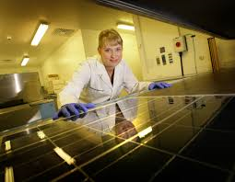
Solar Space – Dominique Morrison
Dominique is a consultant who supports businesses with engineering and physics linked solutions, information and knowledge.
In her previous role as Head of Research, she had to manage a number innovative solar projects. Solar Capture Technologies develop and manufacture solar panels for many sectors including: water supply and protection, telecoms, transport, oil and gas, defence and aerospace.
The process used when developing solar panel technologies is Photovoltaics
Watch this video for more information:
What Dominque Does:
Self Employed as a consultant
Previously worked for:
www.solarcapturetechnologies.com
Studied a Physics Degree at University
Notes:
Teachers: the next slides provide examples of people working in or linked to space.

Slide 12
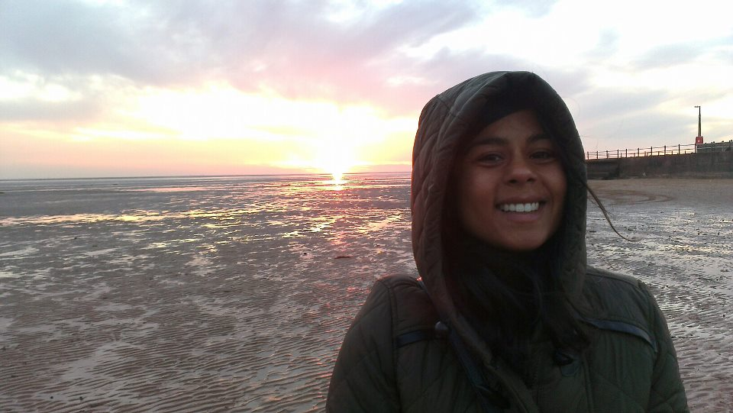
Space - Dr Sheila Kanani
“I help to encourage and promote the study of astronomy, solar-system science and geophysics”.
“I teach astronomy and organise events as well as delivering workshops at science festivals…and more!”
Education, Outreach & Diversity Officer
Sheila works at the Royal Astronomical Society, London www.ras.org,uk
Studied: A Degree in Physics & Astrophysics

Slide 13
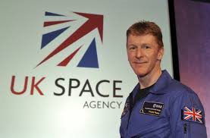
Space – Tim Peake
Tim is the first British citizen selected by ESA
Peake beat over 8,000 other applicants for one of the six places on the ESA's new astronaut training programme.
The selection process included taking academic tests, fitness assessments and several interviews
Tim is also an ‘Aquanaut’
European Space Agency (ESA) Astronaut
www.esa.int
Education: BSc In Flight Dynamics.
Before becoming an astronaut Tim was a platoon commander, helicopter pilot and instructor in the Army.

Slide 14
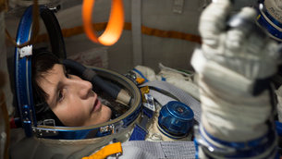
Space –Samantha Cristoforetti
She is also one of the first women to be lieutenant and flight commander in the Italian air force.
Sam was selected to be an astronaut in May 2009
She has now been on three space missions.
Tweet Sam by following her @AstroSamantha or by following @esa
European Space Agency (ESA) Astronaut
www.esa.int
Graduated from University with a Degree in Mechanical Engineering and later with a Degree in aeronautical sciences
Samantha is the third female in space and the first Italian female in space

Slide 15
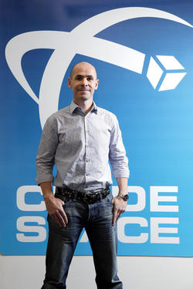
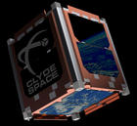
Space – Craig Clark MBE
Clyde Space is an award winning supplier of small and micro spacecraft systems including Cube Satellites
Craig was awarded an MBE in the Queen's Birthday Honours in June 2013 for Services to Technology and Innovation
Follow Clyde Space:
twitter.com/craig_s_clark.
Craig is the founder of a company called Clyde Space www.clydespace.com
Graduated with a Degree in Power Engineering and went on to study Satellite Technology
Notes:
Teachers: You can also demonstrate using this template what a ‘cubesat’ looks like following this link: http://www.clyde-space.com/fun

Slide 16
What Next?
Have you been inspired to find out more?

Slide 17
A Career In Space is Definitely Possible!
These careers require you to study and be able to apply the knowledge of STEM subjects:
Maths
Physics
Computing
Biology
Chemistry
Engineering
Design
Depending on the career you could study A-levels, Apprenticeships or Vocational courses..
Notes:
Teachers: If a pupil is interested in a space career, it is very possible and they can increase their chances by studying STEM subjects

Slide 18
Top Advice:
Try hard and put in as much effort as you can every day
Investigate- Find out the answers to as many questions as you can
Dream Big, Think Big!
Start inventing and innovating… always think of how you can do things better.
Hardwork and Resilience
Read, Read, Read!
Don’t think that you have to be a certain type of person to do STEM.
The 95,000 people who have a space career are not all rocket scientists and astronauts.
Remember - Space careers are on your doorstep!
Notes:
Teachers: This slide is trying to get pupils to think about what skills and attitude they need to be successful and progress. Not just within the space sector but any career that they are interested in.

Slide 19
STEM Quest Challenge:
Go home and research a space career and what you need to do to get that job!
Or research another career linked to space.
Notes:
Teachers: This is a great way of extending with a homework activity outside of the classroom. Attached with the email for PPT is a pdf resource sheet you can use for homework tasks.
You may wish to use some questions, all of the questions, it is up to you and the class you are with. It is though important you encourage them to discuss the session with parents so that they to realise the sector is much bigger than perhaps they are also thinking.

