Slide 1
Unconscious Bias
Dr Carol Davenport
Notes:
Change your name for mine.

Slide 2
Today’s session
Unconscious bias
The effect of bias
Benefits of reducing bias
Planning to reduce bias

Slide 3
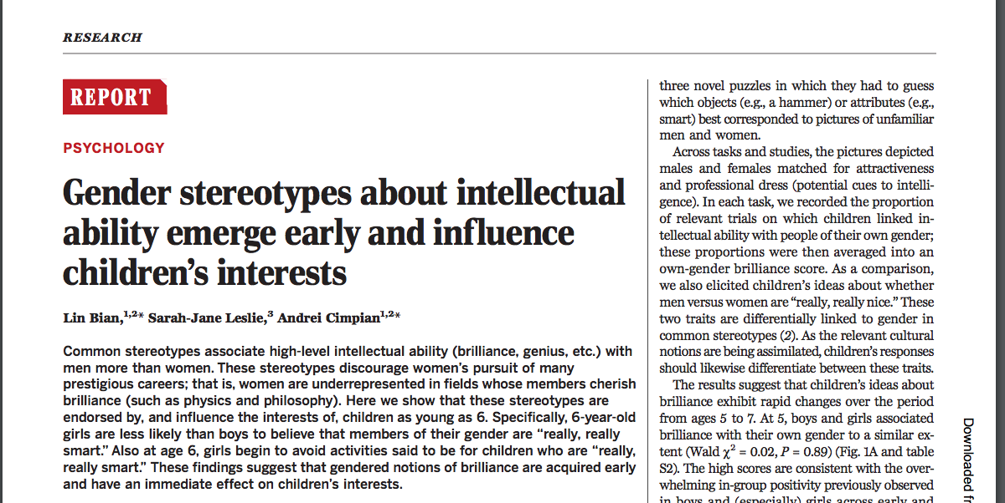

Slide 5
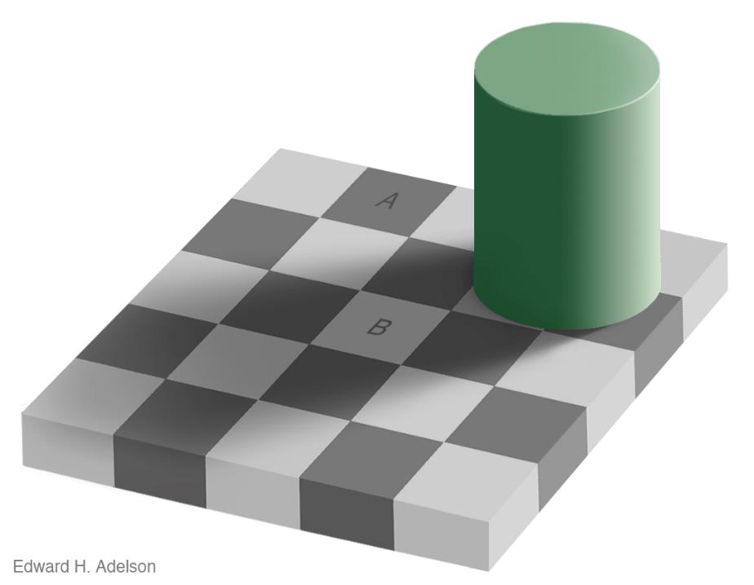
https://www.youtube.com/watch?v=0i8ZKTyIaQc
https://www.youtube.com/watch?v=z9Sen1HTu5o
Notes:
Again, they can cut this out, or can use a handout

Slide 6
Notes:
Explain to the group that you are going to split them into two groups.
On the next 2 slides half the group will turn from the screen and answer the questions on a green post-it note.
At the next blank slide the two groups will swap and a different colour post-it will be used

Slide 7
Group A:
Please read this silently
Question 1:
Does this hotel room cost more than £5500 per night?
Write your answer on a post-it note.
Double bedroom suite, city centre location, panoramic views, Manhattan, New York.

Slide 8
Group A:
Please read this silently
Question 2:
How much would you expect to pay for this hotel room?
Write your answer on the post-it note.
Double bedroom suite, city centre location, panoramic views, Manhattan, New York.

Slide 10
Group B:
Please read this silently
Question 1:
Does this hotel room cost more than £55 per night?
Write your answer on a post-it note.
Double bedroom suite, city centre location, panoramic views, Manhattan, New York.

Slide 11
Group B:
Please read this silently
Question 1:
How much would you expect to pay for this hotel room?
Write your answer on the post-it note.
Double bedroom suite, city centre location, panoramic views, Manhattan, New York.

Slide 12
Notes:
Ask people to stick their post-it notes in order from lowest to highest values. Is there a difference?

Slide 13
Anchoring Bias
Group A:
Please read this silently
Question 1:
Does this hotel room cost more than £5500 per night?
Write your answer on a post-it note.
Group B:
Please read this silently
Question 1:
Does this hotel room cost more than £55 per night?
Write your answer on a post-it note.
Group A:
Please read this silently
Question 2:
How much would you expect to pay for this hotel room?
Write your answer on the post-it note.
Double bedroom suite, city centre location, panoramic views, Manhattan, New York.
Group B:
Please read this silently
Question 1:
How much would you expect to pay for this hotel room?
Write your answer on the post-it note.
Notes:
Place the post-its in a line from lowest to highest.
There should be a obvious difference.
This bias is called anchoring, group one were anchored to a high number (£5500) in the initial slide, group 2 anchored to a low number (£55).
Again you have no choice in this, you brain made some automatic decisions on your behalf and fed you some dodgy information.

Slide 14
Cognitive biases
Shepherd’s tables and Adelson’s illusions are examples of visual cognitive biases
The hotel prices – a bias called anchoring

Slide 15
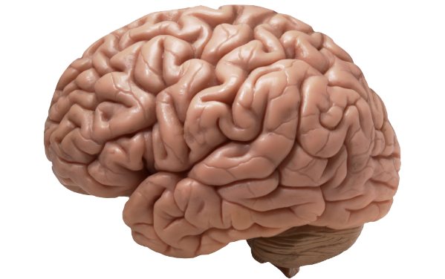
Why do biases arise?
Automatic processing system – background processes, allowing large data processing
Reflective processing system – active processes, conscious decisions
Kahneman (2011)
Notes:
Refer to

Slide 16
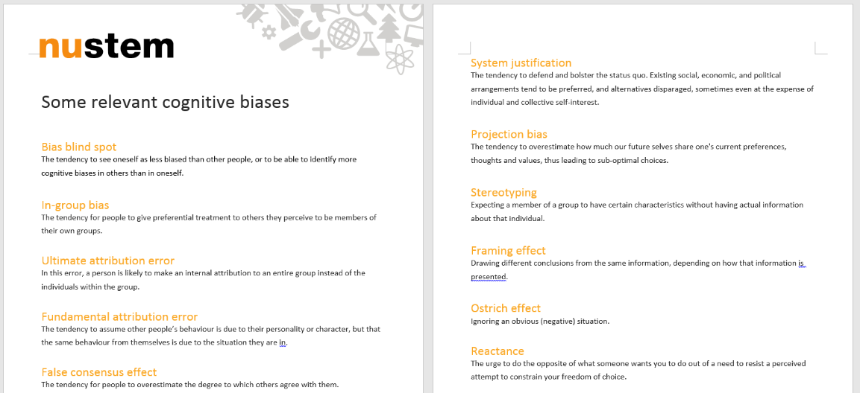
Our cognitive biases
Notes:
Give out the list of biases. Ask if people have seen this or experienced them. Point out that it is often easier to see the biases in other people than in ourselves.

Slide 17
Read through the sample of cognitive biases on the sheet
Discuss, in small groups, examples when you have seen any of these biases (in yourself or others).

Slide 18
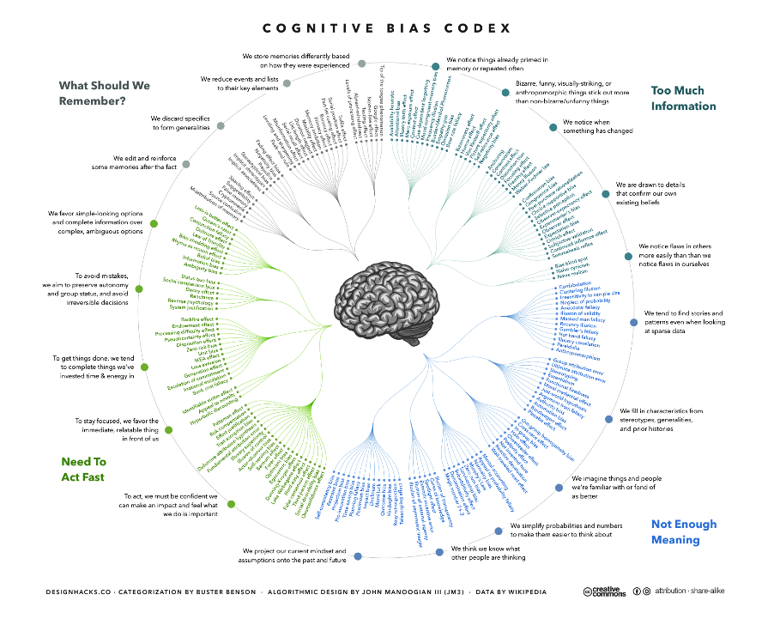

Slide 19
A father and his son are in an accident. Badly injured they are rushed to the hospital. In the operating room, the surgeon looks at the boy and says, “I can’t operate on this boy, he is my son.” Who is the surgeon? When you think you know the answer to the question raise your hand

Slide 20
Surgeon = Male
Automatic mental associations may have caused you to think “male” on reading “surgeon”

Slide 21
Race
Gender
Age
Disability
Marital status
Education level
Weight
Religion (or lack of)
Accent / location
Sexuality
and so on….
Notes:
Discuss the types of characteristics that humans make judgements about, and that can affect our views of people.

Slide 22
Some common stereotypes
Old people are forgetful
Women are nurturing
White van drivers are aggressive

Slide 23
Common, relevant stereotypes
What are the common stereotypes that are linked to your areas of expertise?

Slide 24
Why is unconscious bias a problem?
Notes:
Treatment for heart attack – women often under diagnosed.

Slide 25
Top 10 jobs for girls |  |  | Top 10 jobs for boys
Teacher | 71% |  | Game tester | 75%
Hairdresser | 67% |  | Athlete | 51%
Actor/Actress | 60% |  | Detective | 49%
Vet | 60% |  | Soldier | 45%
Athlete | 48% |  | Tennis Player | 43%
Shopkeeper | 47% |  | Mechanic | 43%
Nurse | 46% |  | Pilot | 41%
Doctor | 42% |  | Astronaut | 40%
Game tester | 40% |  | Engineer | 38%
Author | 38% |  | Estate Agent | 34%
Notes:
Hand out a copy of this slide for discussion
This slide shows the top 10 jobs chosen by boys and girls and the percentage of pupils that included that job in their ‘would like to do’ or ‘not sure’ categories.
Participants should discuss the data.
Are there any patterns that they notice? Anything surprising.
Notes:
There are only two jobs that are common to both boys and girls: athlete and game tester.
The STEM jobs that girls are interested in are mainly healthcare related: vet, nurse, doctor (and game tester).
The STEM jobs that boys are interested in are physical science related: game tester, mechanic, pilot, astronaut, and engineer.
The full list of jobs was:
Actor/Actress
Detective
Farmer
Mechanic
Surveyor
Athlete
Doctor
Game Tester
Nurse
Teacher
Astronaut
Engineer
Hairdresser
Pilot
Tennis Player
Author
Entrepreneur
Judge
Politician
Technician
Banker
Estate Agent
Lawyer
Shopkeeper
Vet
Civil Servant
Firefighter
Librarian
Soldier
Zoologist
italicized jobs shows occupations classified as general STEM
jobs in bold show jobs classified as core STEM

Slide 26
Top 10 jobs for girls |  | salary range | Top 10 jobs for boys |  | salary range
Teacher | 71% | £24k - £63k | Game tester | 75% | £15k - £40k
Hairdresser | 67% | £14k - £30k | Athlete | 51% | variable
Actor/Actress | 60% | variable | Detective | 49% | £21k - £59k
Vet | 60% | £30k - £50k | Soldier | 45% | £15k - £35k
Athlete | 48% | variable | Tennis Player | 43% | variable
Shopkeeper | 47% | £11k - £25k | Mechanic | 43% | £18k - £35k
Nurse | 46% | £24k - £37k | Pilot | 41% | £20k - £140k
Doctor | 42% | £37k - £105k | Astronaut | 40% | £40k - £80k
Game tester | 40% | £15k - £40k | Engineer | 38% | £18k - £80k
Author | 38% | variable | Estate Agent | 34% | £15k - £40k
Average £35k
Average £44k
Notes:
Slide 11
This slide adds in the salary range for the jobs shown on slide 10. The data is taken from the national Careers Website job explorer.
Point out the difference in average salary for girls and for boys. Choices in primary school have potential long term consequences for future earning potential.

Slide 27
Unconscious bias – effects in education

Slide 28
In school?
On average, teachers give boys more time than girls to answer questions in class.
Boys are more likely than girls to raise their hands in class than girls.
White males tend to get more attention from the teacher than other groups.
When teachers are asked to remember their ‘best’ students, the answers are overwhelmingly males.
Sadker & Sadker, 2009

Slide 29
Still an issue?
Male and female teachers both interact more with boys than girls, but the difference is greater for male teachers.
All interactions | Lessons with male teacher (%) | Lessons with female teacher (%) | Science interactions | Lessons with male teacher (%) | Lessons with female teacher (%)
Whole class | 67 | 64 | Whole class | 51 | 43
Teacher to boys | 21 | 21 | Teacher to boys | 32 | 32
Teacher to girls | 12 | 15 | Teacher to girls | 18 | 25
Eliasson et al., 2016
Notes:
Measured interactions in Swedish schools for grade 9 pupils in 6 schools. 14 teachers (7 male, 7 female) and 85 boys and 110 girls.

Slide 31
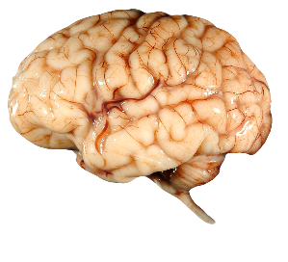
Researchers analysed over 1400 MRI brain scans to look at similarities and differences in structure.
“Our results demonstrate that regardless of the cause of observed sex/gender differences in brain and behaviour (nature or nurture), human brains cannot be categorized into two distinct classes: male brain/female brain”
Joel et al.,(2015), PNAS, 112 (50) 15468 -15473

Slide 32
Where might Unconscious Bias affect your children?

Slide 33
Discussion exercise

Slide 34
The pattern of classroom interactions can unintentionally reinforce messages of expected and accepted behaviours.
There is a surprising amount of sexist language and behaviour used in society and this could be picked up and imitated by young children.
Ideas about what children are ‘good’ at, and subsequently what paths are open to them are embedded at an early age.
Cultural change will only be achieved if all members of the school community are involved, including parents and carers.
Many fictional texts uphold traditional stereotypes.
Teaching materials and displays can reinforce gender stereotypes.

Slide 35
Language
“He writes like a typical boy.”
“What a pretty dress you’re wearing today Sophie.”
“I need two strong lads to help me carry these books.”
“OK guys, pens down.”
“You’re being very kind there Emily.”
“Don’t be such a girl Josh.”
Notes:
Discuss the effects of gendered language. Give some suggestions of possible phrases.
The phrase ‘OK guys, pens down’ is often the most controversial example of a gendered statement that might be heard in the classroom. Participants might feel that ‘guys’ has become a non-gendered term. However, as with many ‘generic’ terms, the default is male – consider who you would draw or describe if you were drawing a group of males. As teachers, it is worth considering if there are other terms that could be used to ensure that both boys and girls are included.
This blog post describes one company’s attempt to think about gender inclusive language to replace ‘hey guys’. https://www.hotjar.com/blog/gender-inclusive-language-workplace/
UNESCO produced guidelines on gender-neutral language in 1999. Although old, the principles still hold and you can download a copy from https://unesdoc.unesco.org/ark:/48223/pf0000114950?posInSet=1&queryId=a45a3fc4-738d-4da4-96c8-fa1bbf7833b2. If you want to find out more, searching for ‘gender-neutral language’ will provide many examples from different professions and organisations.

Slide 36
Overcoming unconscious bias
“Behavioural scientists for a very long time have been trying to understand biases. And not just biases related to demographic characteristics like gender — cognitive biases in general. What we’ve found is that biases are very stubborn. They are very hard to overcome simply by trying to change mindsets…”
Iris Bohnet
Professor of Public Policy, Harvard University

Slide 37
In 1970 only 5% of musicians performing in the top five orchestras in the US were women. Today, women compose more than 35% of the most acclaimed orchestras. This did not happen by chance.
Bohnet, 2016
Notes:
Need to put processes in place, can’t rely on people dealing with it.

Slide 38
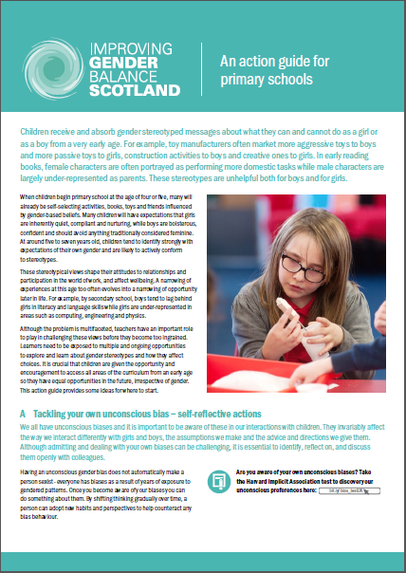
What can we do about it?
Be consciously aware of the issue
Put structures and processes in place that reduce the effect of unconscious bias.
Think carefully about the messages in lesson materials, literature, displays, etc.
Think about choice of language and the underlying messages it sends
Be aware of choices you make regarding classroom management
Notes:
This slide contains some initial strategies that could be used to start to tackle the issue of unconscious bias in classrooms.
Further detailed ideas can be found in materials produced by Improving Gender Balance Scotland: https://education.gov.scot/improvement/learning-resources/improving-gender-balance-3-18/
This includes an Action Guide for ELC practitioners and for primary schools.

Slide 39
Creating real change
Individuals attending a short training session are unlikely to change behaviour.
But, groups planning together and instigating policy and practice change can make a difference.

Slide 40
Looking to the future . . .
Notes:
What change in practice can they work towards as a result of this training?

Slide 41
Thank you
carol.davenport@northumbria.ac.uk
Website: NUSTEM.uk

Slide 42
References
Banaji, M.R. and Greenwald, A.G., 2016. Blindspot: Hidden biases of good people. Bantam.
Bohnet, I., 2016. What works: Gender equality by design. Harvard University Press.
Equality Challenge Unit, 2017. Equality in Higher Education: Staff statistical report 2017, London
Eliasson, N., Sorensen, H., Karlson, K.G., 2016. Teacher-student interaction in contemporary science classrooms: is participation still a question of gender? International Journal of Science Education, 38:10, 1655-1672
Fine, C., 2010. Delusions of gender: How our minds, society, and neurosexism create difference. WW Norton & Company.
Fine, C., 2006. A Mind of its Own. How our brain distorts and deceives. Thriplow, England: Icon Books.
Joel, D. et al., Sex beyond the genitalia: The human brain mosaic, 2015, Proceedings of the National Academy of Sciences, 112(50), pp 15468-15473
Kahneman, D., 2011. Thinking, fast and slow. Macmillan.
Moss-Racusin, C.A., Dovidio, J.F., Brescoll, V.L., Graham, M.J. and Handelsman, J., 2012. Science faculty’s subtle gender biases favor male students. Proceedings of the National Academy of Sciences, 109(41), pp.16474-16479.

