Slide 1
STEM Person of the Week
Guidance and resources for classroom teachers

Slide 2
Overview
STEM Person of the Week is a 5-week, teacher-led intervention designed to reduce the common stereotypes surrounding science and scientists.
Each week every class will receive a poster postcards for the children introducing a new STEM worker.

Slide 3
The resources
An A3 poster to display on the classroom.
A postcard for each of the children in your class.
A PowerPoint presentation slide to introduce the STEM person to your class at the start of the week.

Slide 4
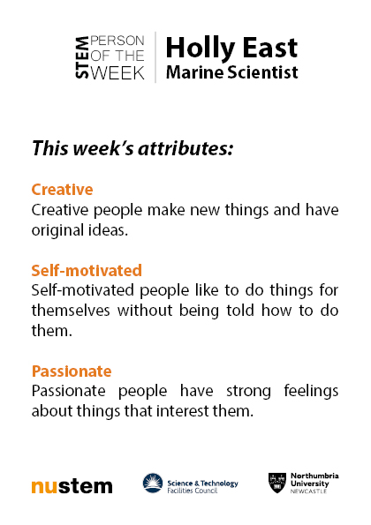
Example materials
The poster
Front and back of the postcard

Slide 5
Attribute focus
The resource is designed to promote a counter-stereotypical view of the STEM profession through a series of 15 attributes.
Each week, there are 3 new attributes for the children to focus on.
In science lessons, and across other subjects, praise should be focused on children who display these attributes.
We want to show children that they already have the skills that you need to be a scientist.

Slide 6
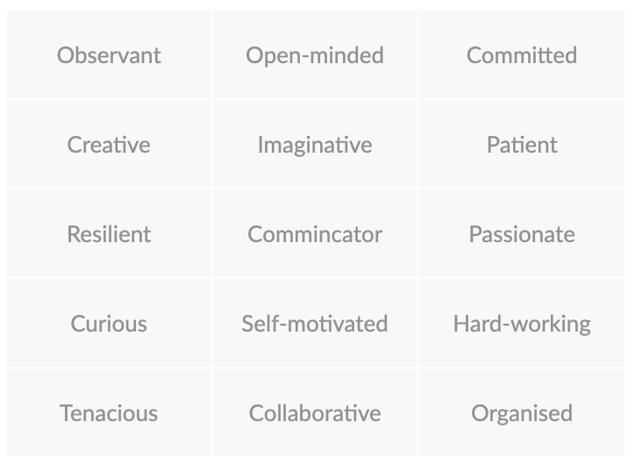
The 15 Attributes

Slide 7
Breaking down stereotypes
The STEM Person of the Week role models and counter-stereotypical attributes provide a new understanding of the skills needed to be a scientist.
After the intervention, children use less stereotypes when describing scientists and more positive attributes.

Slide 8
STEM Person of the Week Timeline
W/b Monday 11 February – schools receive printed and electronic resources.
Monday 25 February – intervention starts
Friday 29 March – intervention ends

Slide 9
Questions and more information
Email: joe.Shimwell@unn.ac.uk
Visit: nustem.uk/spotw/

