Slide 1
STEM Person of the Week 2021

Slide 2
Children’s understanding of ‘scientists’
We asked 450 children from a school to ‘write down 6 words to describe a scientist’.
What do you think were some of the common words that were used?
(write one or two into the chat window)

Slide 3
Children’s understanding of ‘scientists’
We asked 450 children from a school to ‘write down 6 words to describe a scientist’.
What do you think were some of the common words that were used?
(write one or two into the chat window)
mad
brainy
clever
test tubes
white coat
nerdy
special glasses
boy or girl
careful
talented
funny
awesome
hard-working
observant

Slide 4
Expected stereotypical views
Nearly half of all the words chosen were categorized as ‘Stereotypes’
Of the Stereotypes words, 60% described some form of intelligence (clever, brain box, genius, etc.)
Girls were statistically more likely to use positive sentiments to describe scientists (24% for girls, 15% for boys)
Very few gendered words were used (0.5%)

Slide 5
What characteristics are useful to be successful in science (or STEM) careers?
Collaborative
Committed
Communicator
Creative
Curious
Hardworking
Imaginative
Logical
Observant
Open-minded
Organised
Passionate
Patient
Resilient
Self-motivated
Tenacious

Slide 6
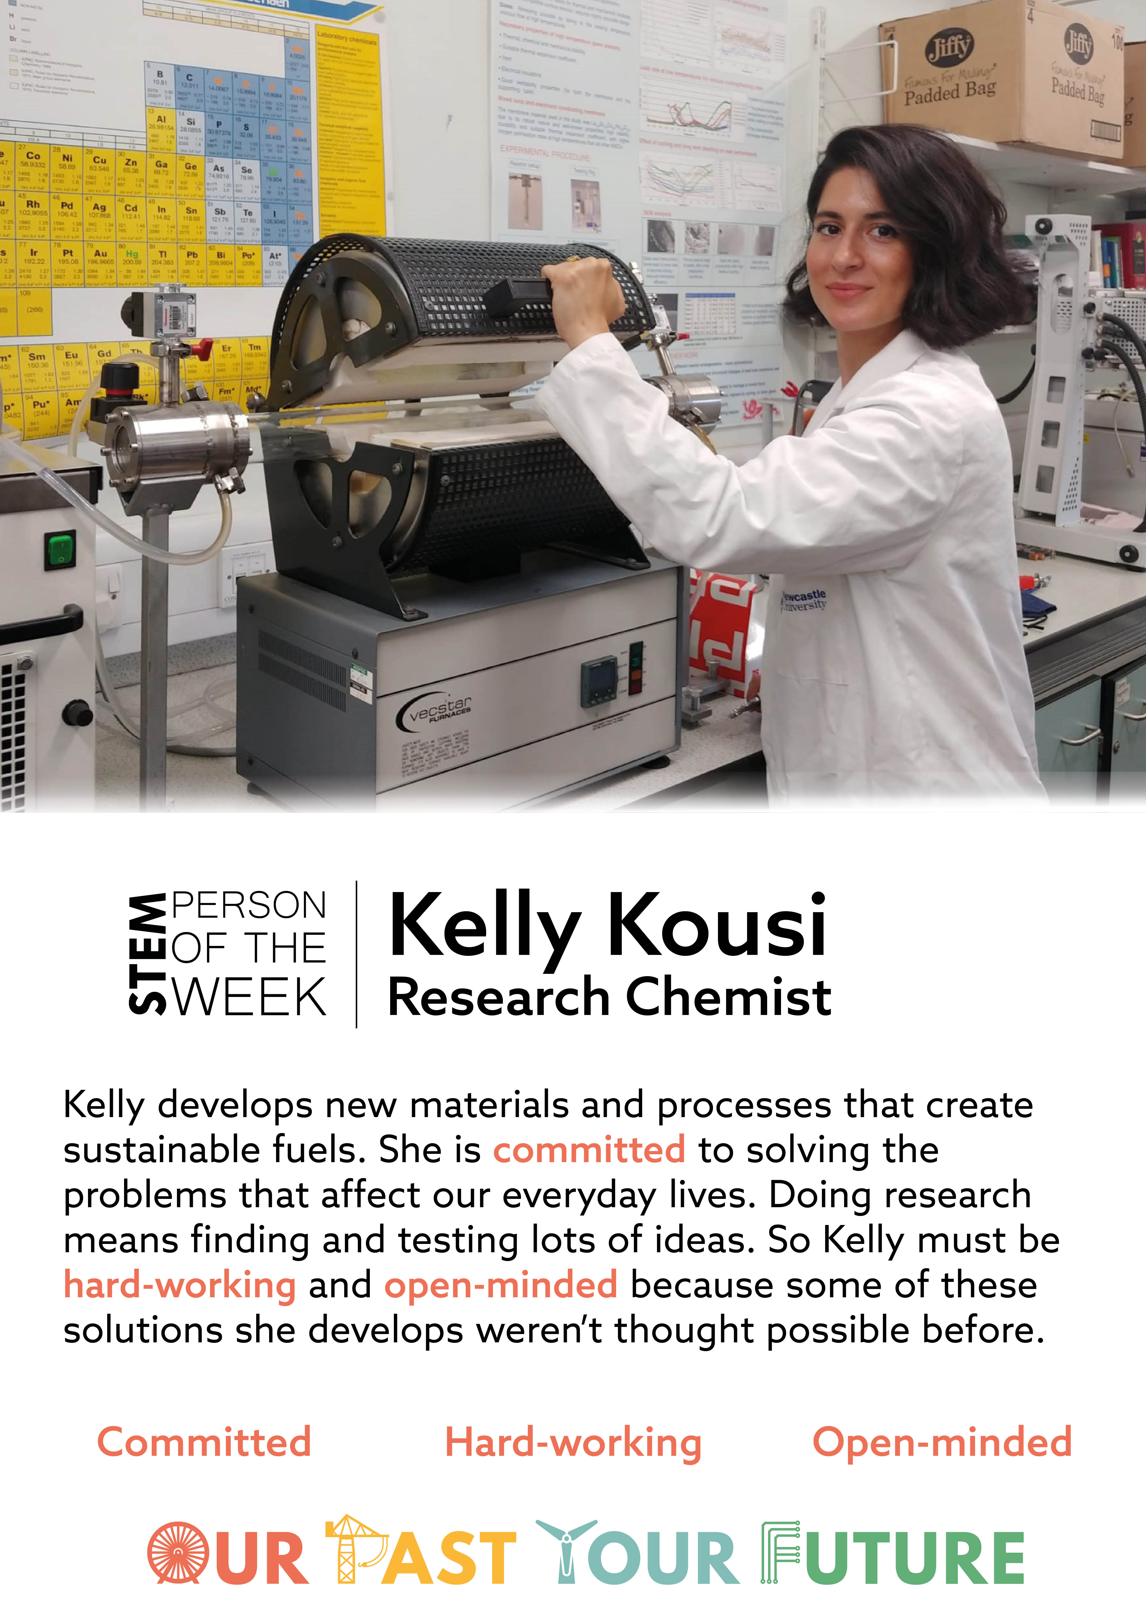
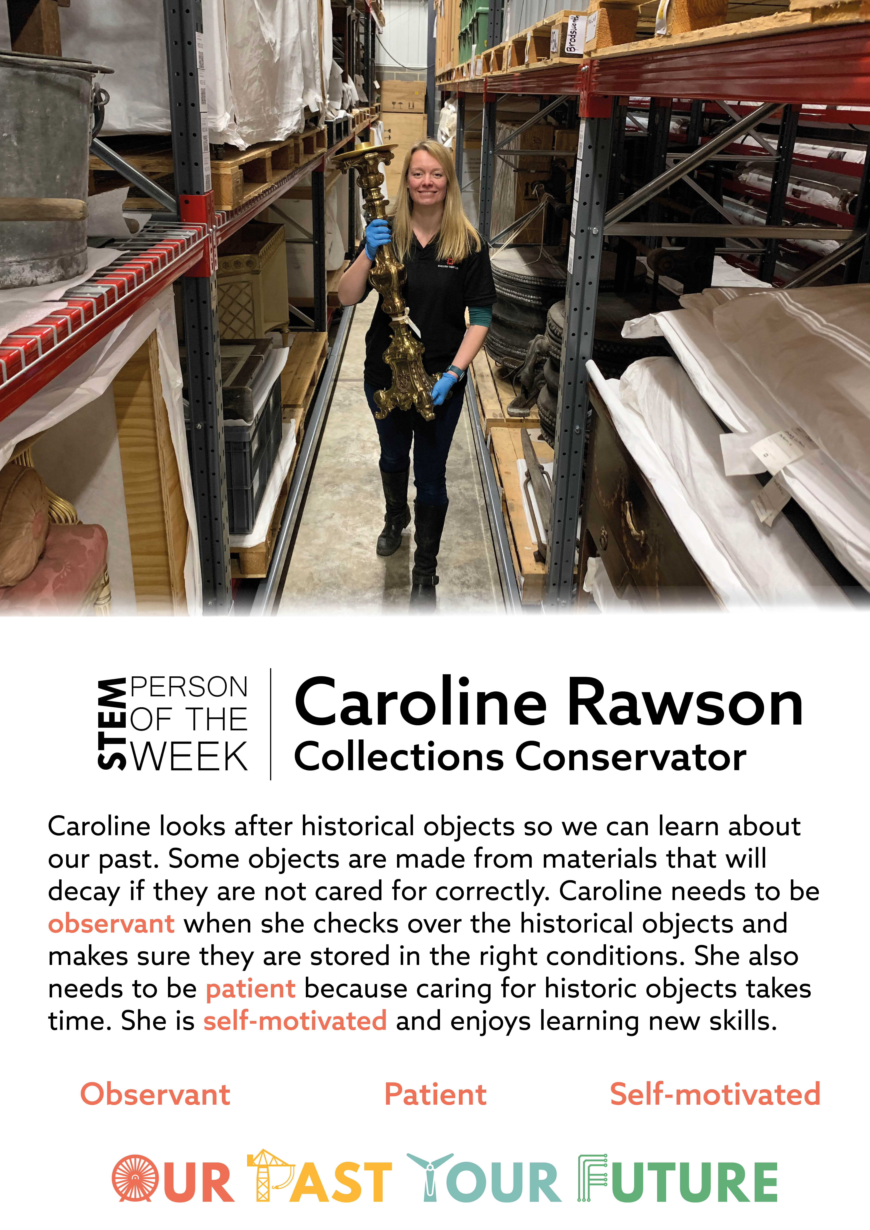
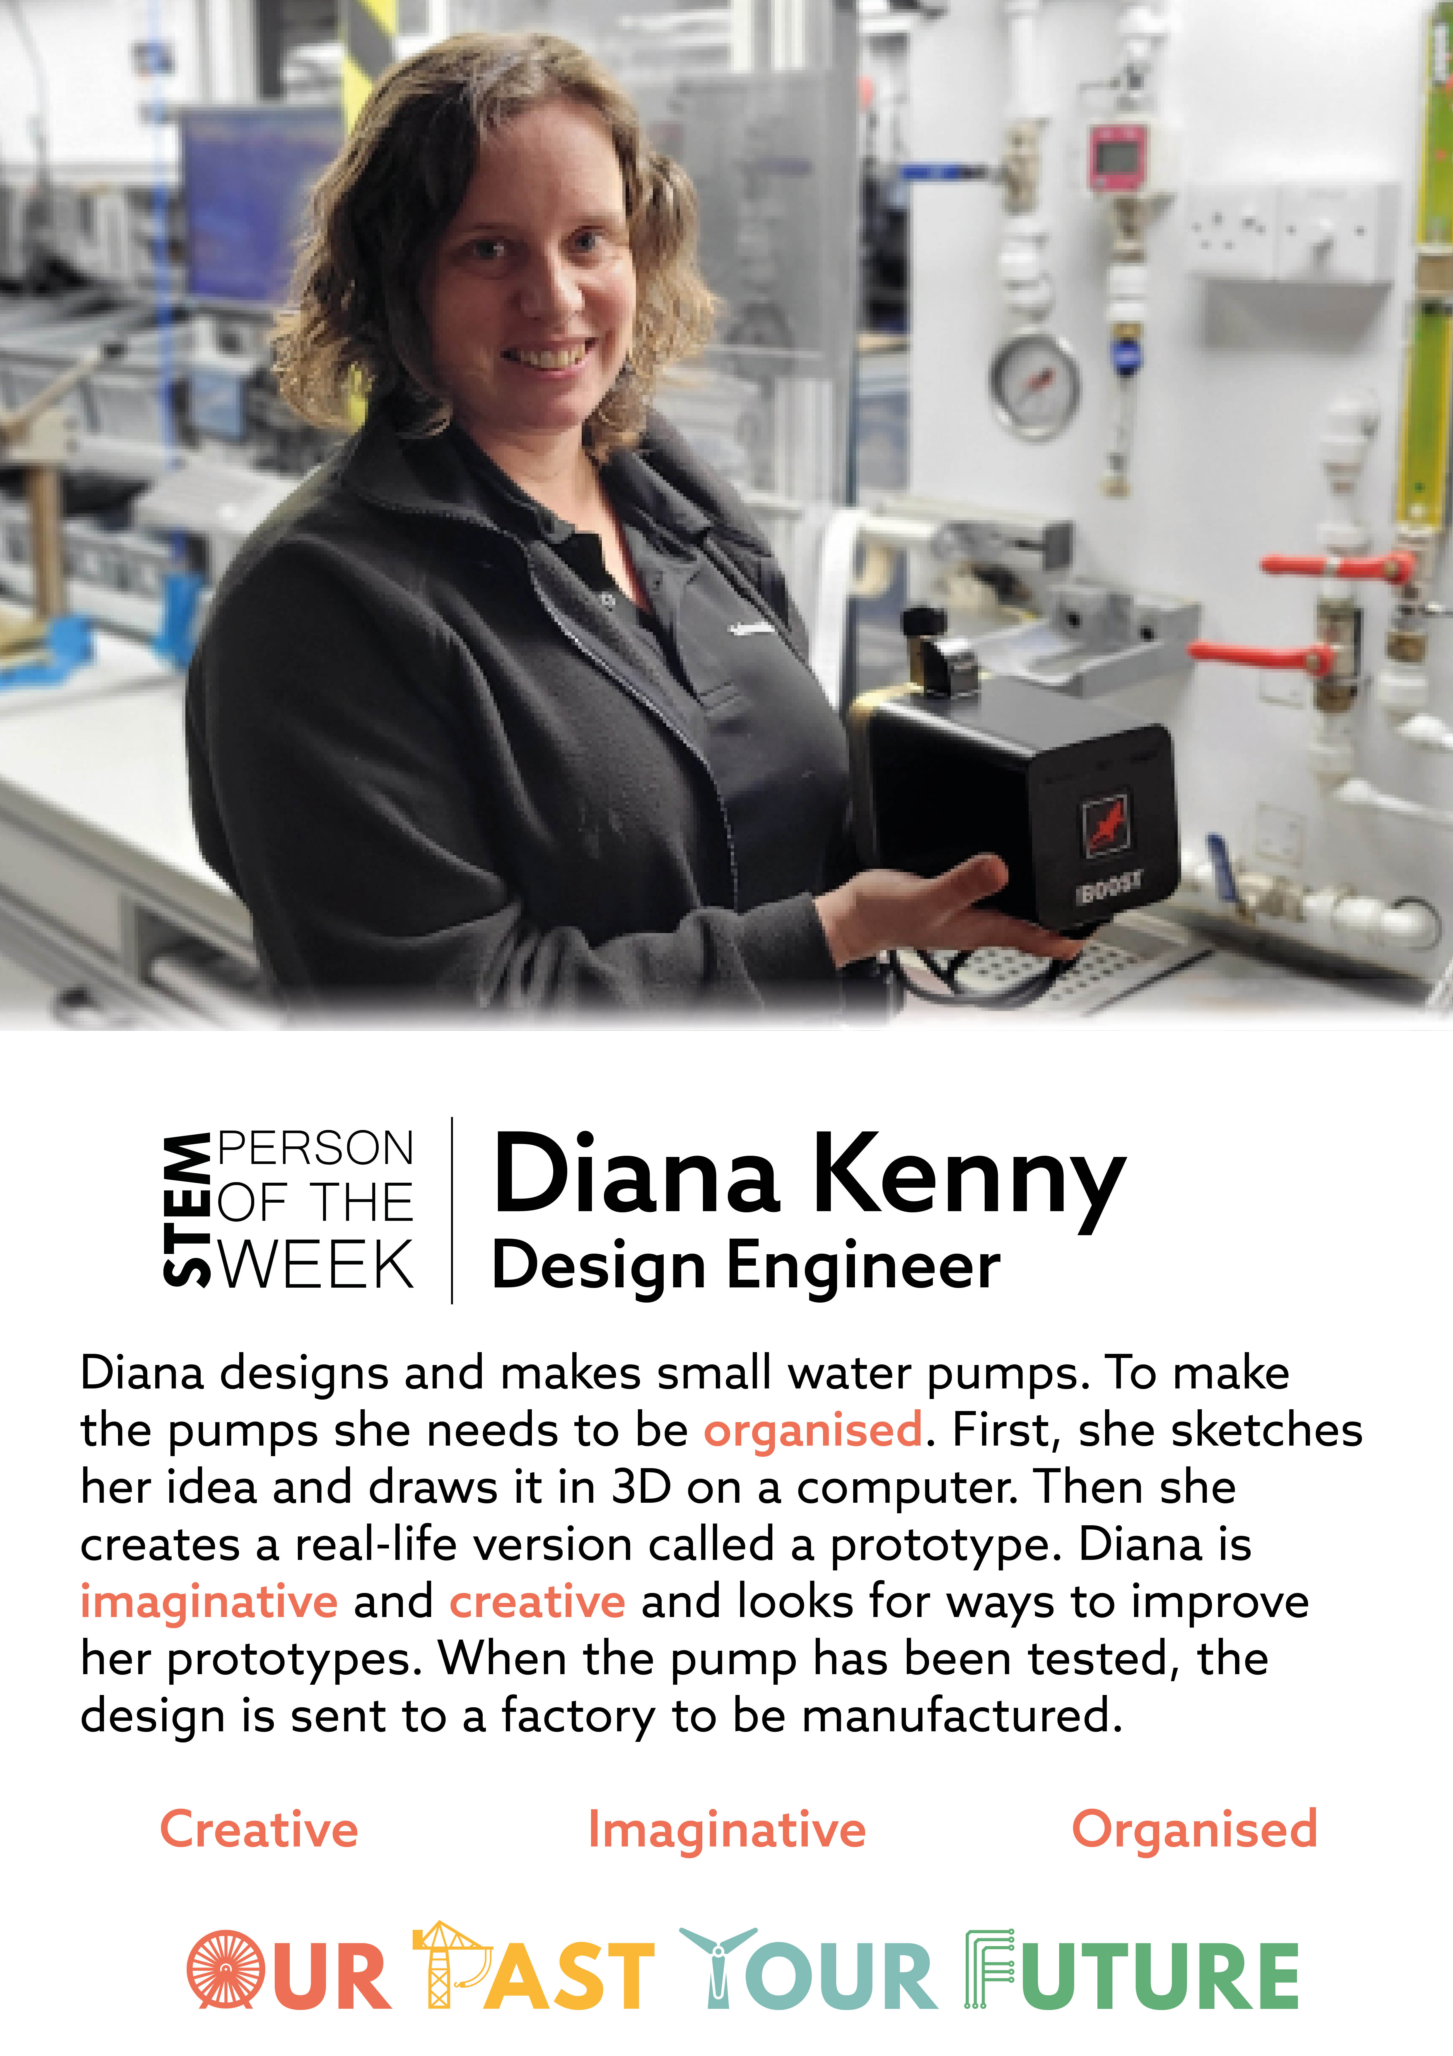

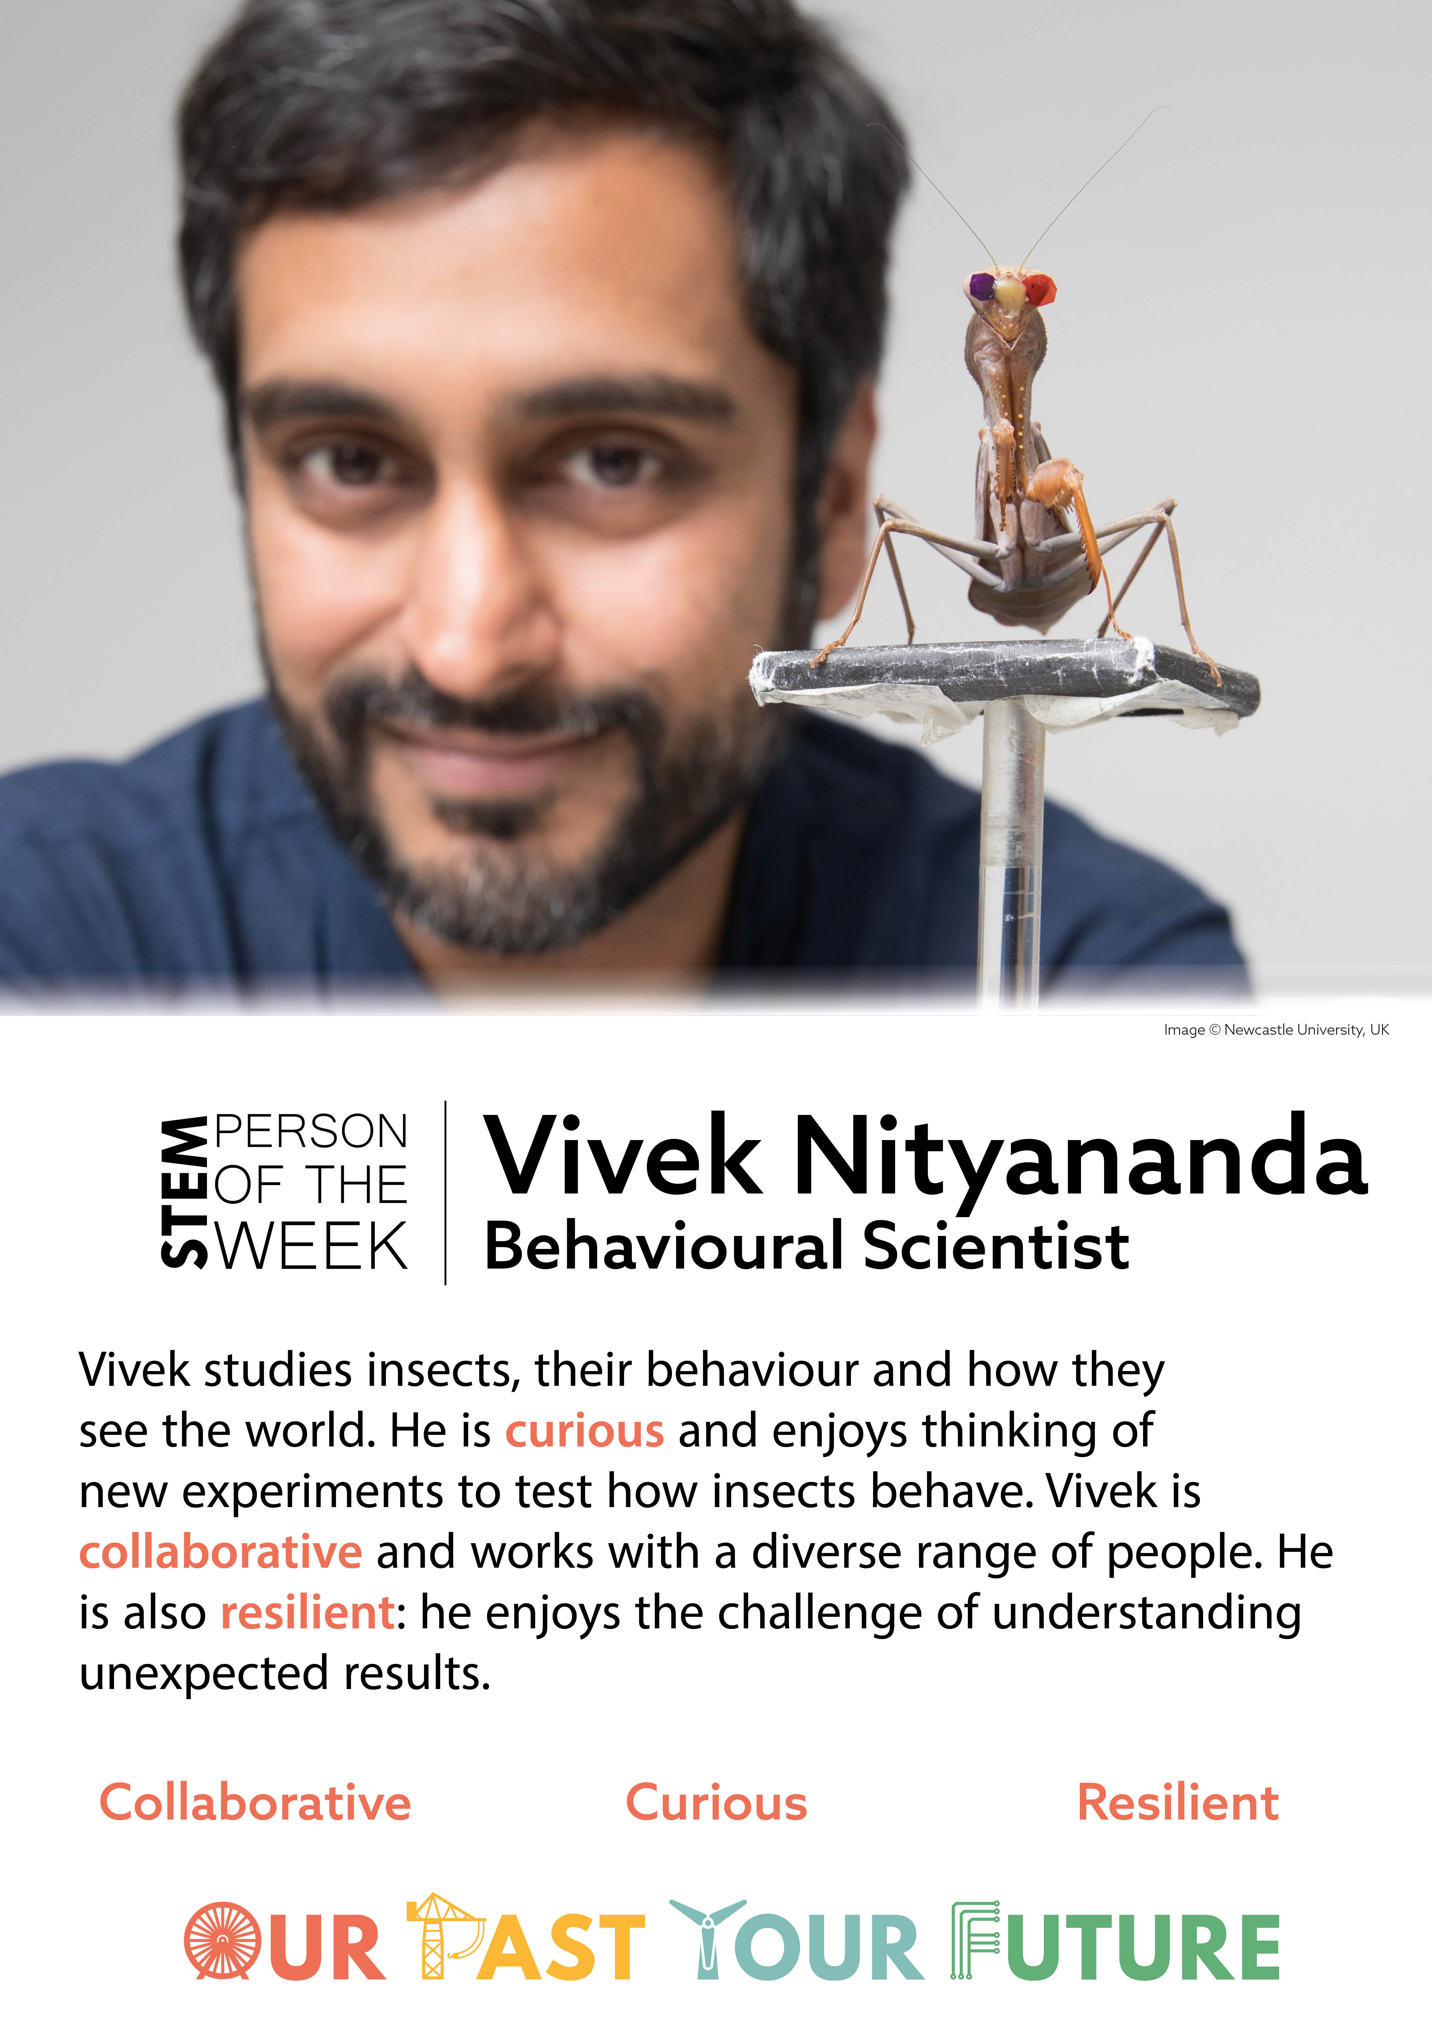
Changing stereotypes: Scientist of the Week
5 week teacher-led, whole school activity
Carefully chosen role models to reflect the diversity in the skills needed in the science workforce, and the people who work in science
Teacher discusses the scientist with their class, and praise students for showing the attributes during the week.

Slide 8
STEM Person of the Week in your school
5 STEM People over 5 weeks (beginning Monday 2 November)
1 poster of each STEM person to display in every class
A postcard of the STEM person for every child each week
PowerPoint presentation slides (at the end of this PowerPoint) with teacher guidance to introduce the STEM people to their class at the start of the week.
Throughout the week encourage children to note down when they have shown the skills that the week’s STEM person has used.

Slide 9
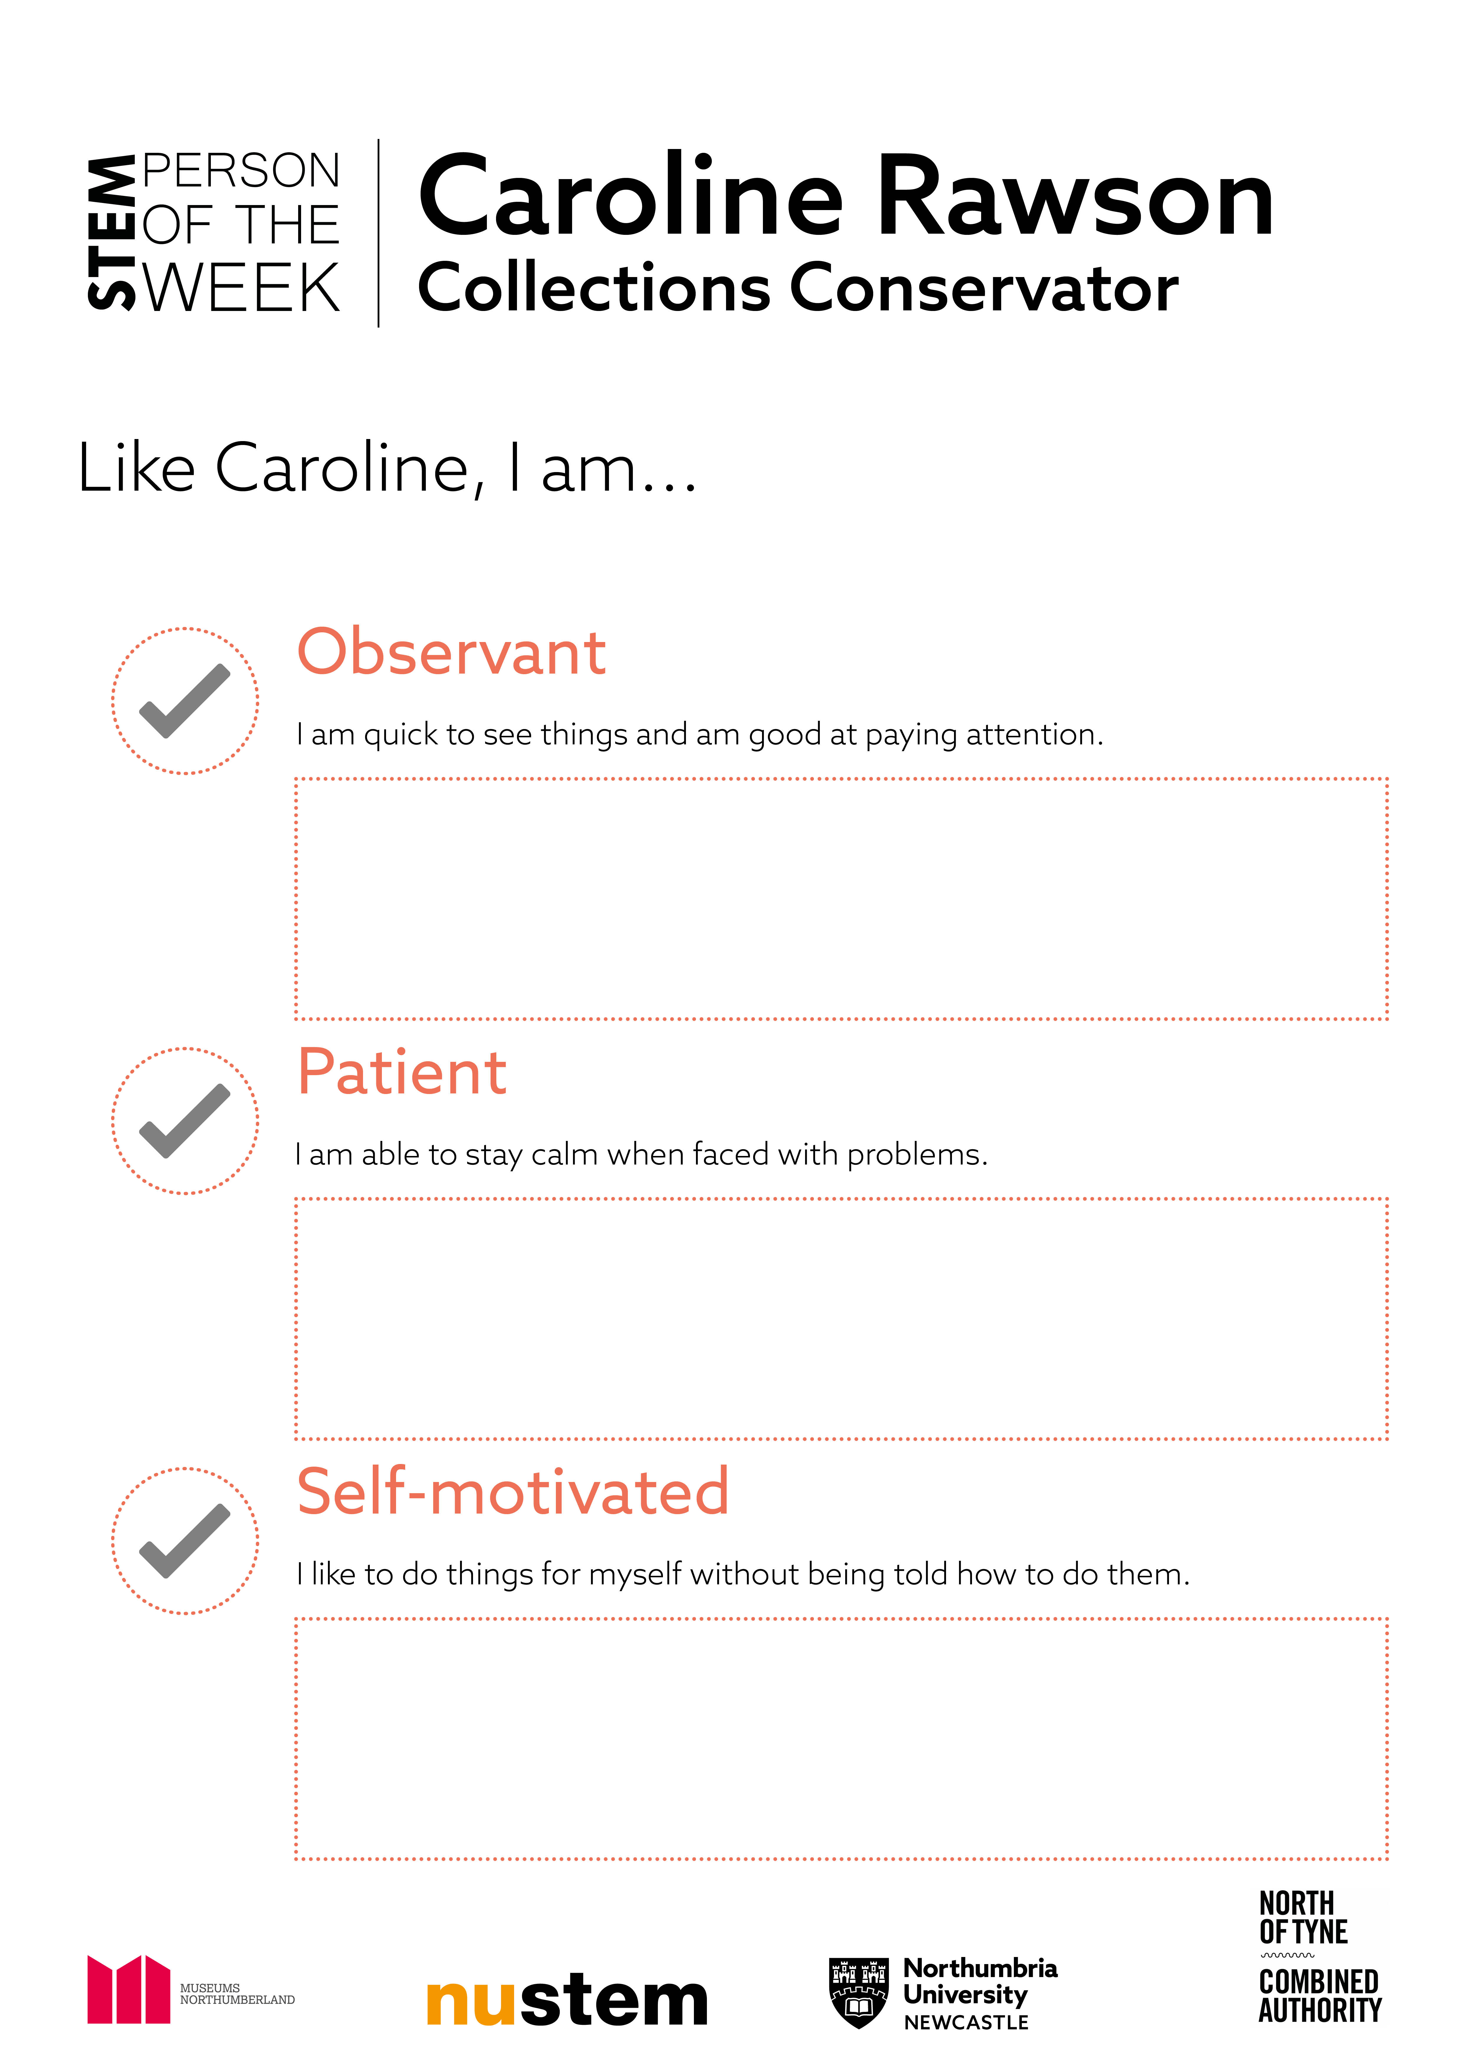
Each card has a description of the STEM person and their chosen attributes on the front.
On the back of the card is space for children to write (or draw) examples of when they’ve used the skills in lessons during the week.
At the end of the week they could take the cards home, or stick them into science books.

Slide 10
SPOTW in your setting
Take a few minutes to plan what you need to do to organise SPOTW in your school.
We’ll make this full presentation available so that you could run a short staff training if needed.

Slide 11
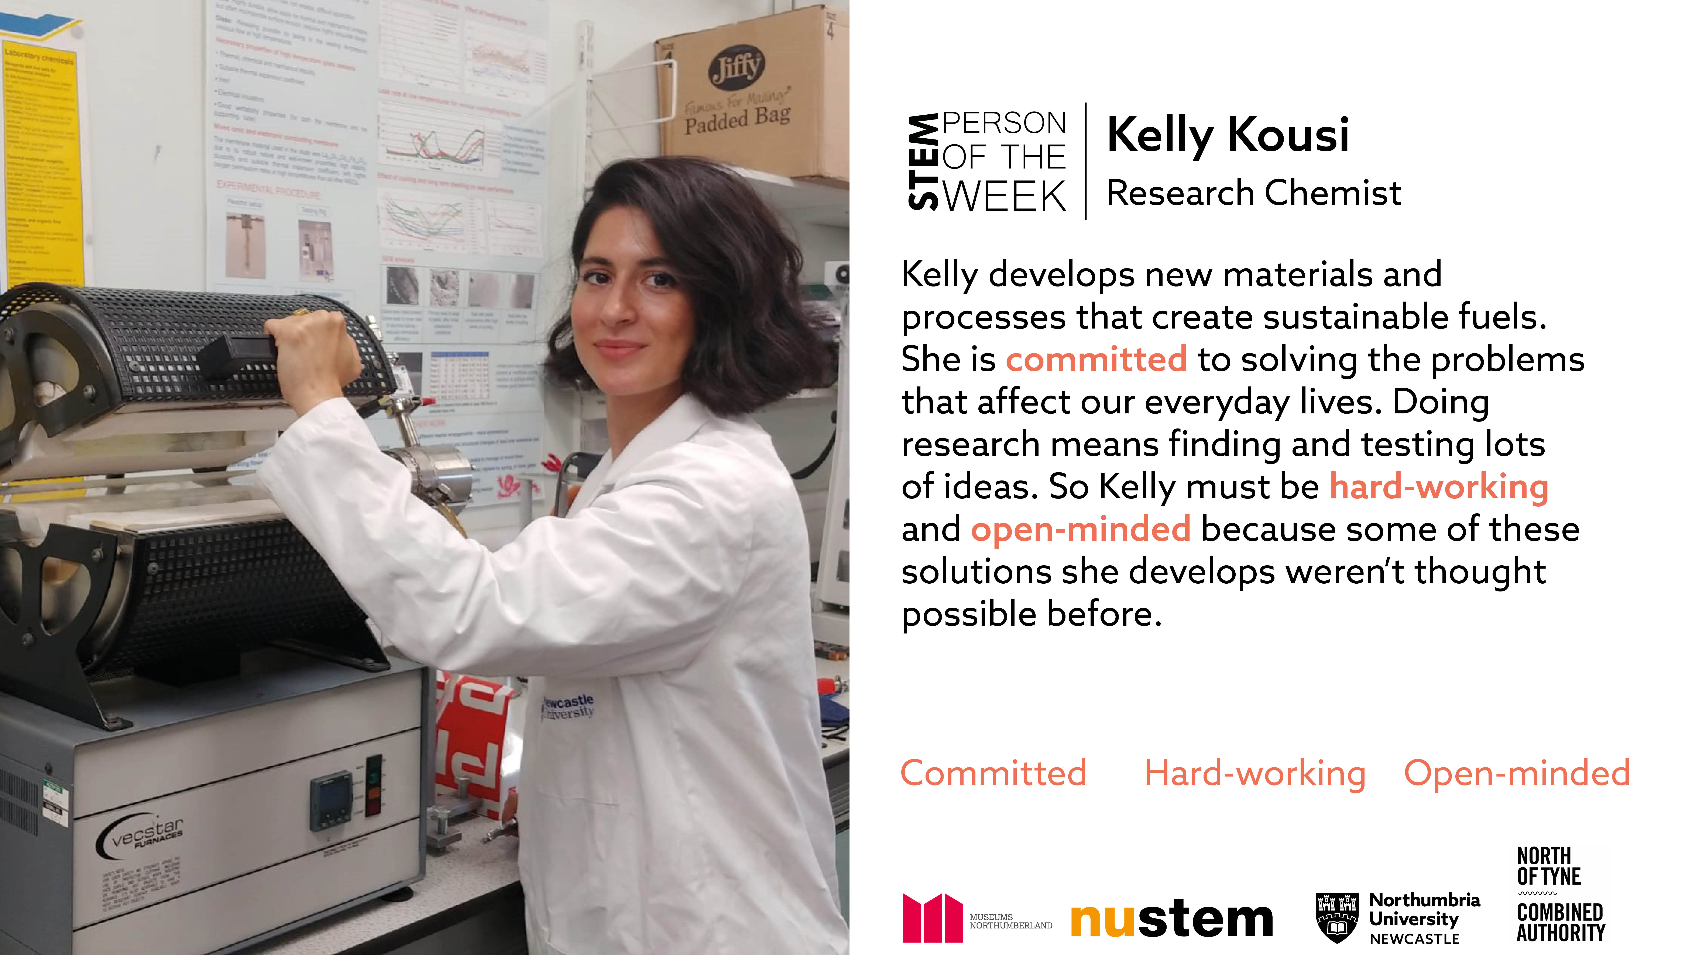

Slide 12
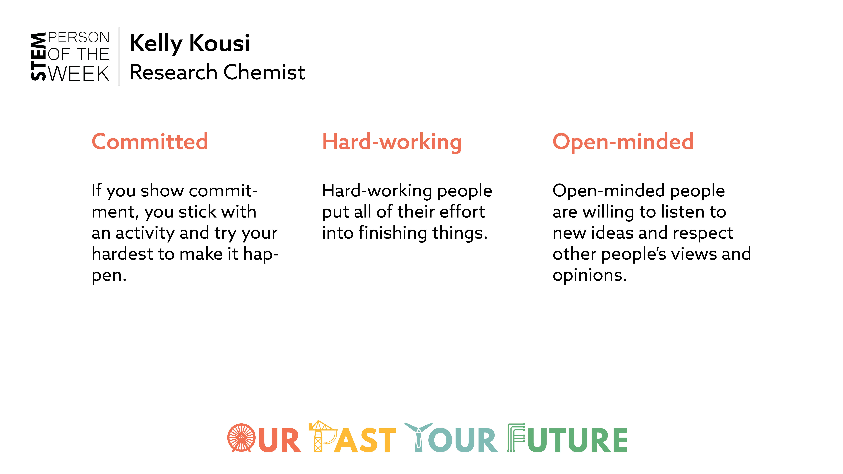

Slide 13
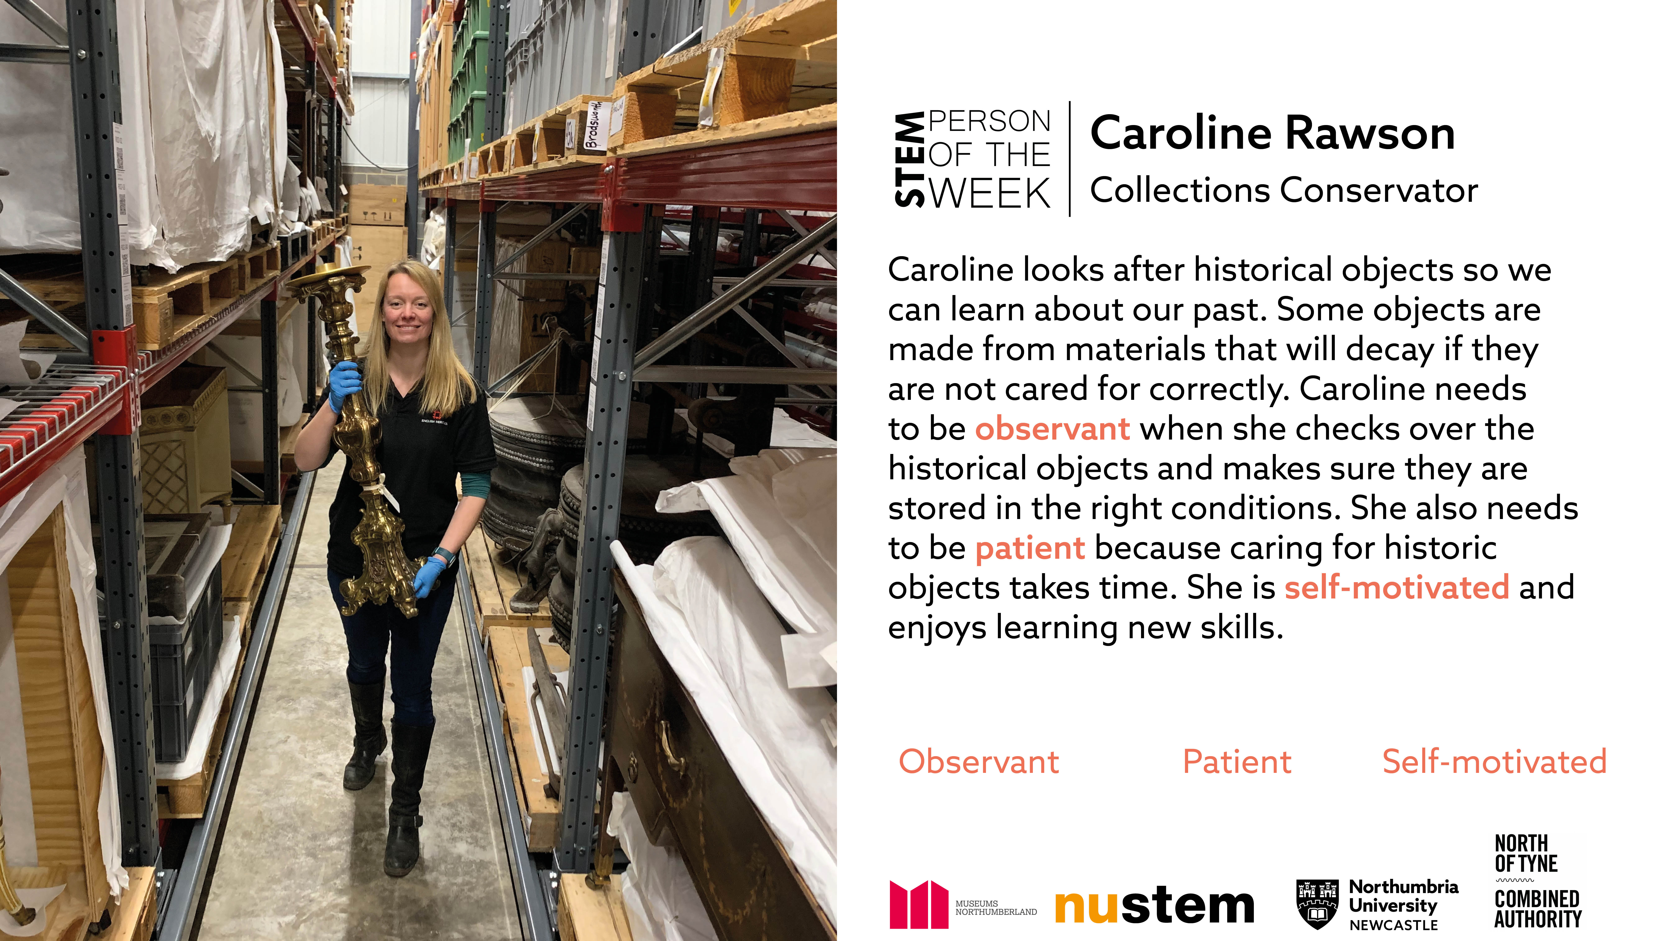

Slide 14
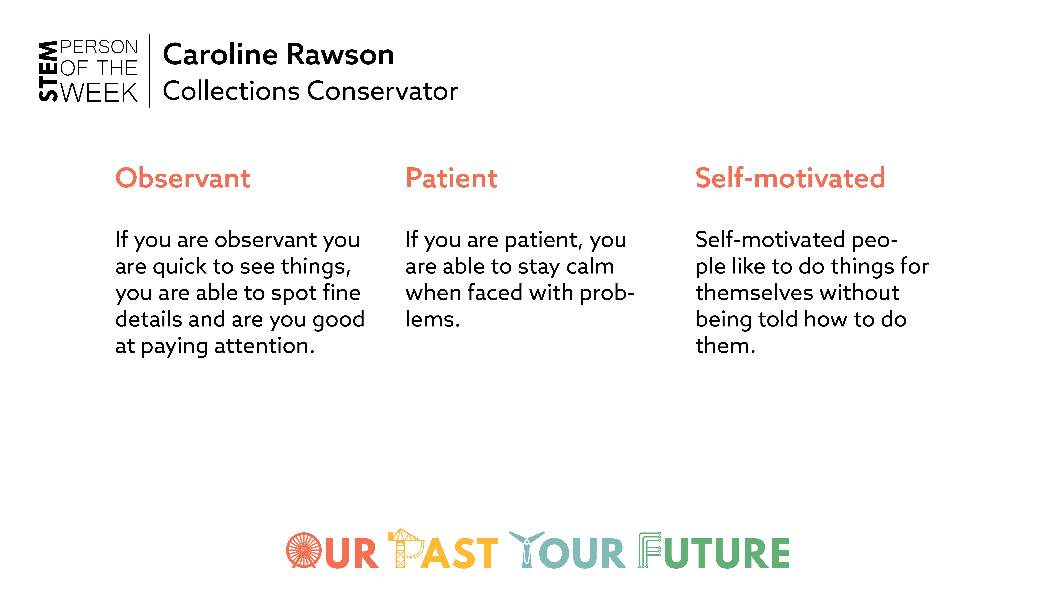

Slide 15
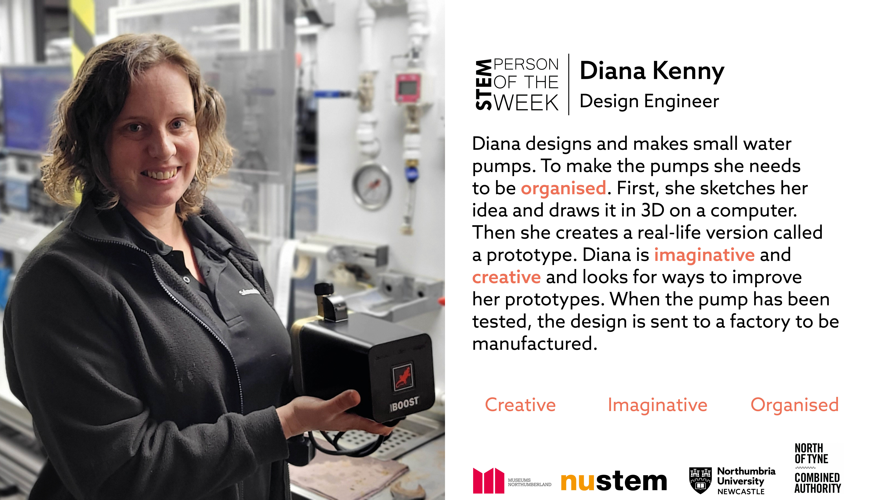

Slide 16
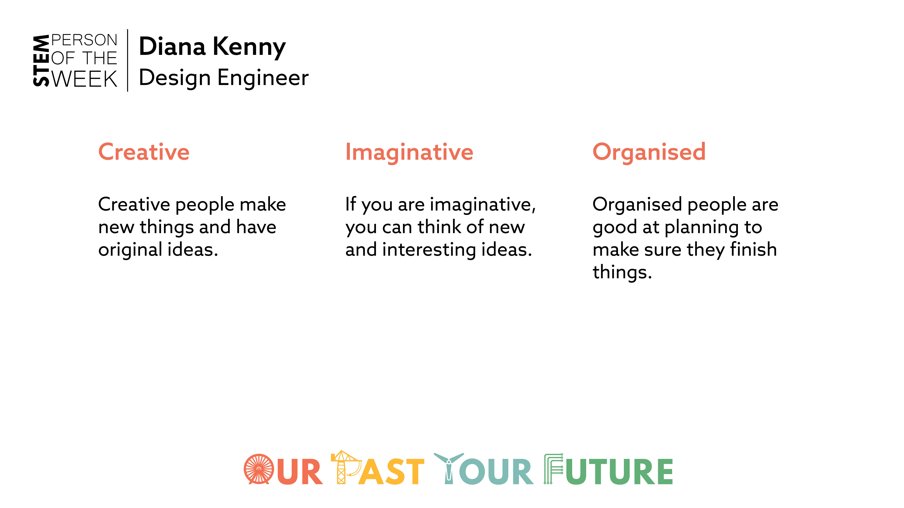

Slide 17
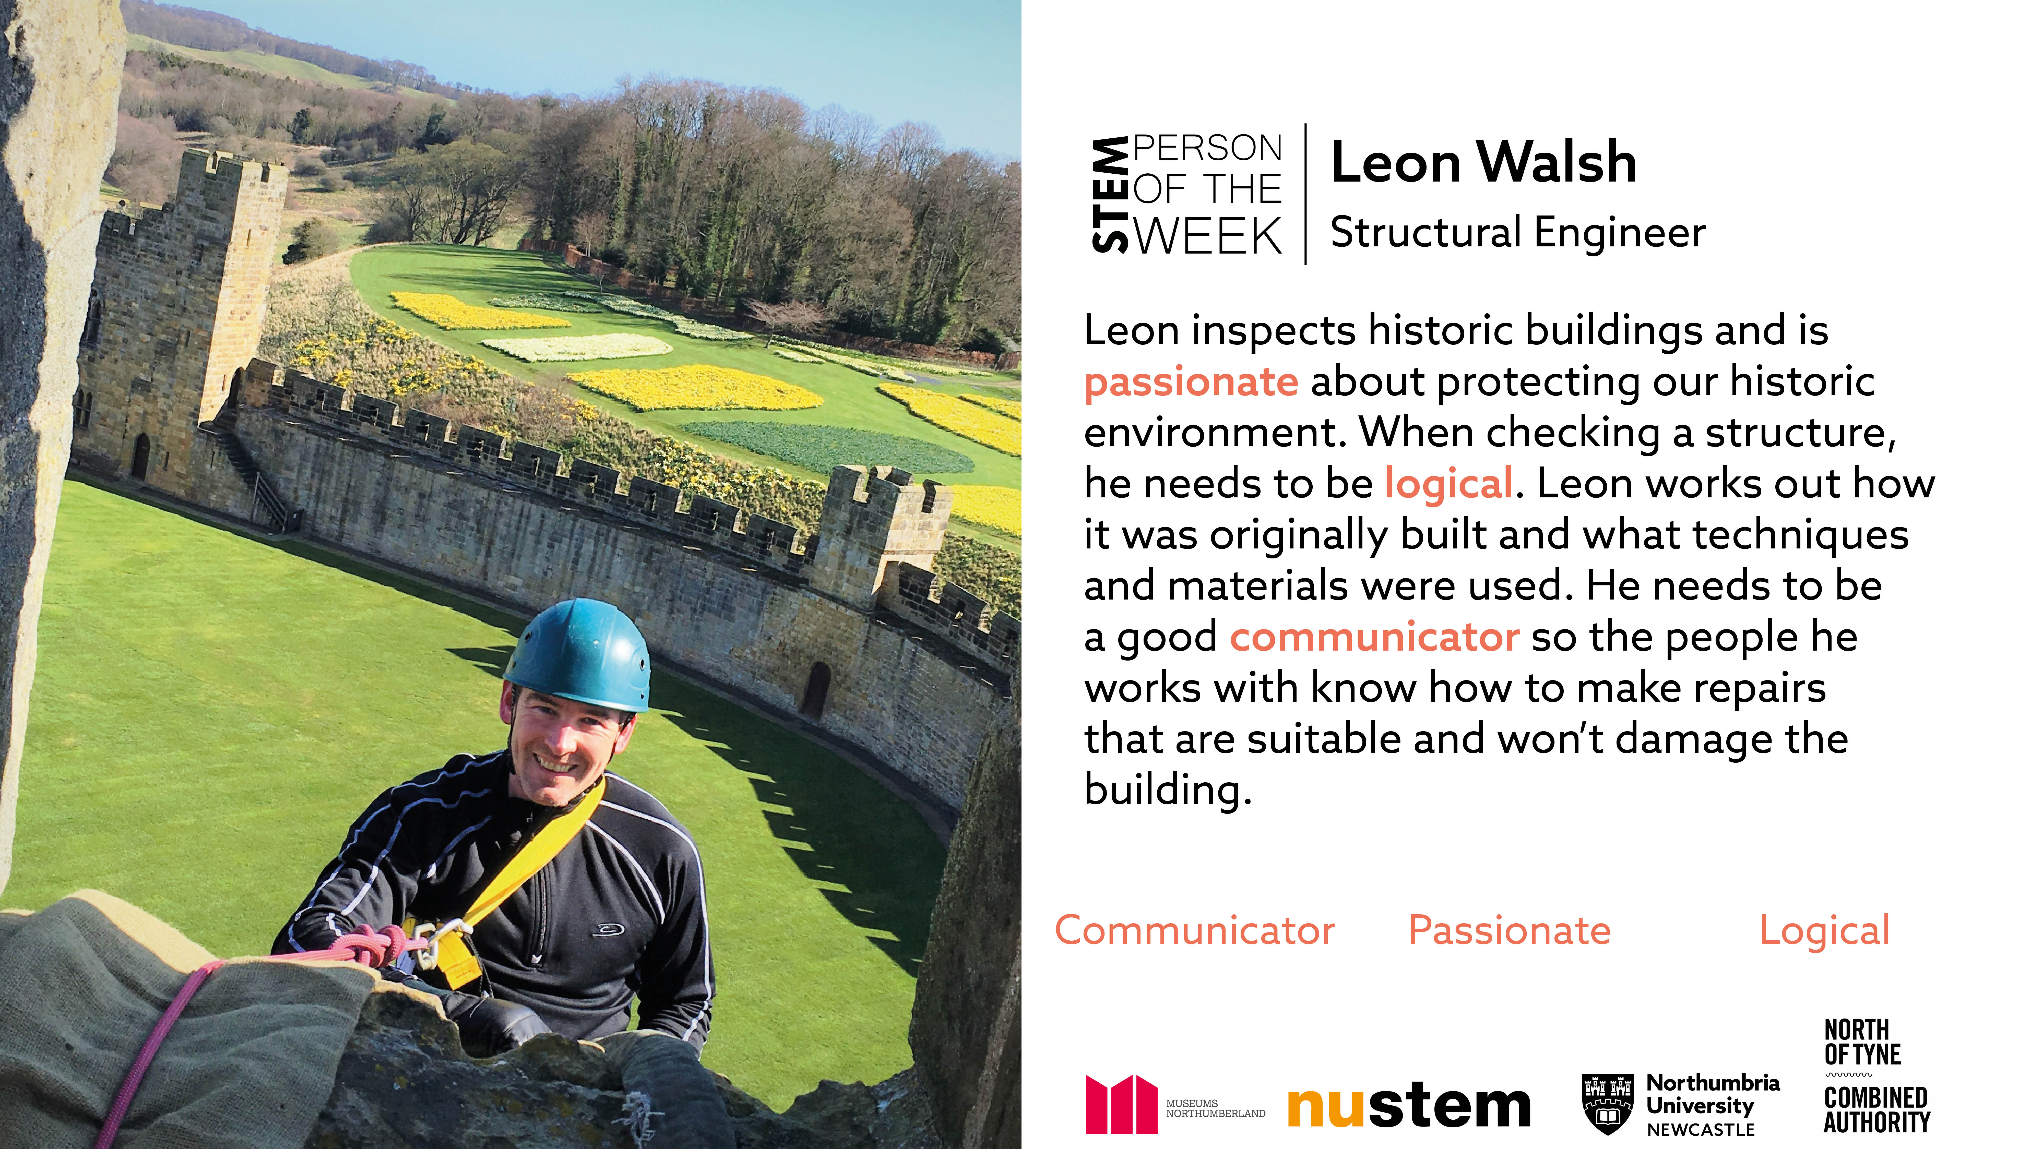

Slide 18
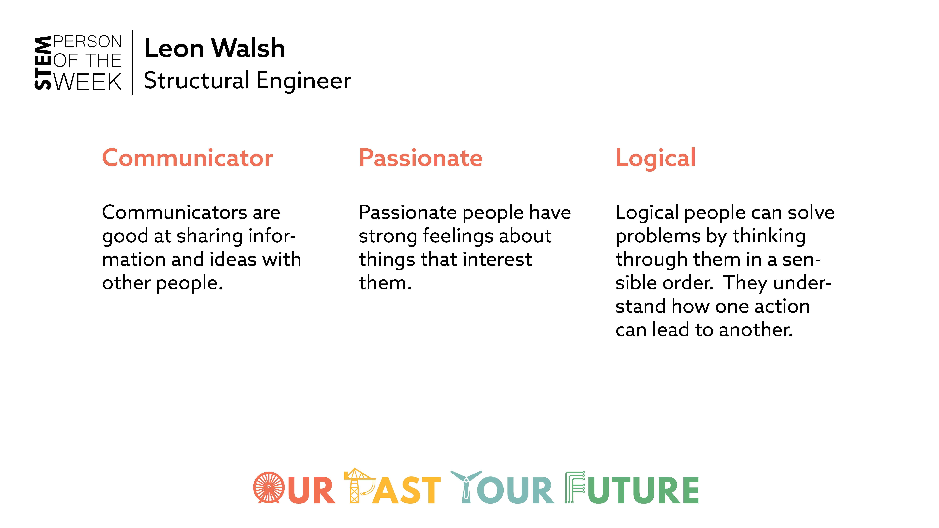

Slide 19
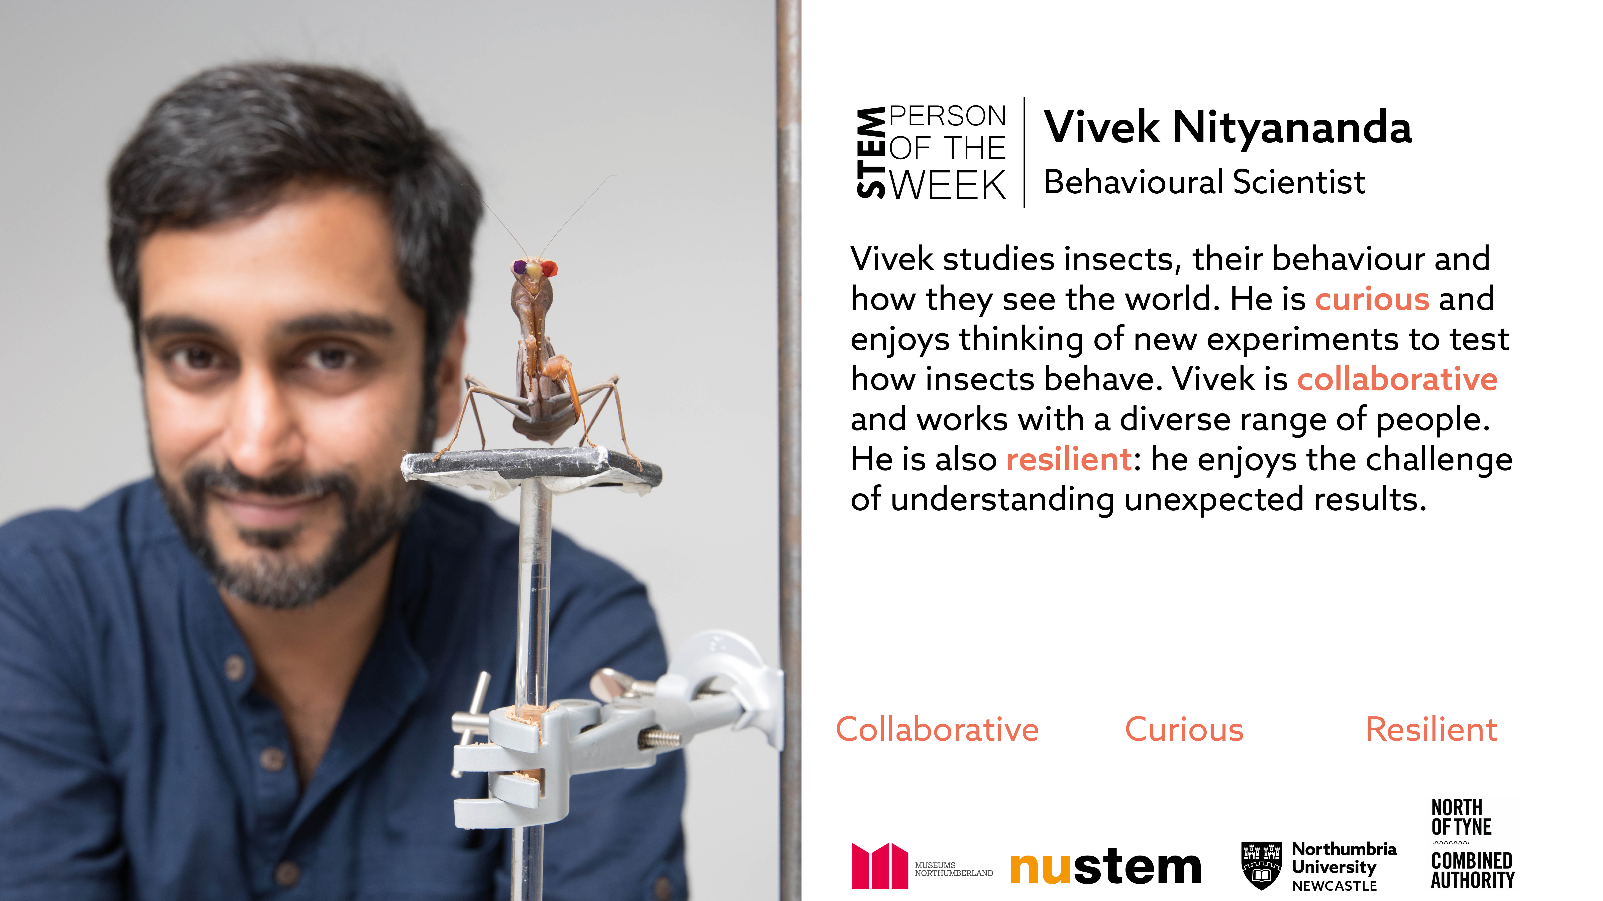

Slide 20
