Slide 1
The Mathematician
curious | creative | logical

Slide 2
Your skills today…
Curiosity
Creativity
Logic
The Mathematician curious | creative | logical

Slide 3
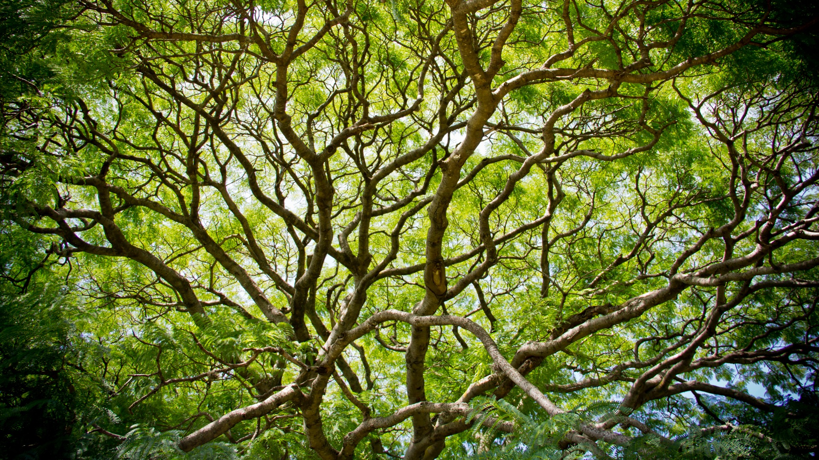
Searching for
Self-Similar Patterns
Self-similar – one part of an object looks like the whole of an object.
Notes:
Word Iteration needs to be on this section somewhere.

Slide 4
Sorting Activity
On your table you have 6 images to explore.
For each image:
  Can you spot a self-similar pattern?
  Can you describe the pattern to you partner?
Remember our skills:
Be curious, be creative, be logical.
The Mathematician curious | creative | logical

Slide 5
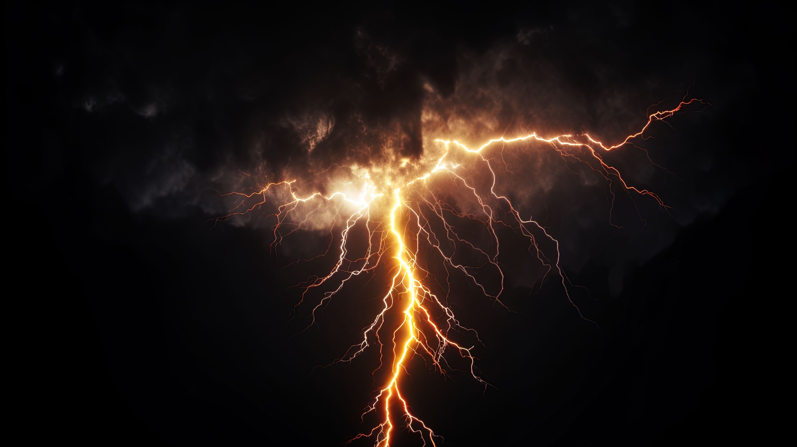

Slide 6


Slide 7
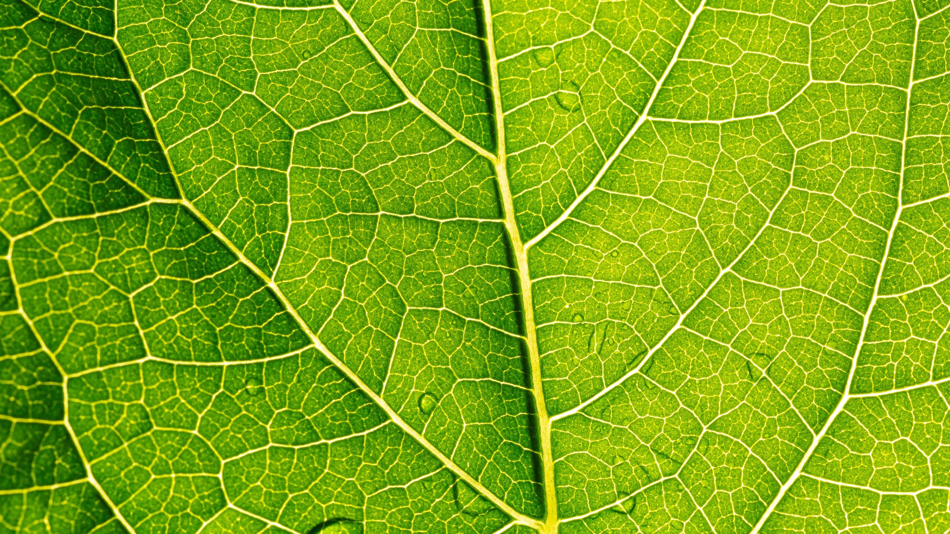

Slide 8
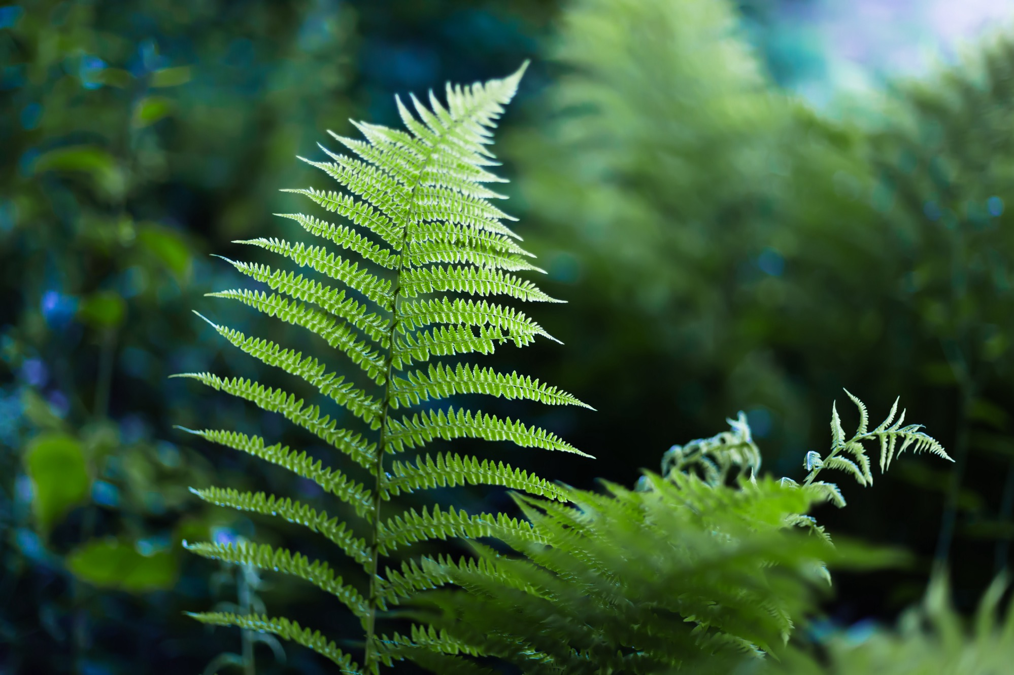

Slide 9
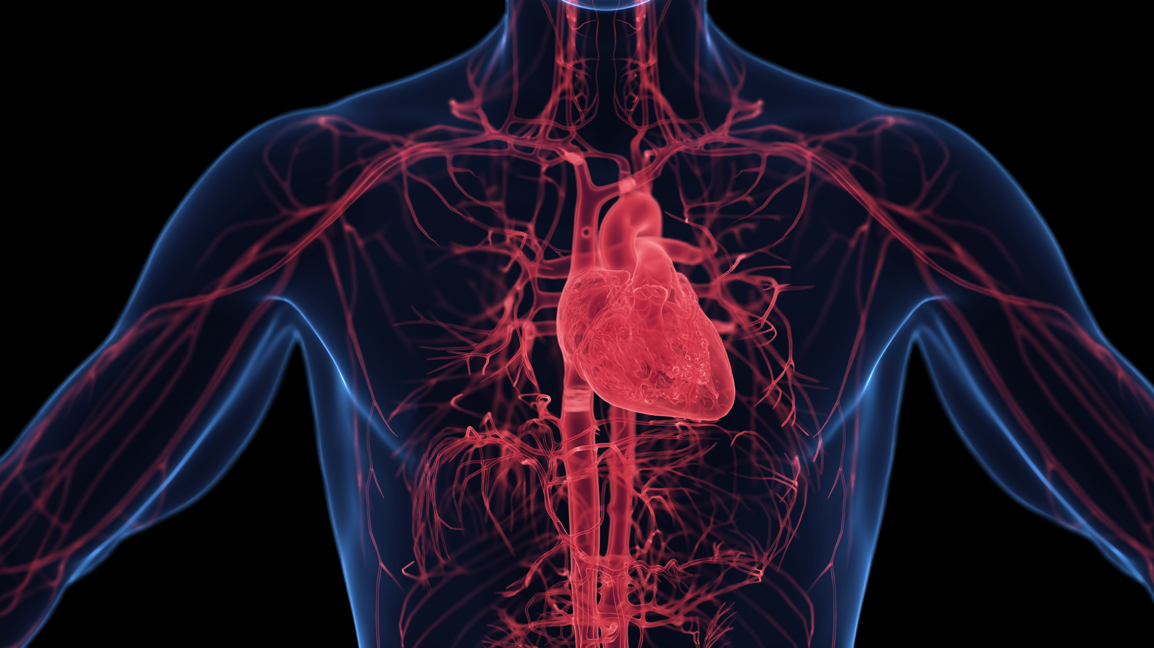

Slide 10
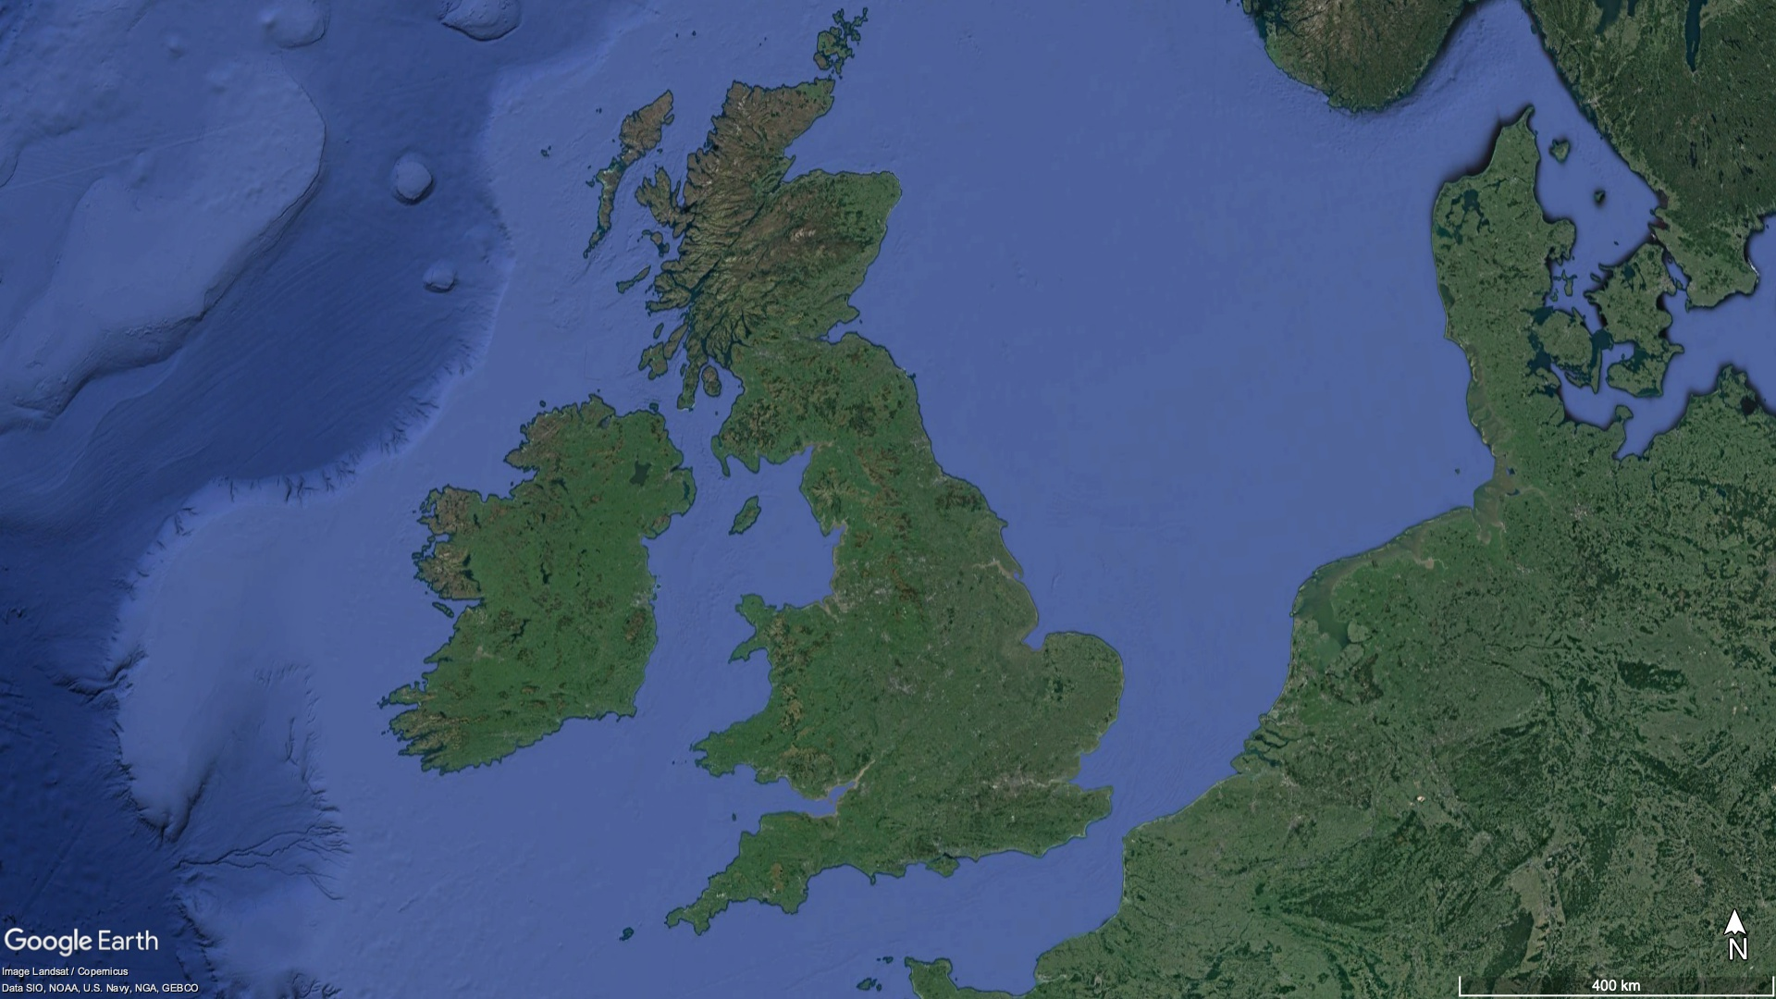

Slide 11
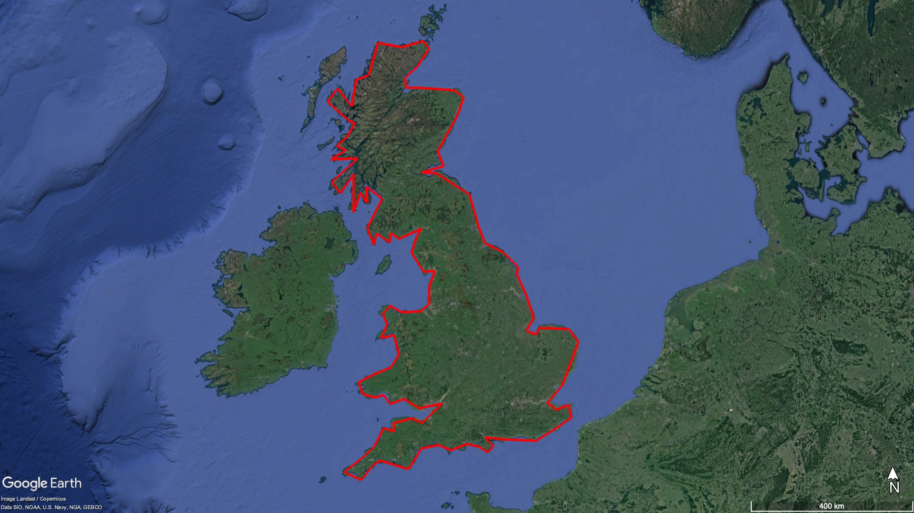
Coastline 4239km

Slide 12
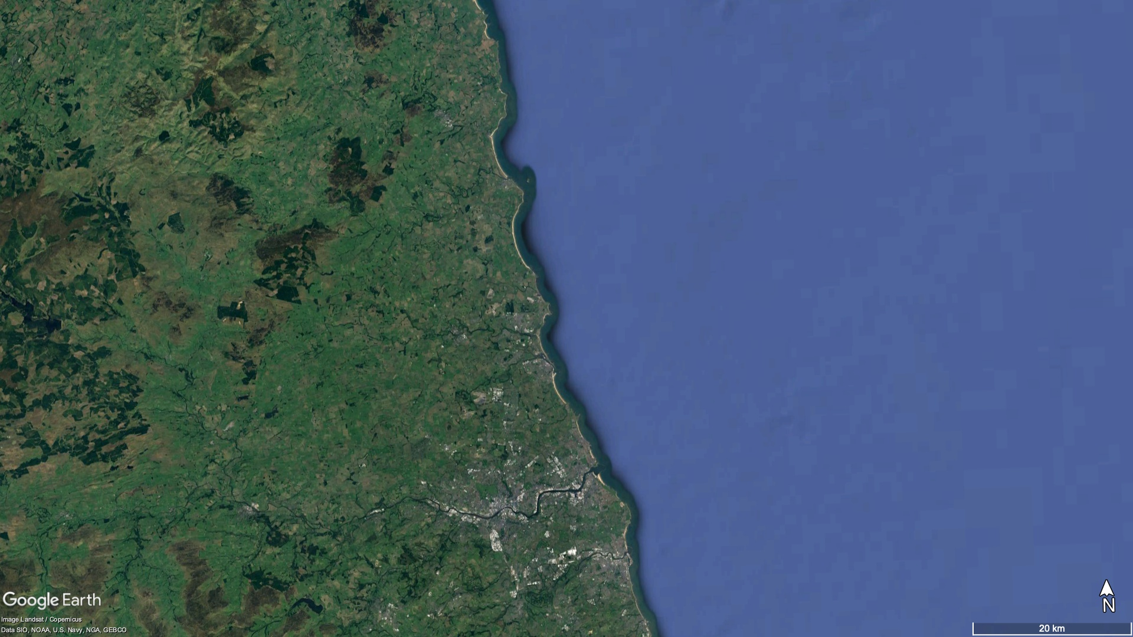

Slide 13
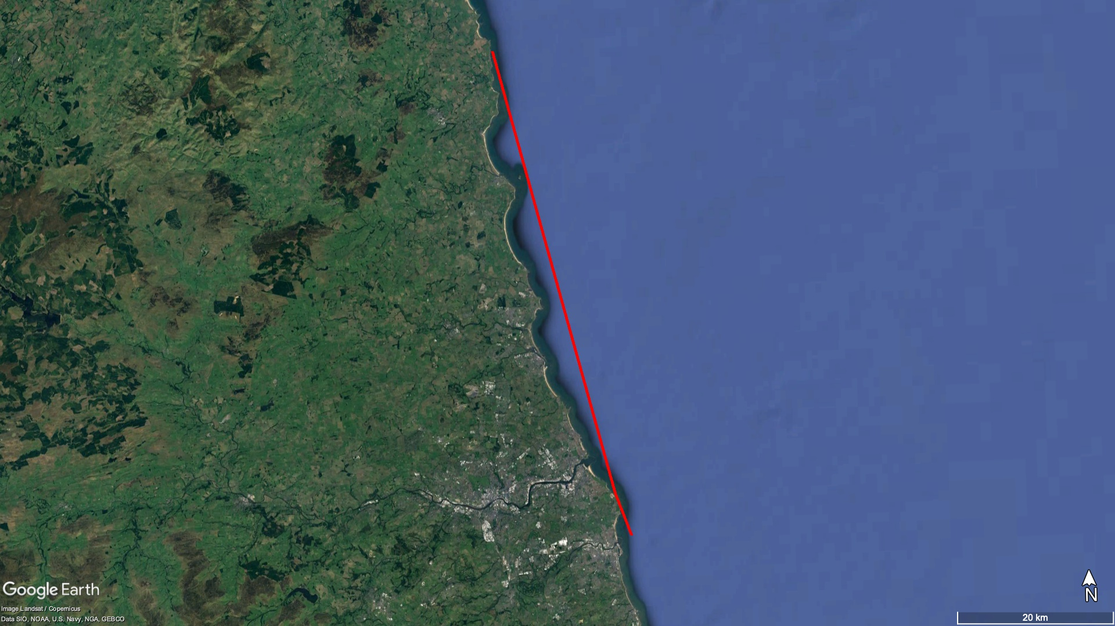
Coastline: 64km

Slide 14
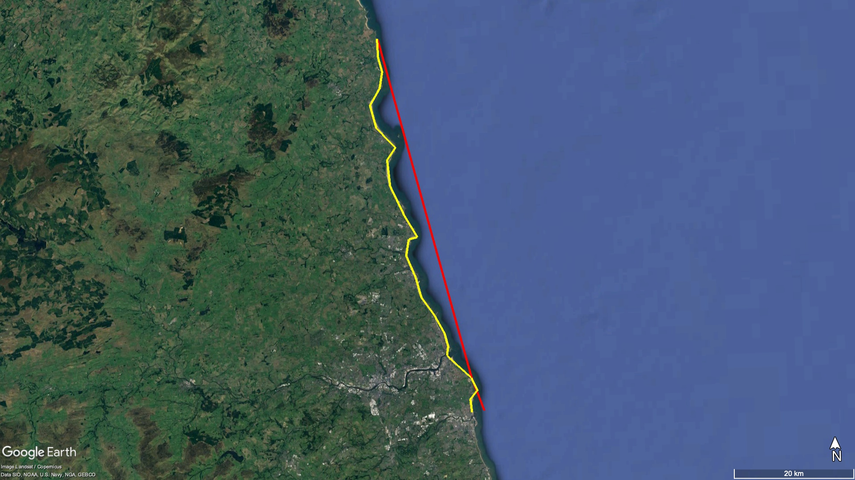
63.8
Coastline 64km
Coastline 71km

Slide 15
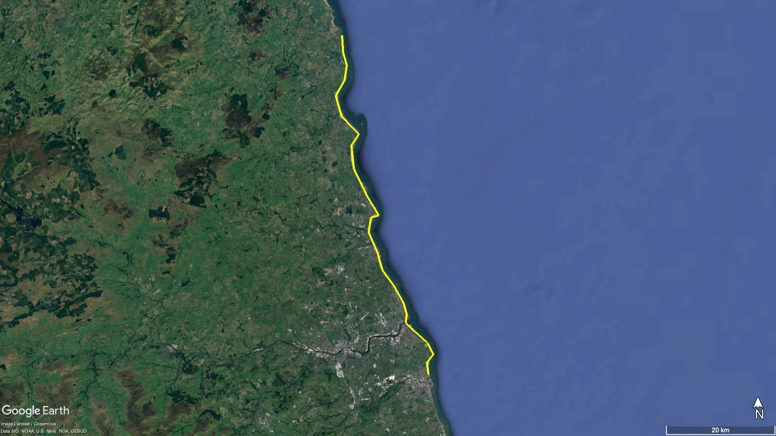
Coastline 71km

Slide 16
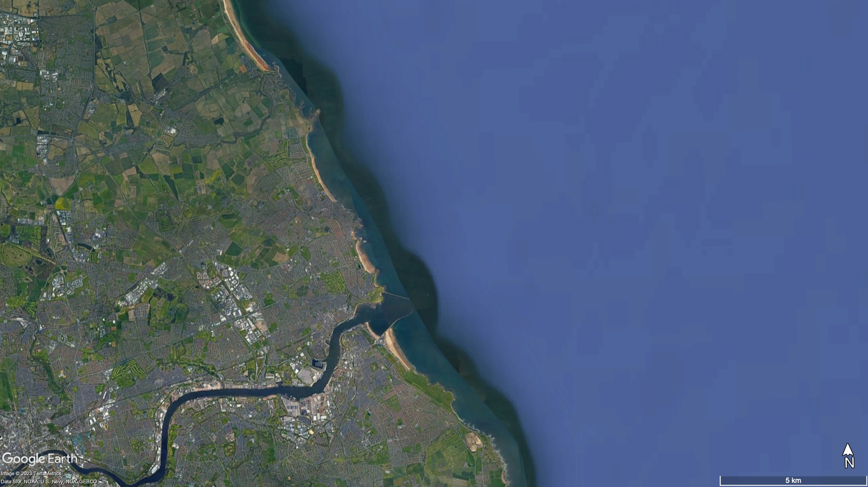

Slide 17
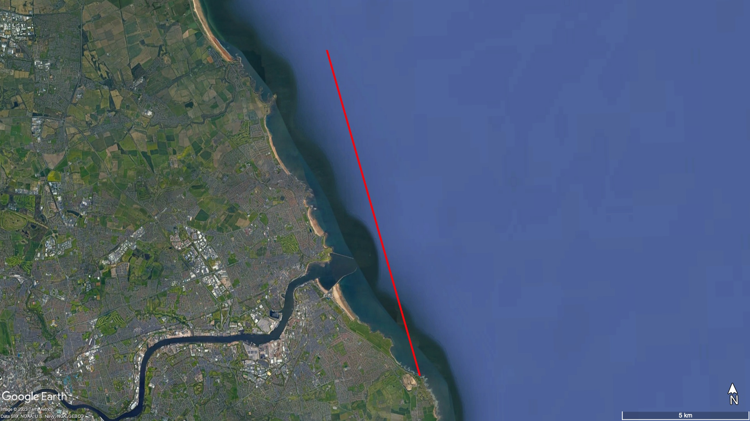
Coastline: 13km

Slide 18
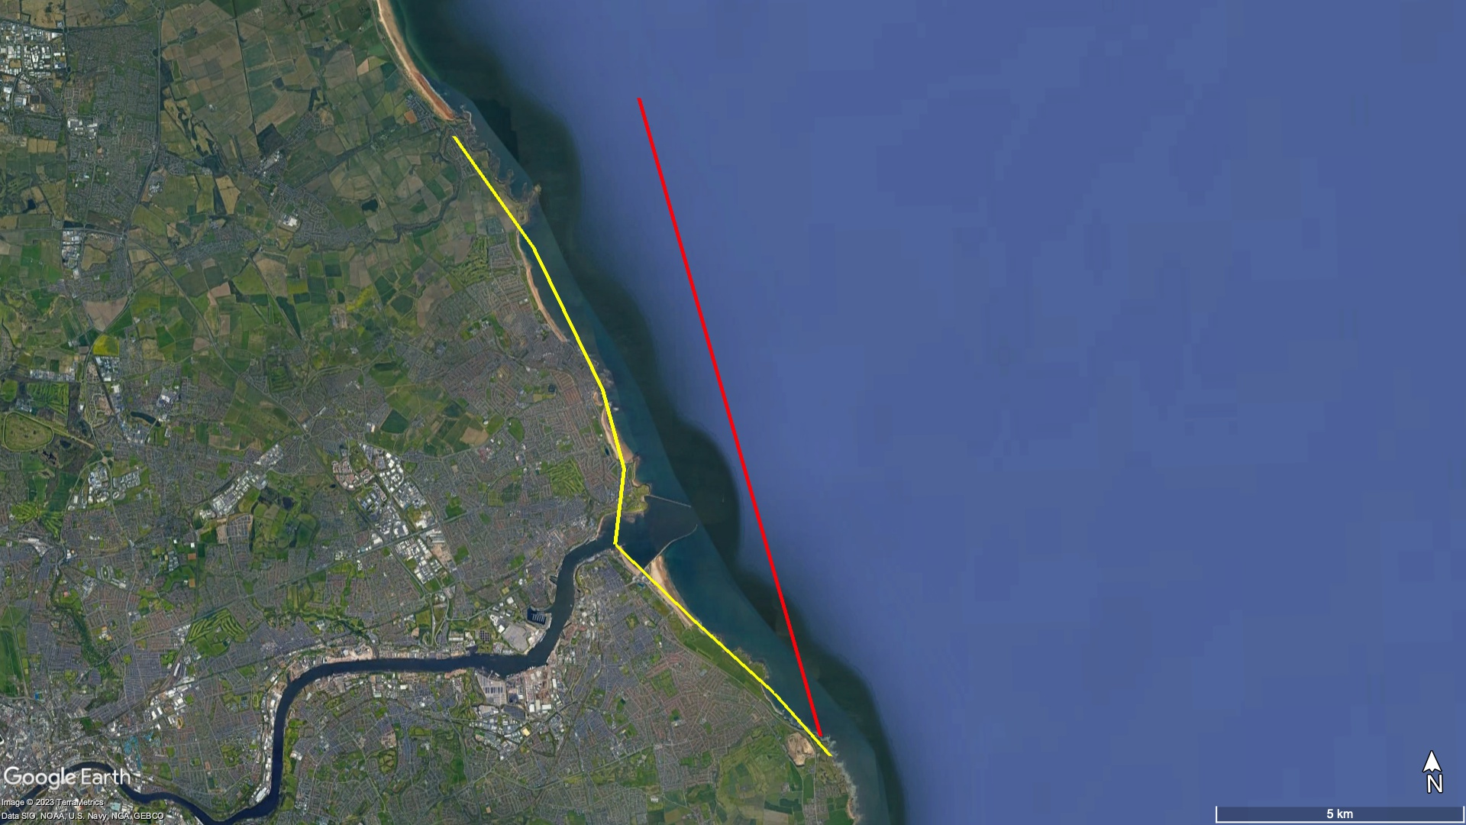
Coastline: 13km
Coastline: 15km

Slide 19
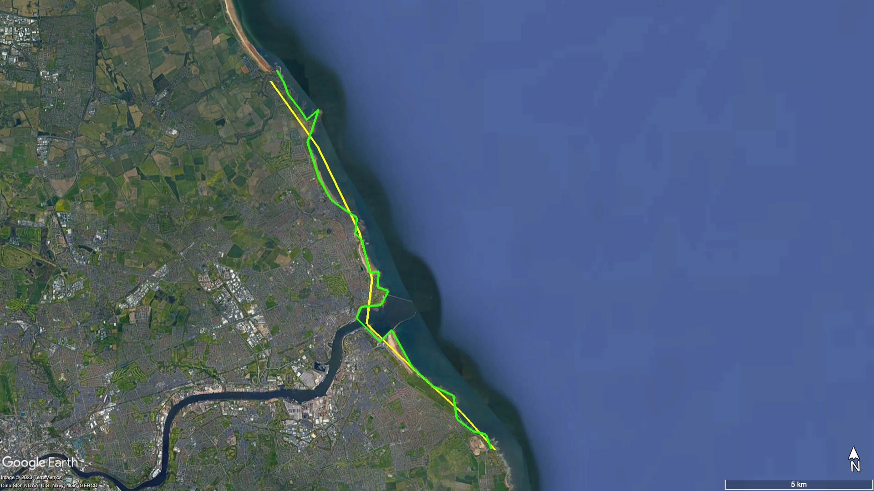
Coastline: 15km
Coastline: 19km

Slide 20
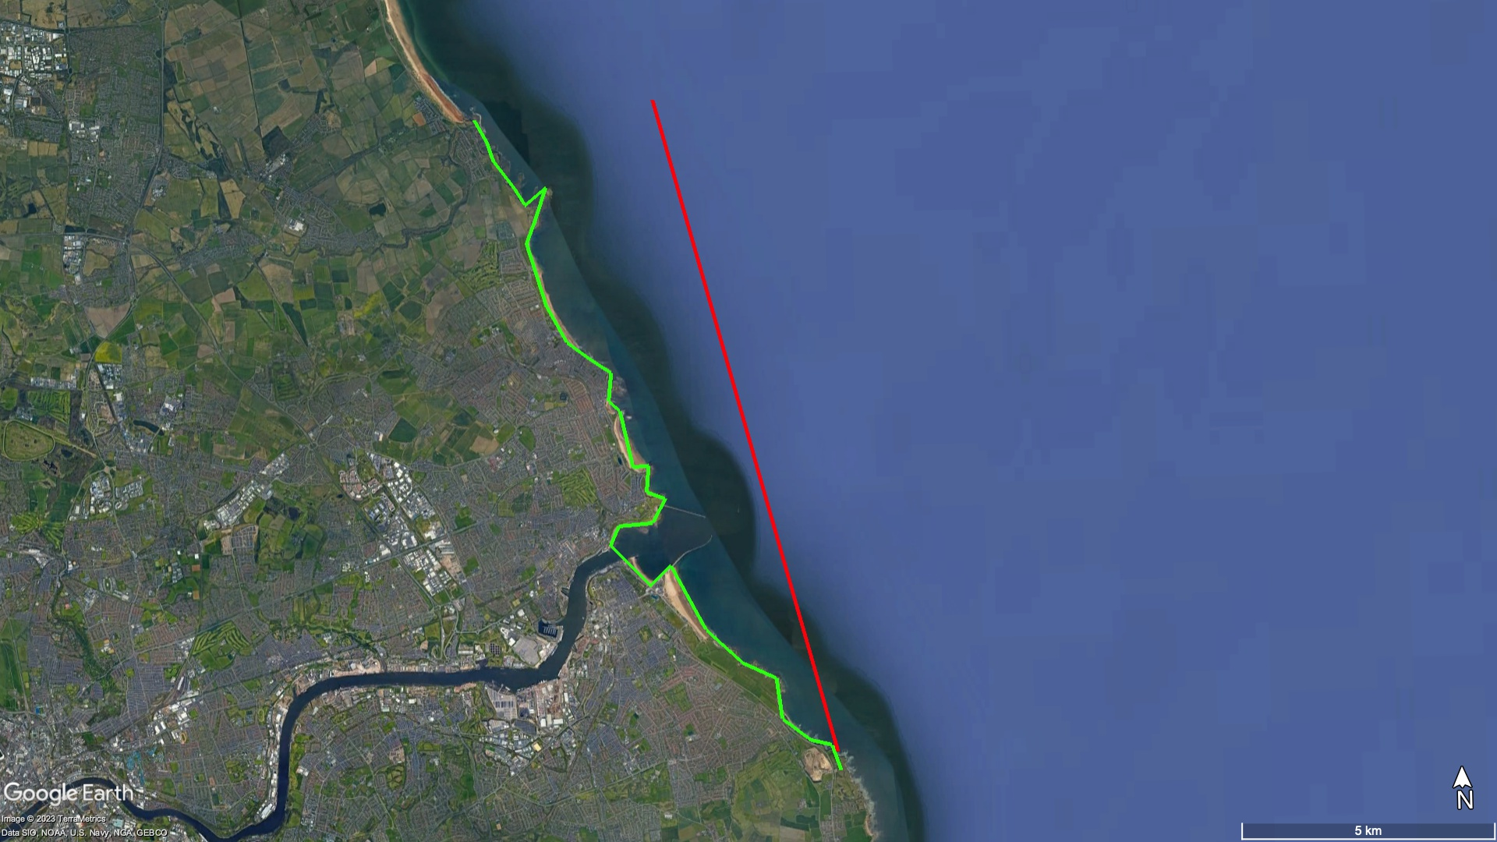
Coastline: 13km
Coastline: 19km

Slide 21
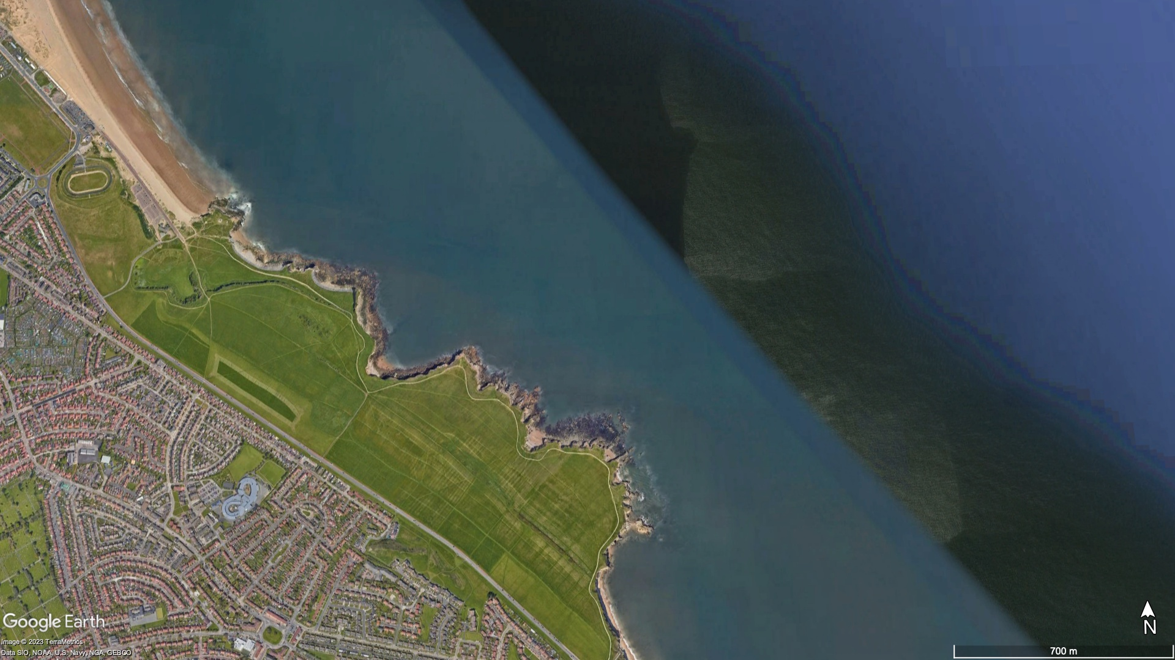

Slide 22
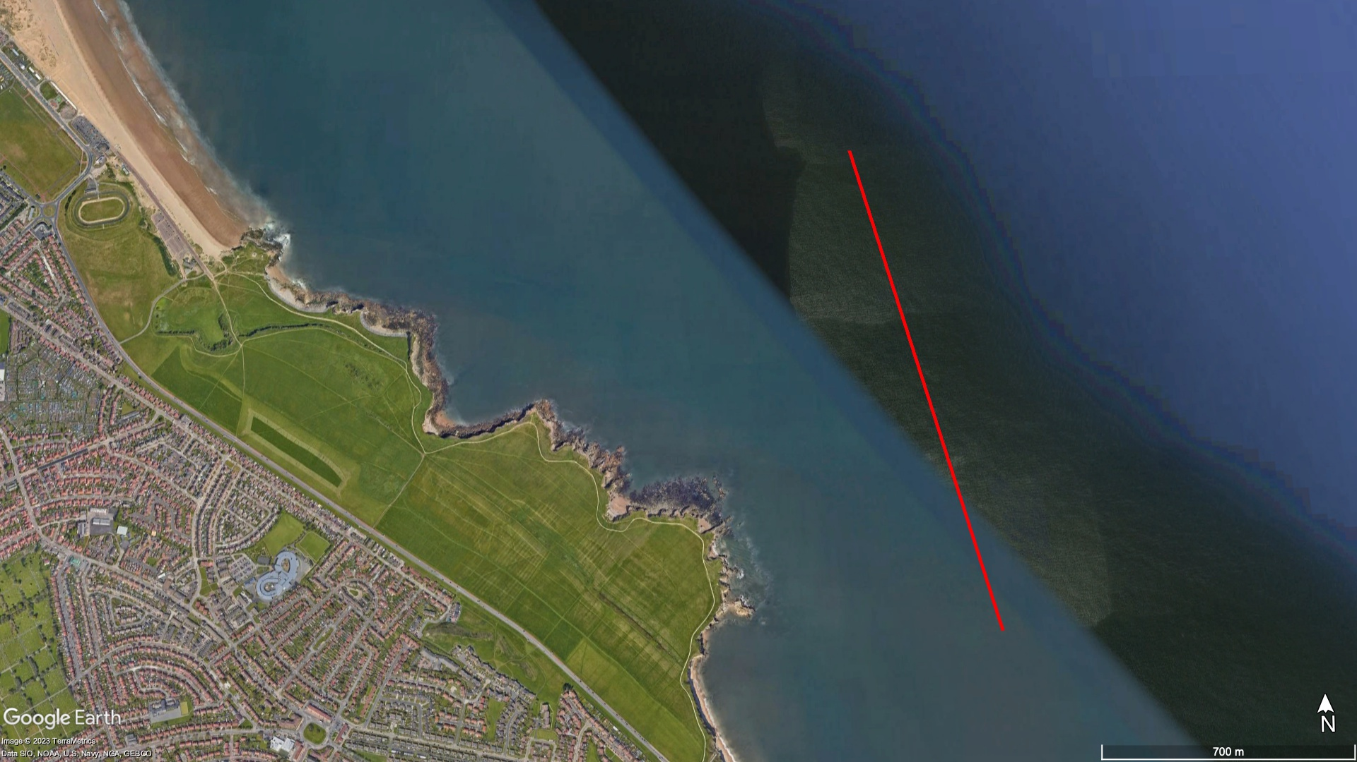
Coastline: 1.4km

Slide 23
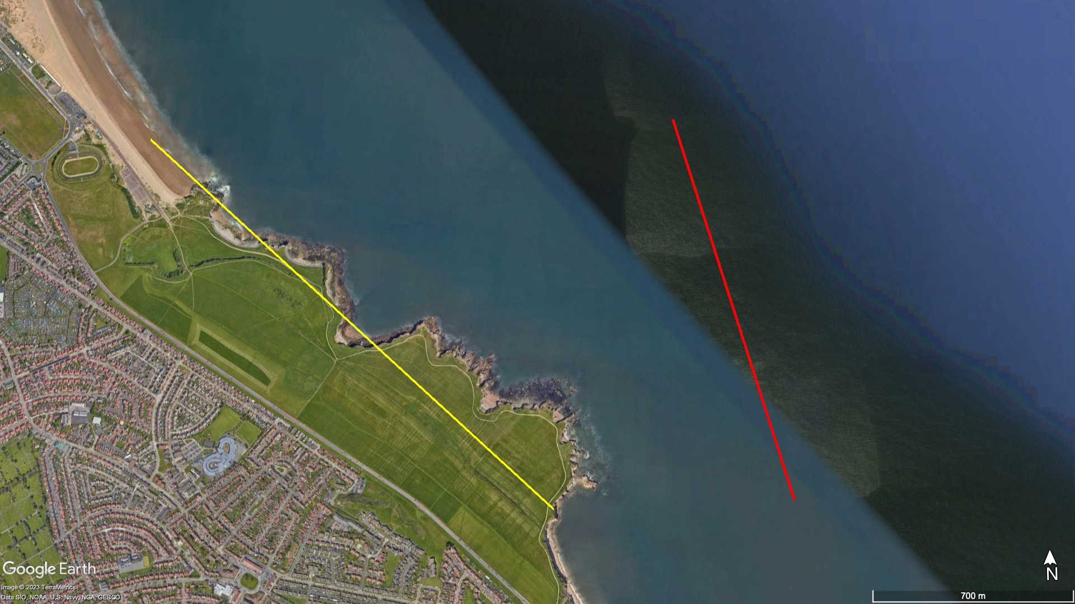
Coastline: 1.4km
Coastline: 2km

Slide 24
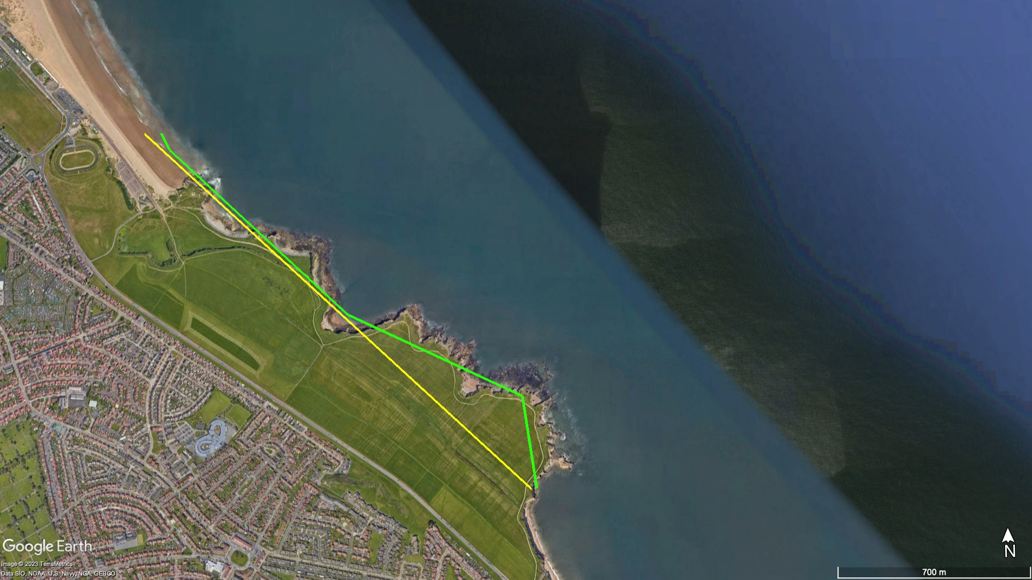
Coastline: 2km
Coastline: 2.1km

Slide 25

Coastline: 2.1km
Coastline: 2.8km

Slide 26
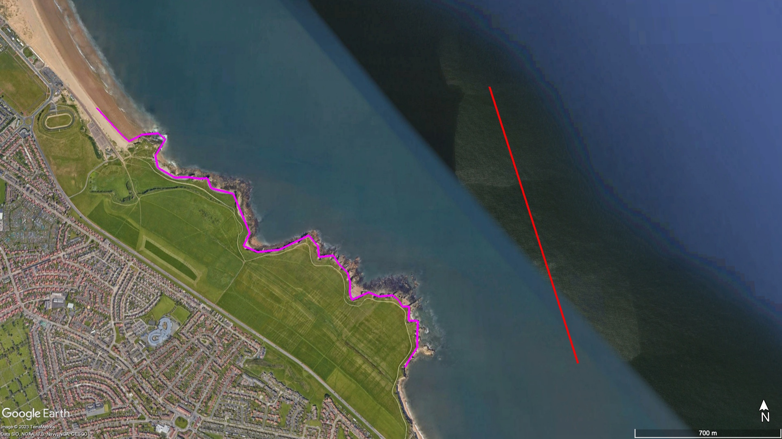
Coastline: 1.4km
Coastline: 2.8km

Slide 27
Coastline 4239km
Or
8500km?

Slide 28
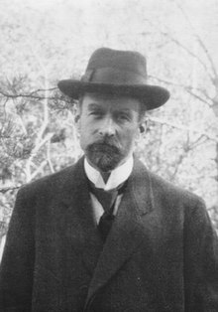
Von Koch was fascinated by the Coastline Problem.
He was curious about what would happen if you kept going, zooming further and further in following logical steps.
He created a set of steps (algorithm) to explore this idea mathematically.
Niels Fabian Helge von Koch
1870 - 1924

Slide 29


Von Koch Algorithm
Find the longest line(s).
Divide it into 3, find the middle section.
Draw an equilateral triangle with side length of the middle section.
Keep going.
The Mathematician curious | creative | logical
Notes:
Insert a example of how to use the stencil on each section.

Slide 30
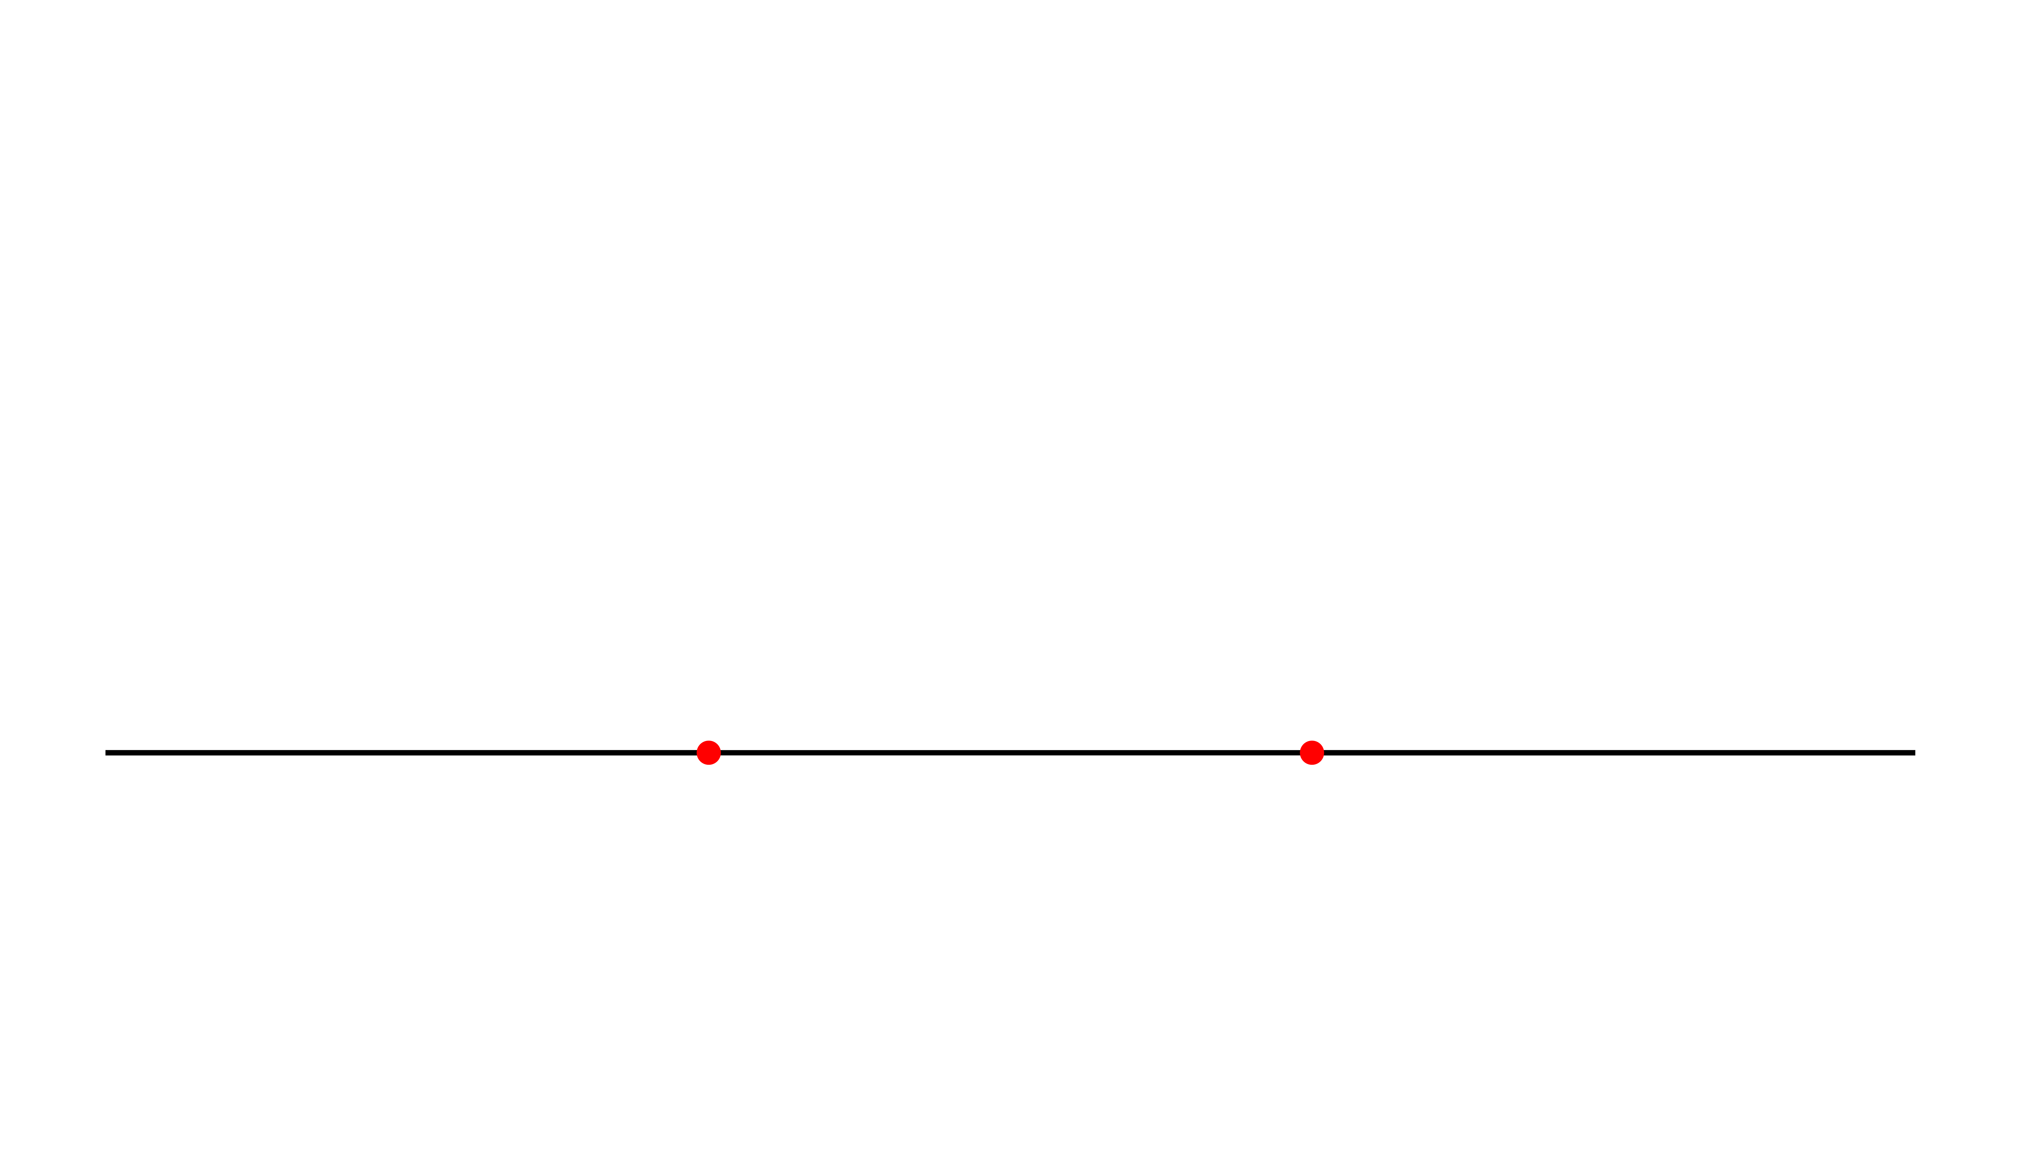
Von Koch Algorithm
Find the longest line(s).
Divide it into 3, find the middle section.
Draw an equilateral triangle with side length of the middle section.
Keep going.
The Mathematician curious | creative | logical
Notes:
Insert a example of how to use the stencil on each section.

Slide 31
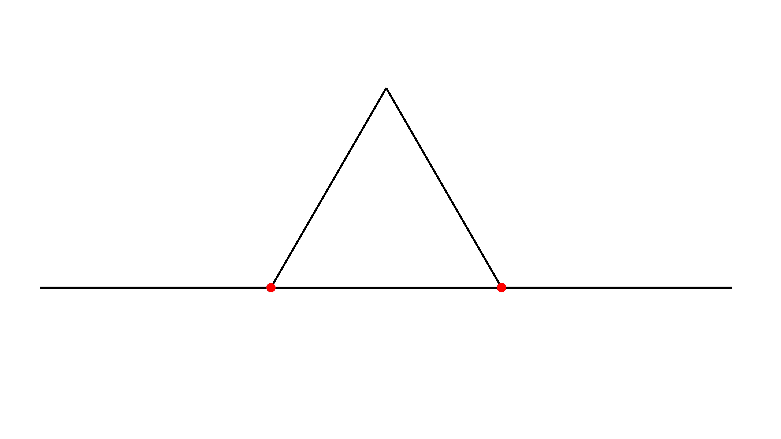
Von Koch Algorithm
Find the longest line(s).
Divide it into 3, find the middle section.
Draw an equilateral triangle with side length of the middle section.
Keep going.
The Mathematician curious | creative | logical
Notes:
Insert a example of how to use the stencil on each section.

Slide 32
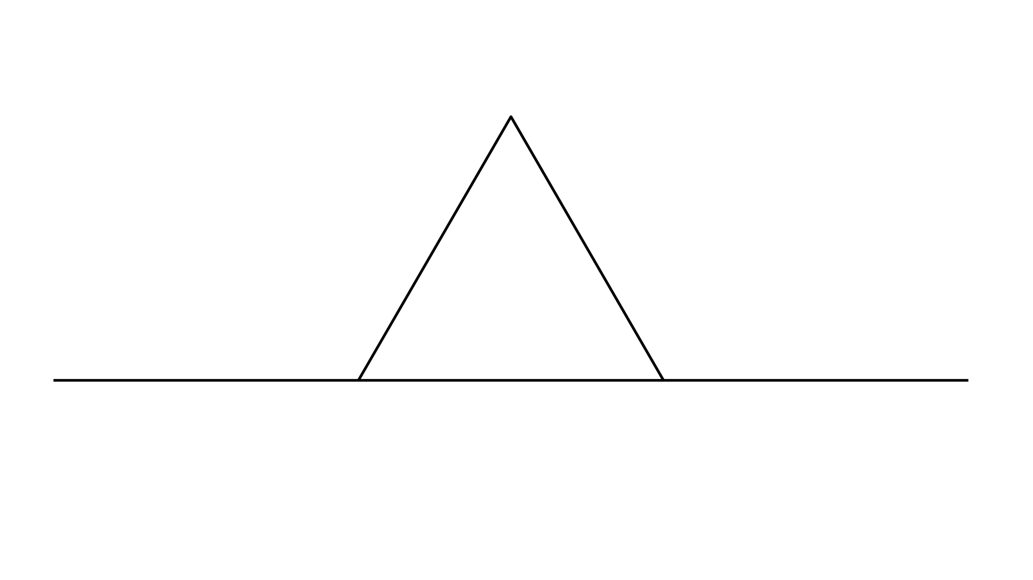
Von Koch Algorithm
Find the longest line(s).
Divide it into 3, find the middle section.
Draw an equilateral triangle with side length of the middle section.
Keep going.
The Mathematician curious | creative | logical
Notes:
Insert a example of how to use the stencil on each section.

Slide 33
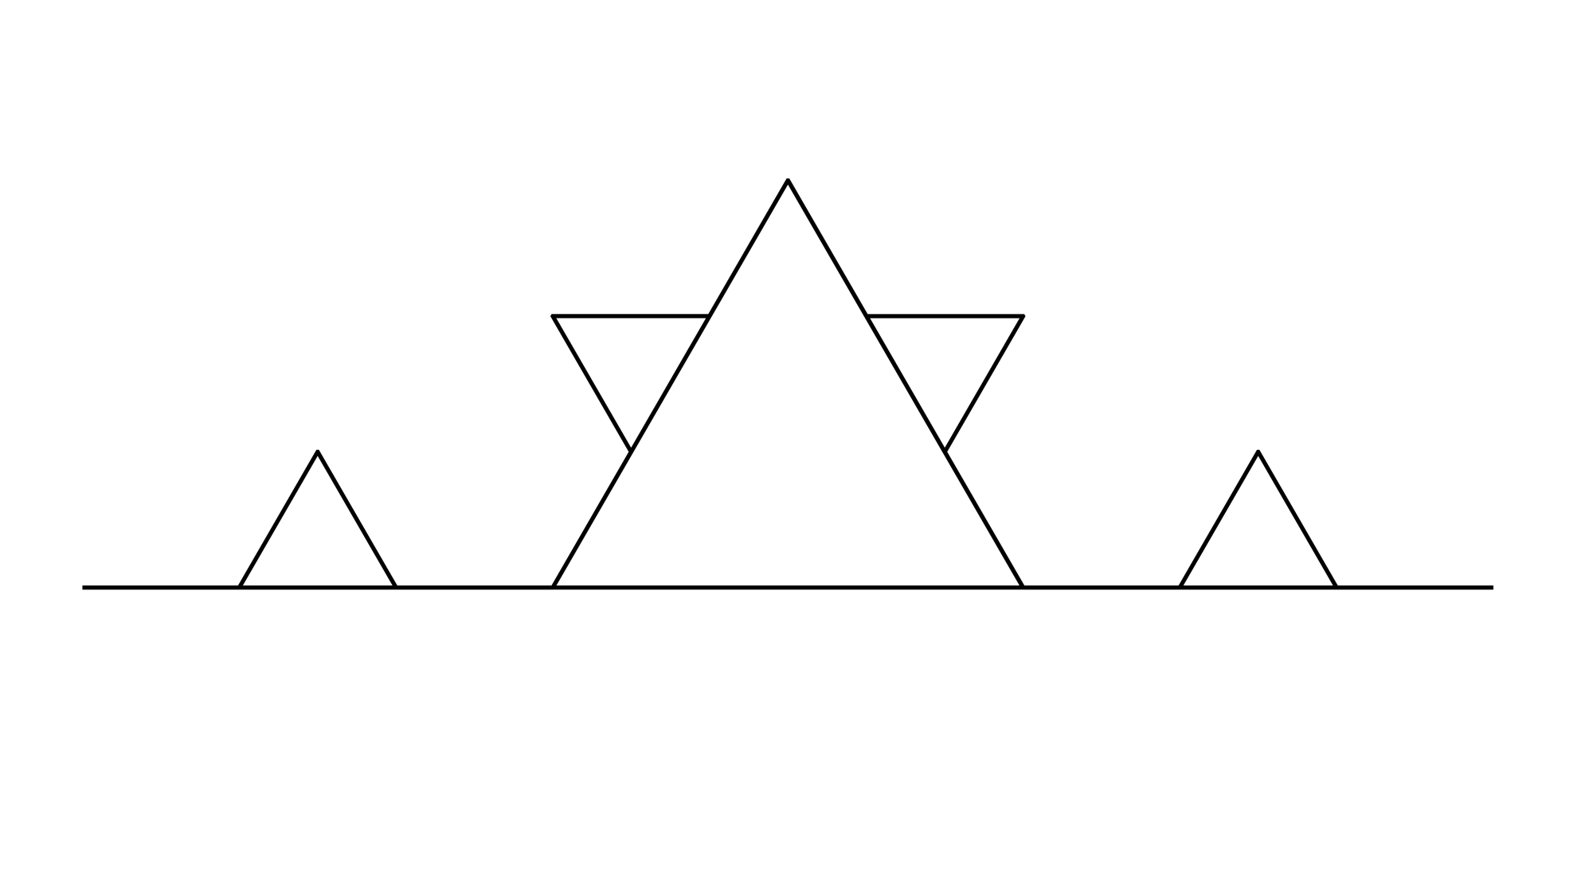
Von Koch Algorithm
Find the longest line(s).
Divide it into 3, find the middle section.
Draw an equilateral triangle with side length of the middle section.
Keep going.
The Mathematician curious | creative | logical

Slide 34
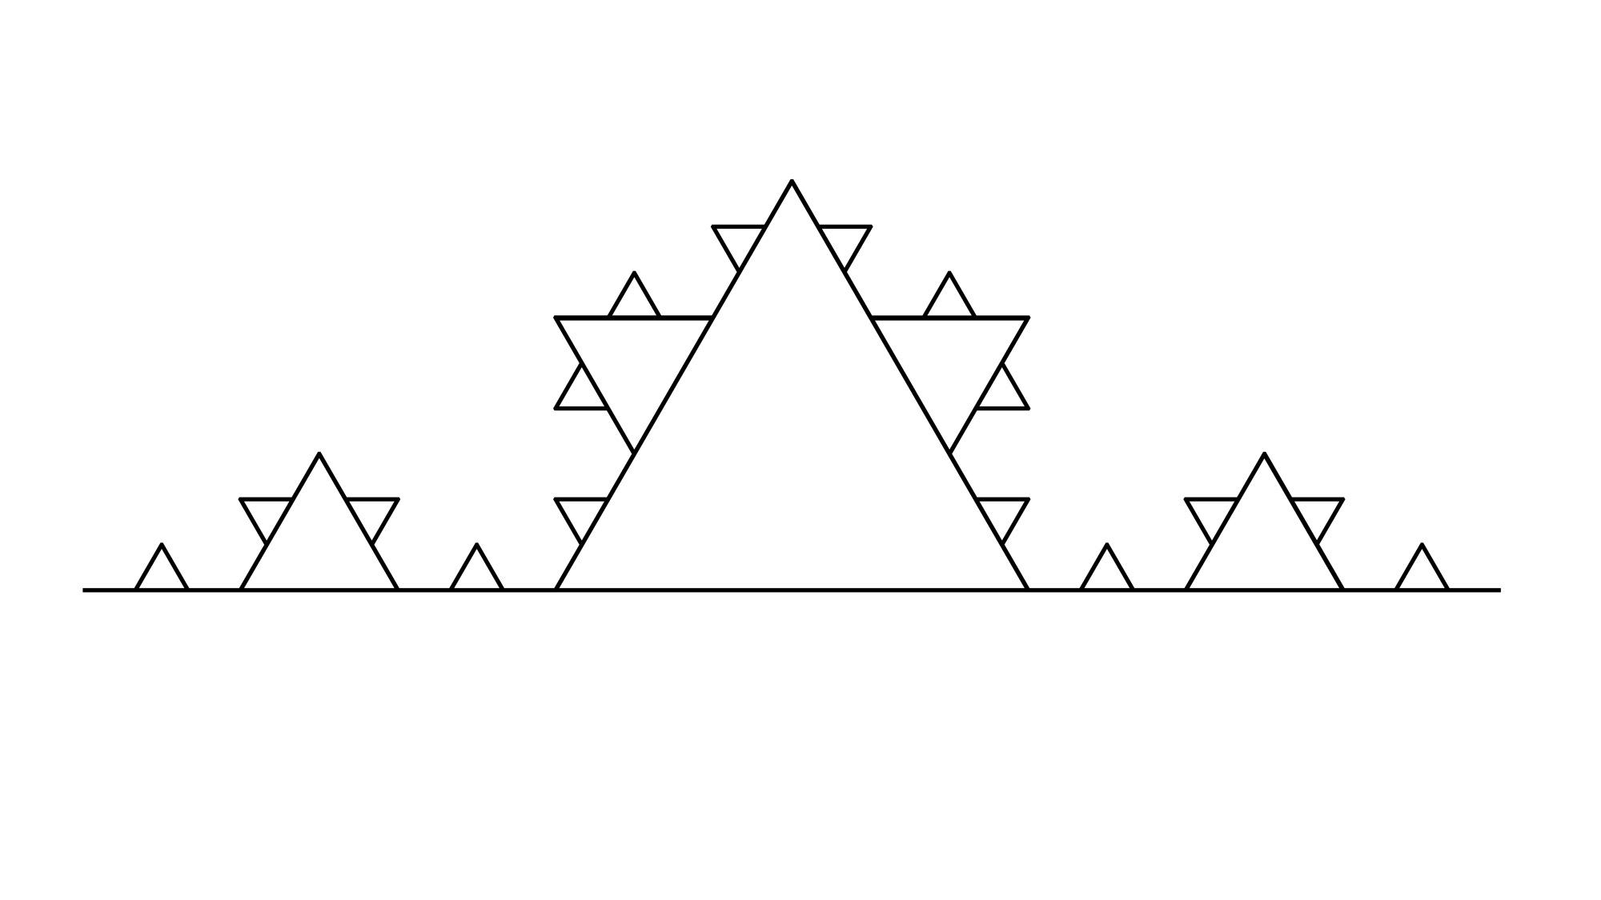
Von Koch Algorithm
Find the longest line(s).
Divide it into 3, find the middle section.
Draw an equilateral triangle with side length of the middle section.
Keep going.
The Mathematician curious | creative | logical

Slide 35
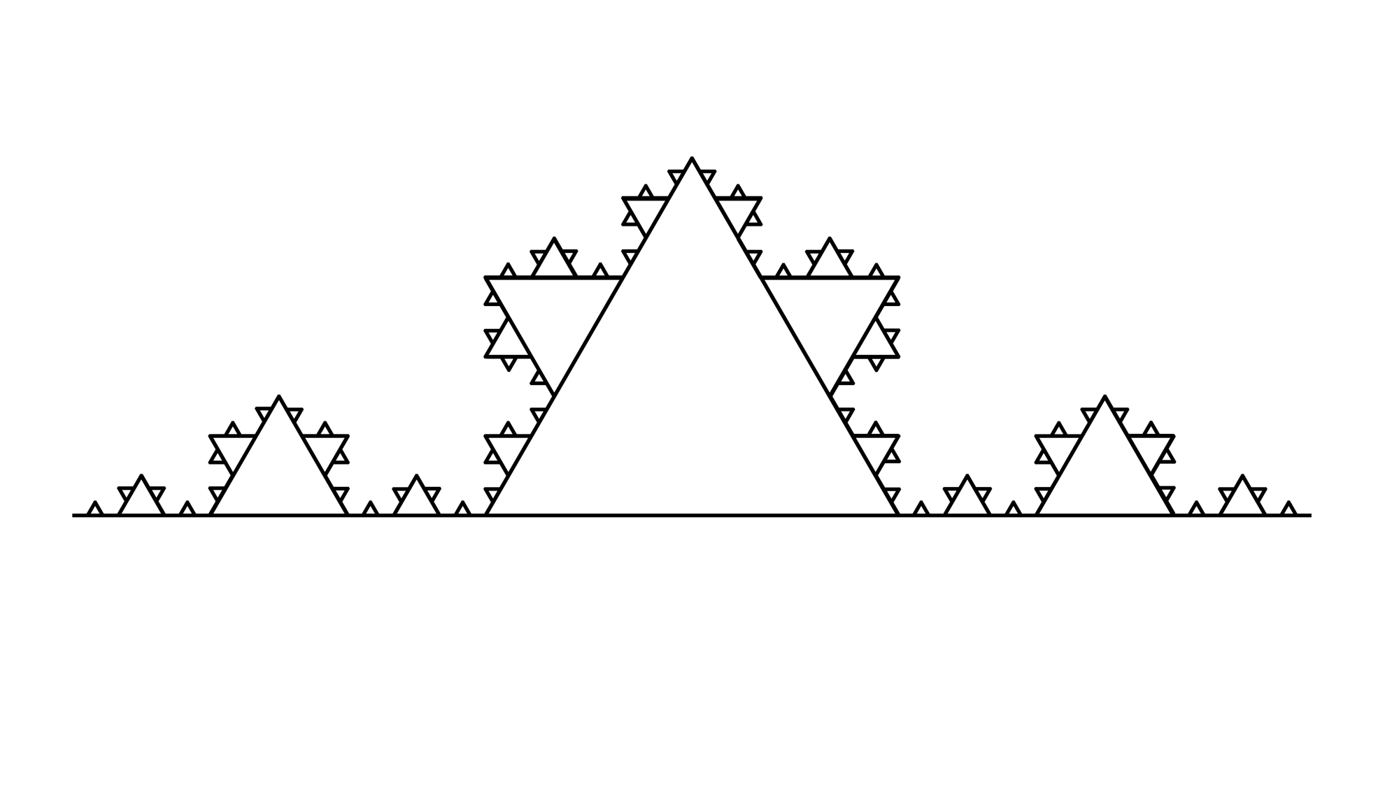
Von Koch Algorithm
Find the longest line(s).
Divide it into 3, find the middle section.
Draw an equilateral triangle with side length of the middle section.
Keep going.
The Mathematician curious | creative | logical

Slide 36
Sierpinski Triangle generation

Slide 37
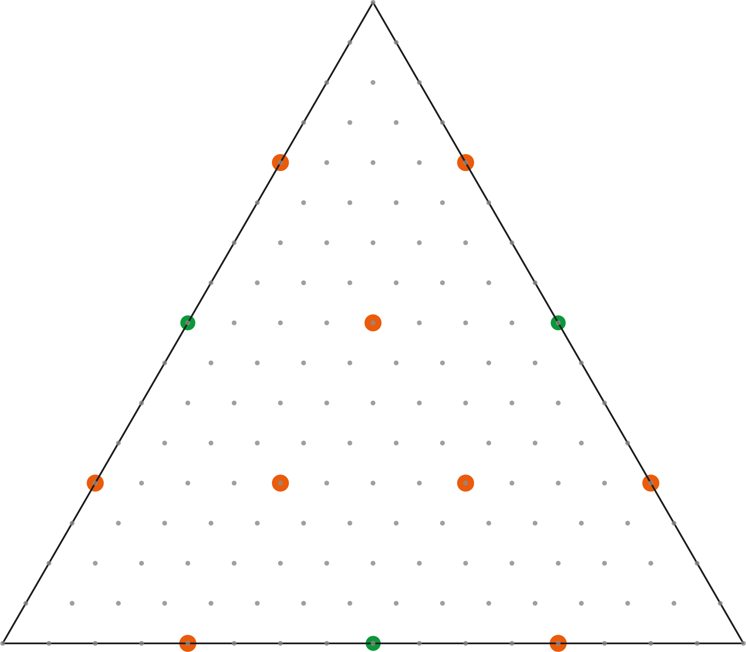
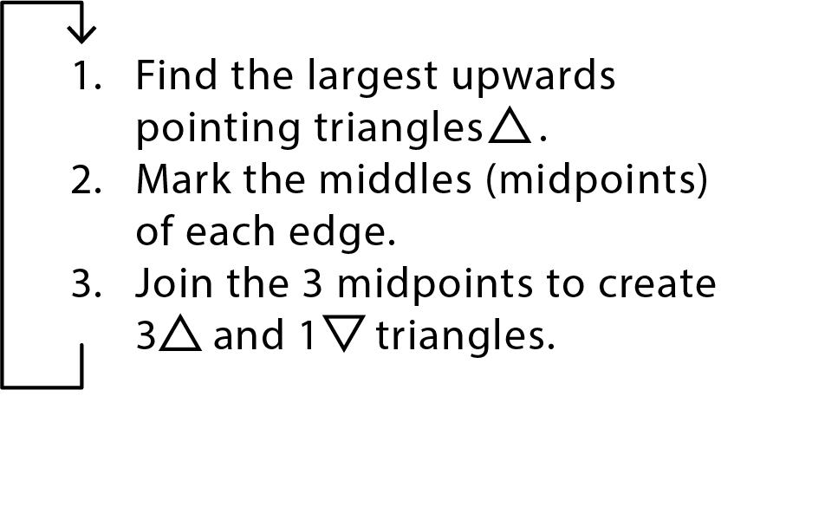
Notes:
Certain children were struggling to understand how to do the next steps of the triangle so were falling behind or doing it wrong, this was a minority of the class. In different sessions this could be most of the students and therefore a lot of students would be falling behind.

Slide 38
Notes:
Certain children were struggling to understand how to do the next steps of the triangle so were falling behind or doing it wrong, this was a minority of the class. In different sessions this could be most of the students and therefore a lot of students would be falling behind.

Slide 39
Notes:
Certain children were struggling to understand how to do the next steps of the triangle so were falling behind or doing it wrong, this was a minority of the class. In different sessions this could be most of the students and therefore a lot of students would be falling behind.

Slide 40

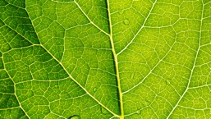

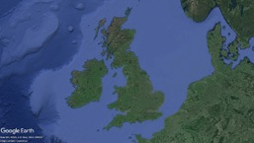
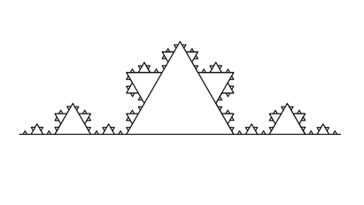
What did we learn about today?
Self-similar patterns in nature:
The Coastline Problem:
Fractals like the Koch Curve and Sierpinski Triangle
The skills of a mathematician: Curious, Creative, Logical

Slide 41
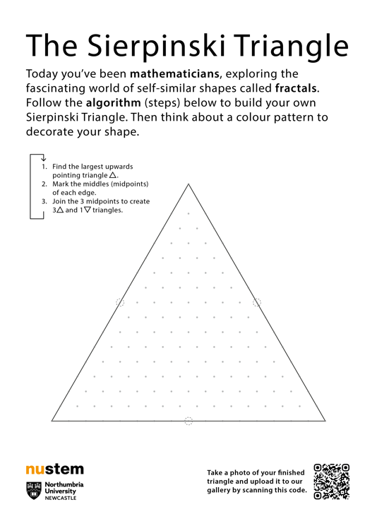
What next?
Take the Sierpinski Triangle worksheet home with you, complete it and then upload it to our gallery!
You parent/career can take a picture on their smartphone and then scan the code on the sheet.
The webpage also has some questions for them to ask you about the workshop!

