Slide 1
The Sports Scientist

Slide 2
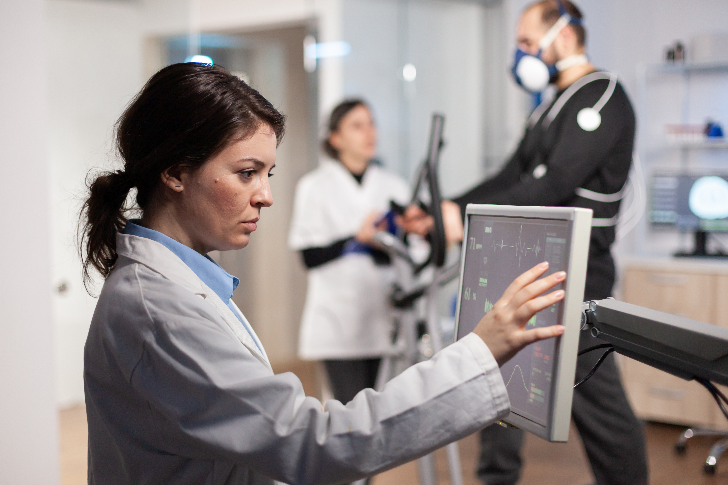
Sports scientist
Notes:
Use specialist equipment along with knowledge of the body and brain

Slide 3
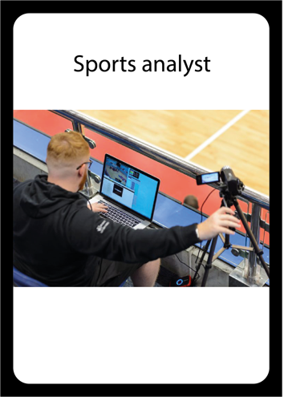
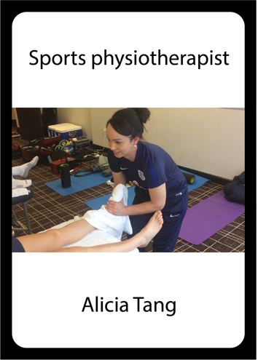
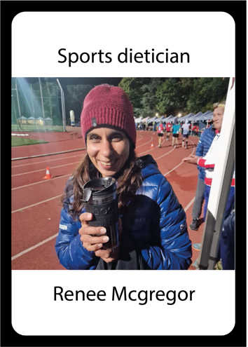
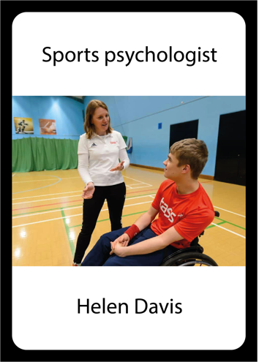
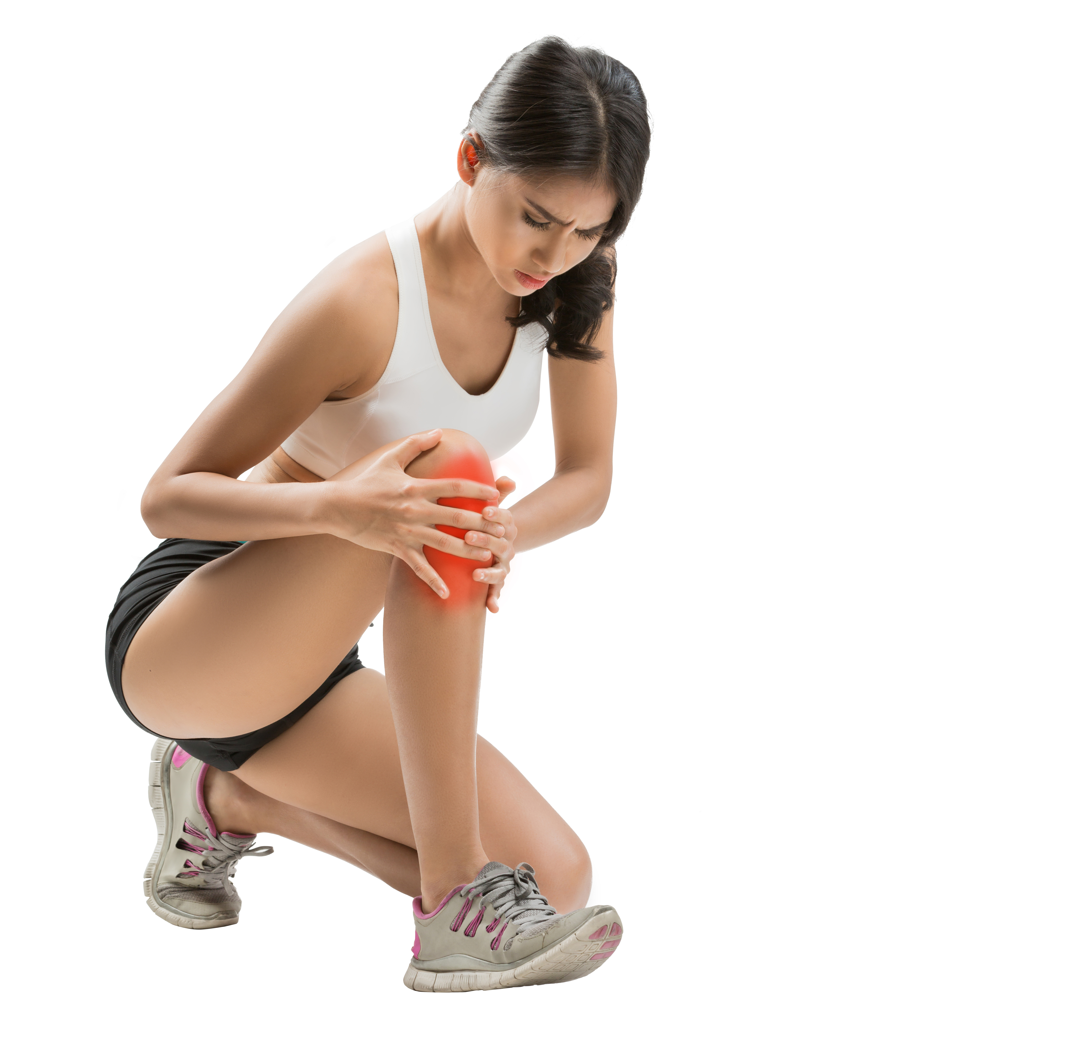

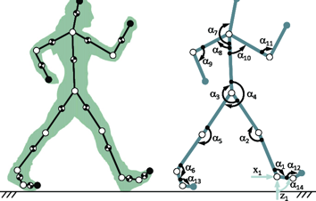

Slide 4
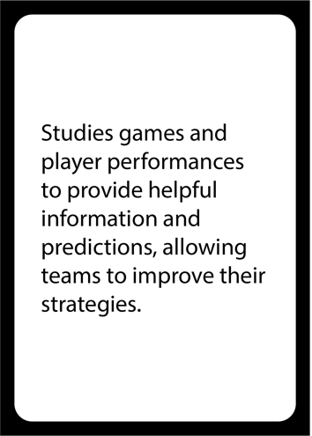
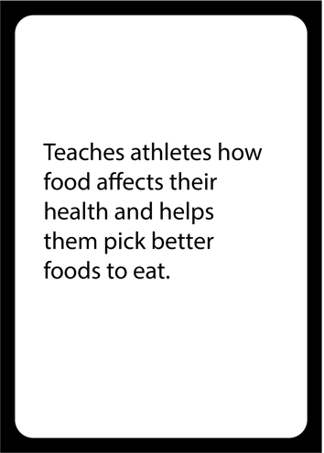
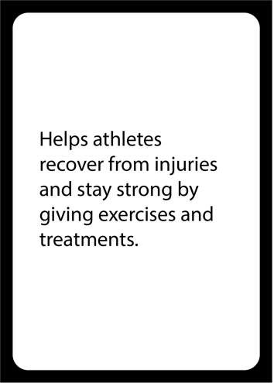
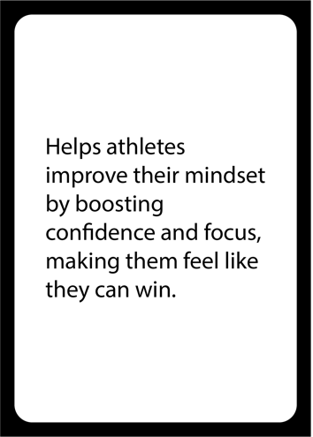

Slide 5
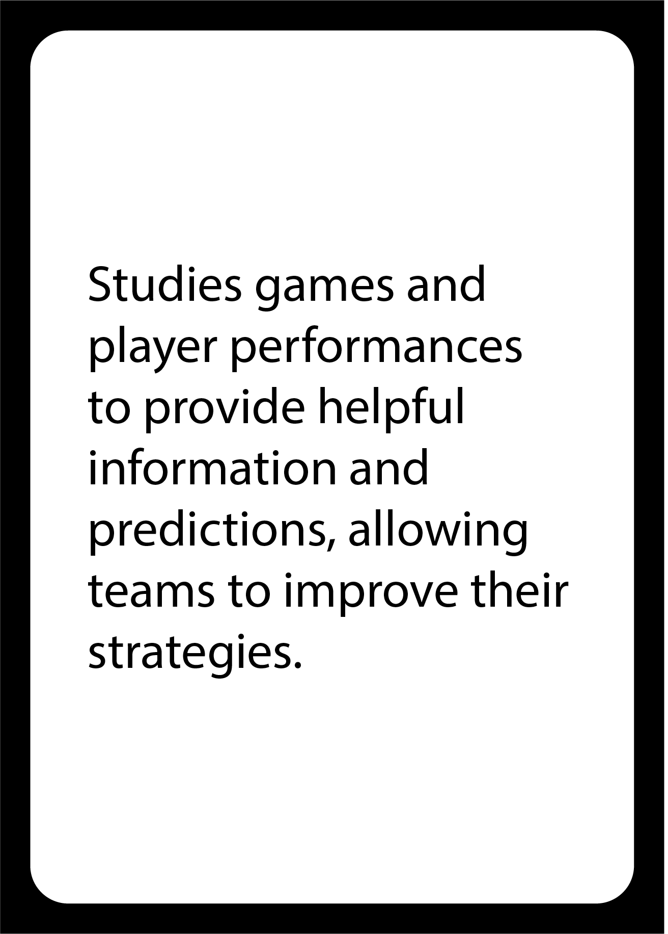

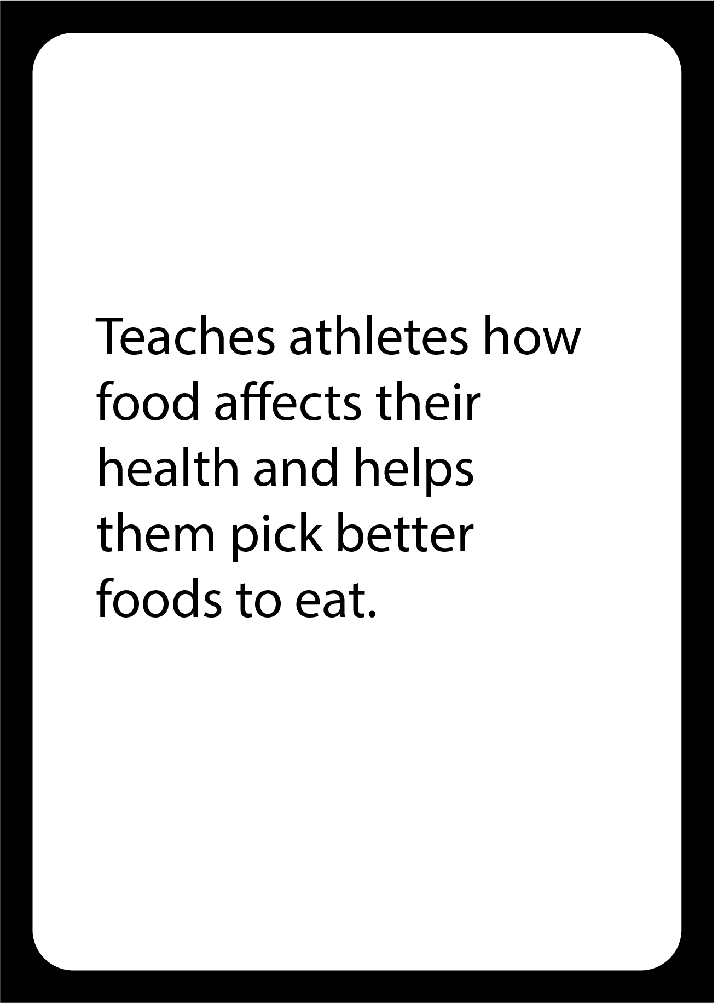

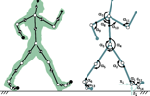


Slide 9
Performance analysts
Studies games and player performances to provide helpful information and predictions, allowing teams to improve their strategies.

Slide 10
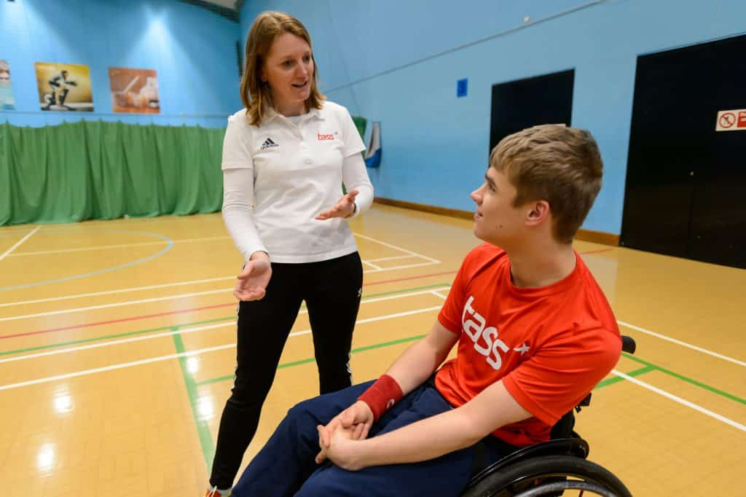
Sport psychologists
Helps athletes improve their mindset by boosting confidence and focus, making them feel like they can win.
Notes:
Helen Davis
Notes from Helen on what is happening in the images:
In the first photo I am working with a disabled Boccia player during a training session. The player has cerebral palsy and at the time was one of the National Champion for Boca. We will be talking about his processes to perform at his best. This might be discussing focus and concentration, pre shot routine or relaxation methods, such as breathing techniques prior to taking the shot.
In the second photo I am on the river bank as the winning 2021 boat race crew come in after their victory. We are standing back as the BBC were filming it and they have to get shots of the girls coming off the water and the coaches. After a few minutes we were allowed to go over and give them a congratulatory hug!

Slide 11
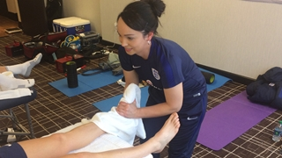
Sports physiotherapists
Helps athletes recover from injuries and stay strong by giving exercises and treatments.
Notes:
https://www.thefa.com/news/2017/mar/08/alicia-tang-interview-080317
Alicia Tang, England Womens Team

Slide 12
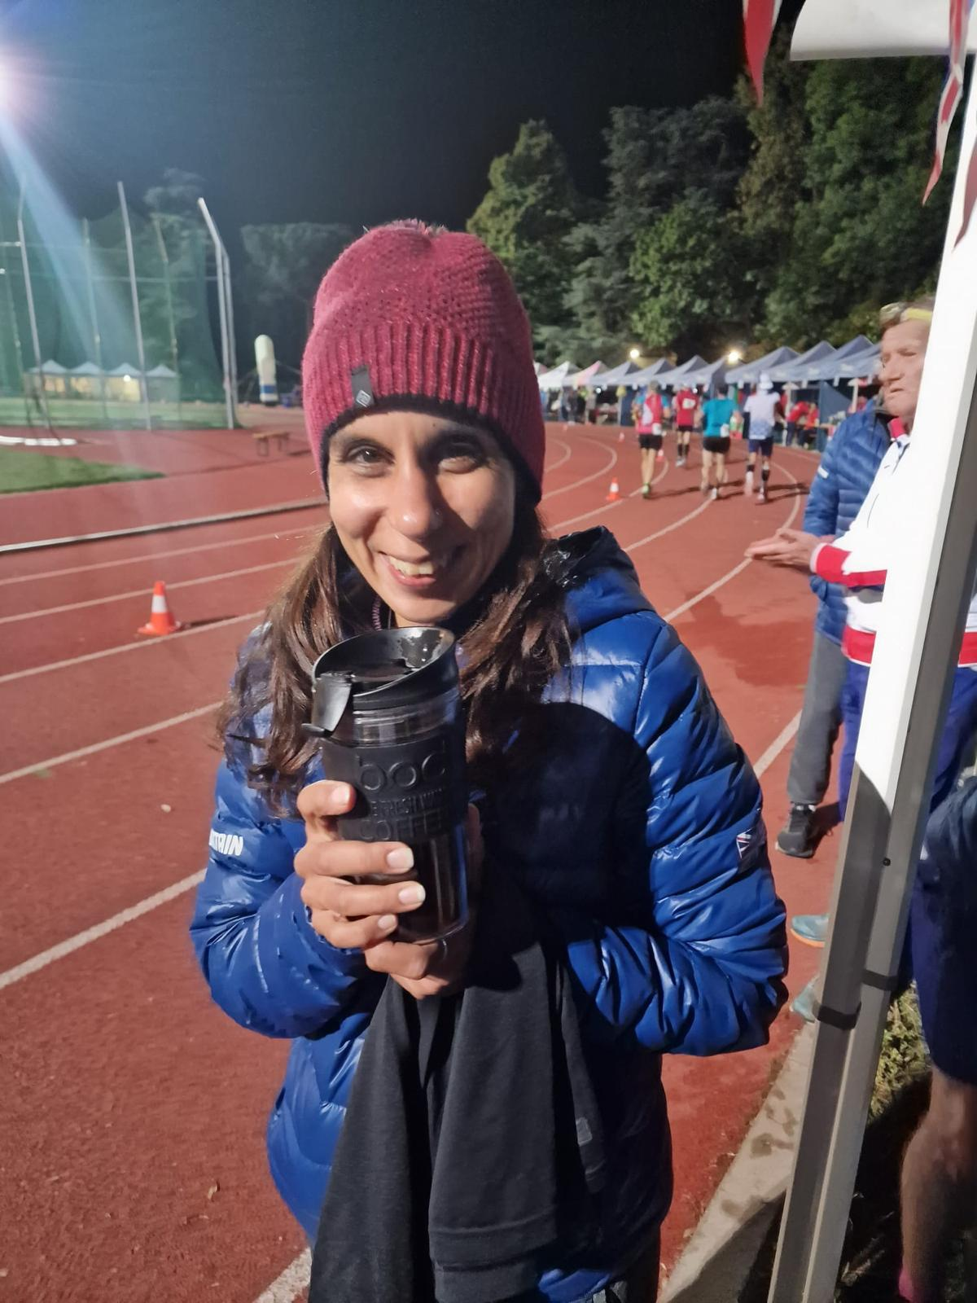
Sports Dietician
Teaches athletes how food affects their health and helps them pick better foods to eat.

Slide 13
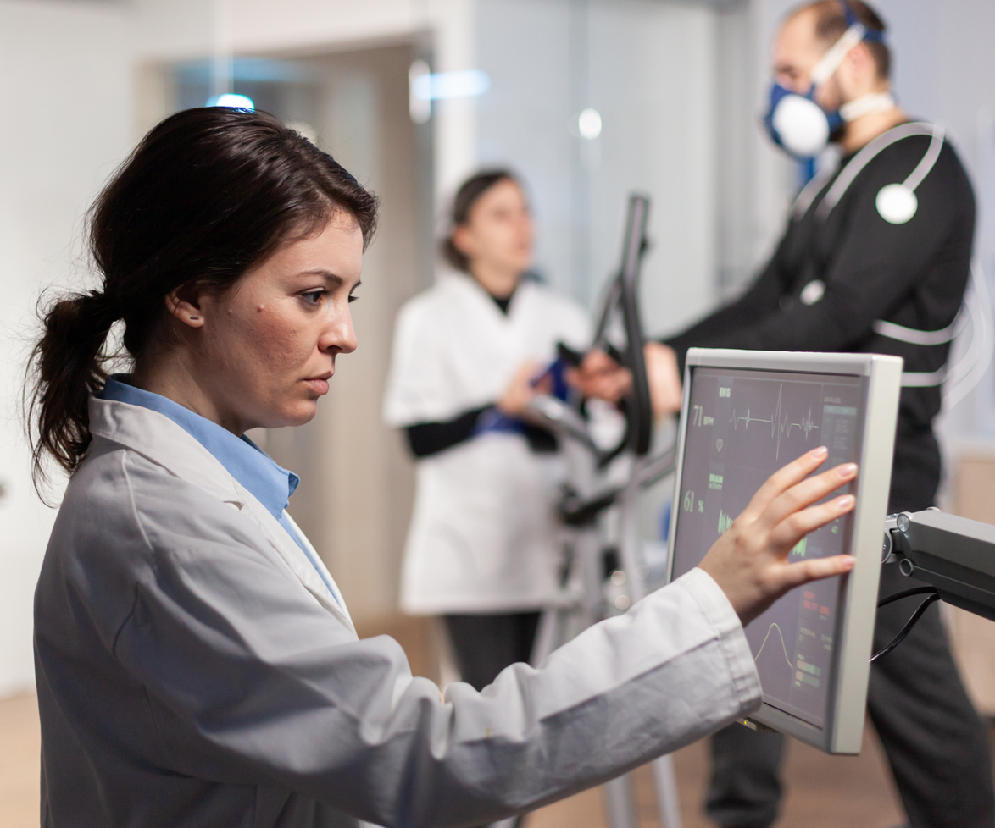
Attributes
Observant
Logical
Communicator
Notes:
What do the words mean?
If you are observant you are quick to see things, you are able to spot fine details, and you are good at paying attention.
Logical people can solve problems by thinking through them in a sensible order. They understand how one action can lead to another.
Communicators are good at sharing information and ideas with other people.

Slide 14
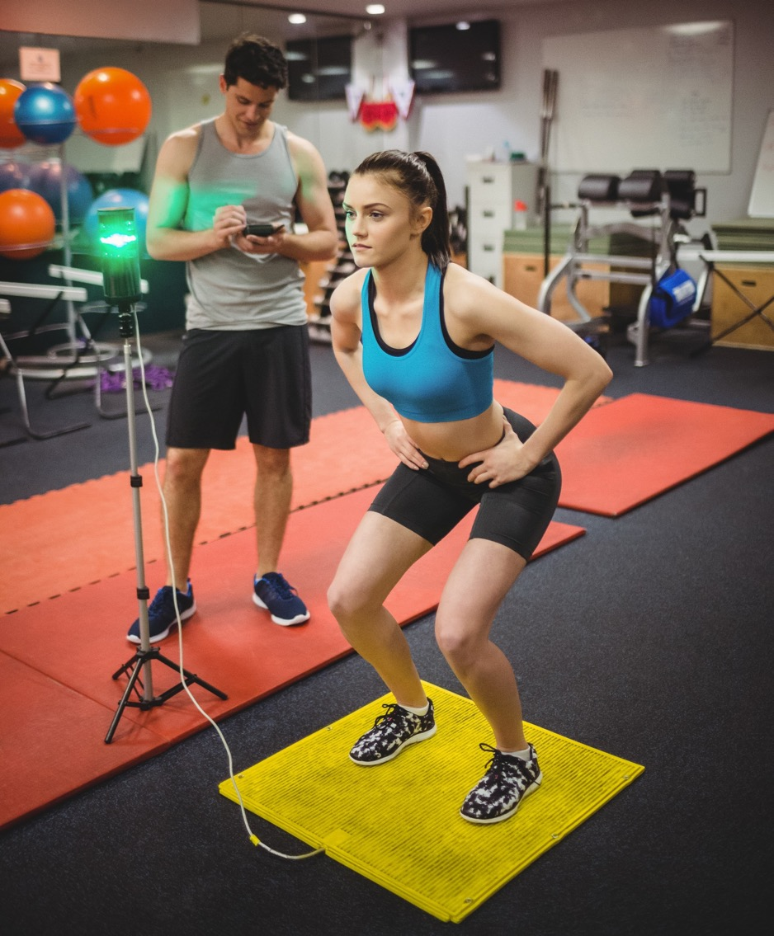
Today’s skills
Observant
Logical
Communicator
Notes:
Observant to take readings and analyse data collected
Logical people can solve problems by thinking through them in a sensible order. They understand how one action can lead to another. Logical people take a baseline so they know what something was like to start off with and can measure the effects of whatever they chose to do next.
Communicators so we can share what we have found out with others.

Slide 15

“As a sports scientist, I take something called baseline measurements to find out how strong, fast, or fit athletes are at the start.
These measurements are our 'starting points' and help us see how much you improve after all their practice. We might take their heart rate, see how high they can jump, or measure how strong they are.
Later, after athletes train, we measure again and compare the results. This way, we can see how much they’ve changed.”
Renee McGregor, Sports Dietician

Slide 16
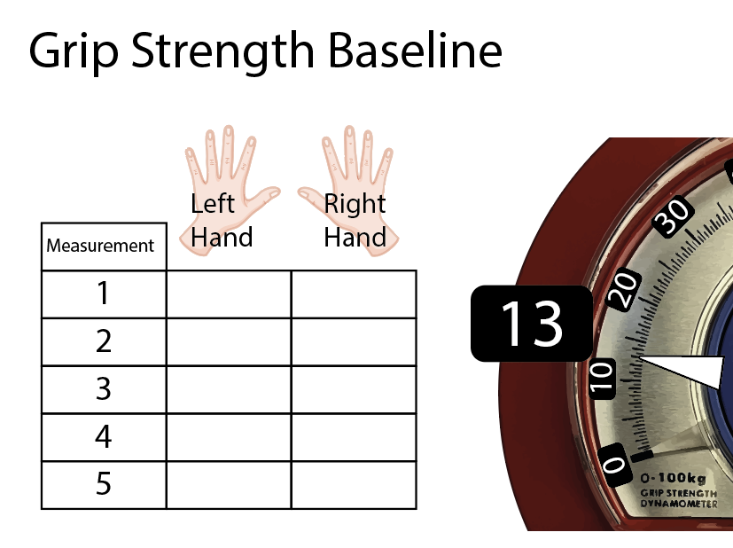
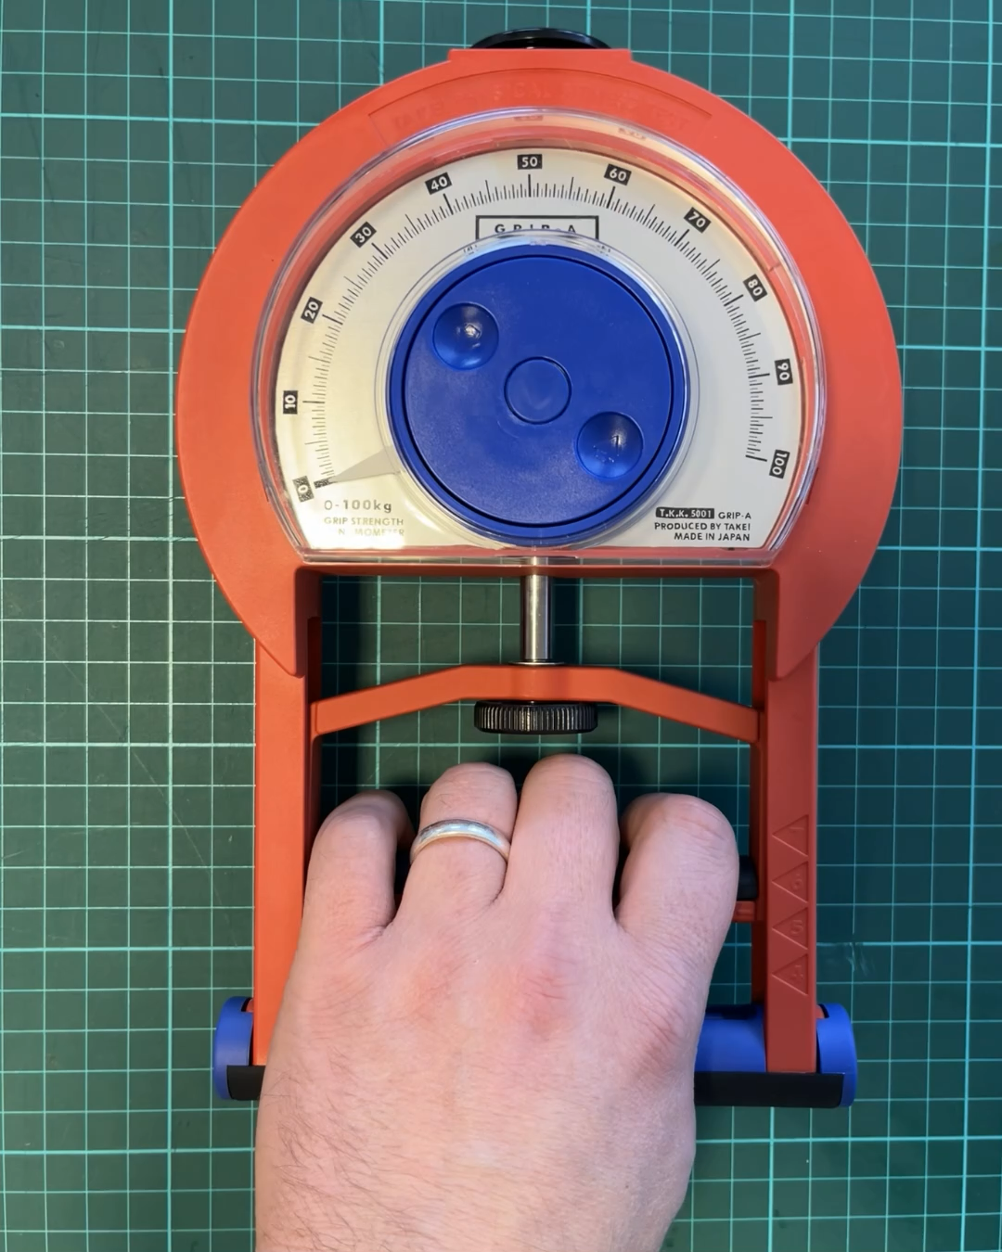

Slide 17
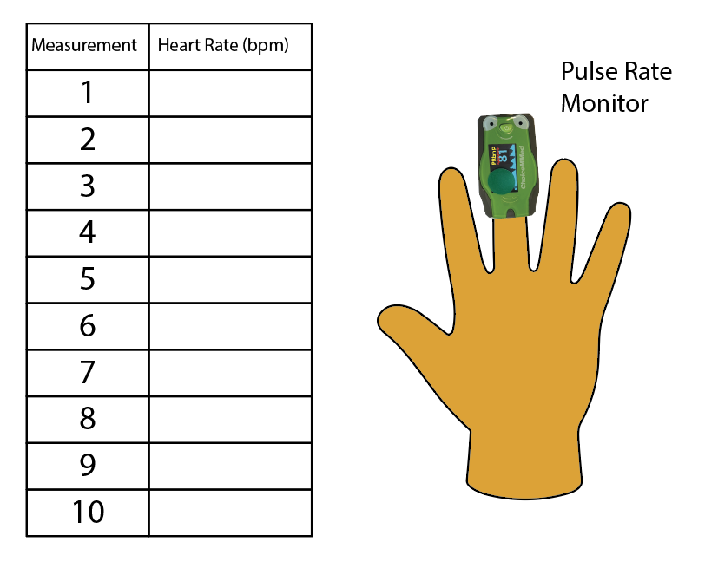
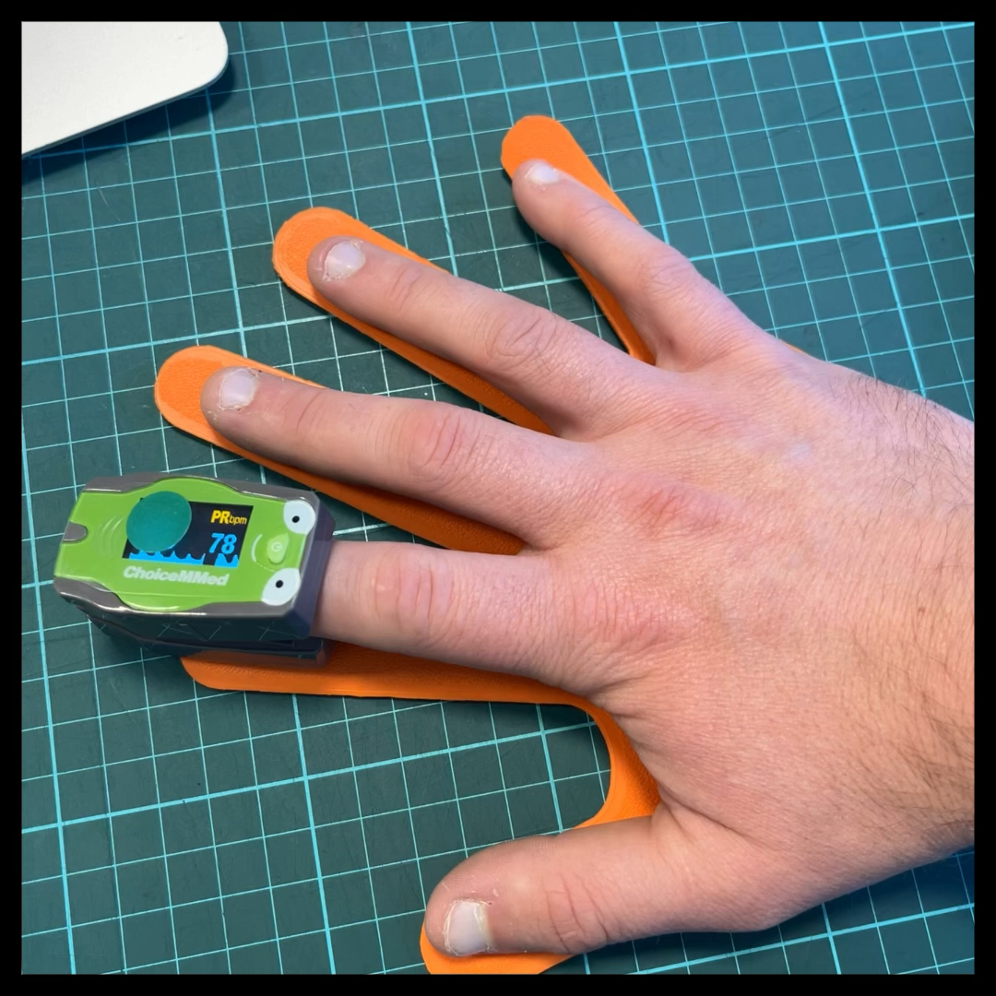
Heart Rate Baseline

Slide 18
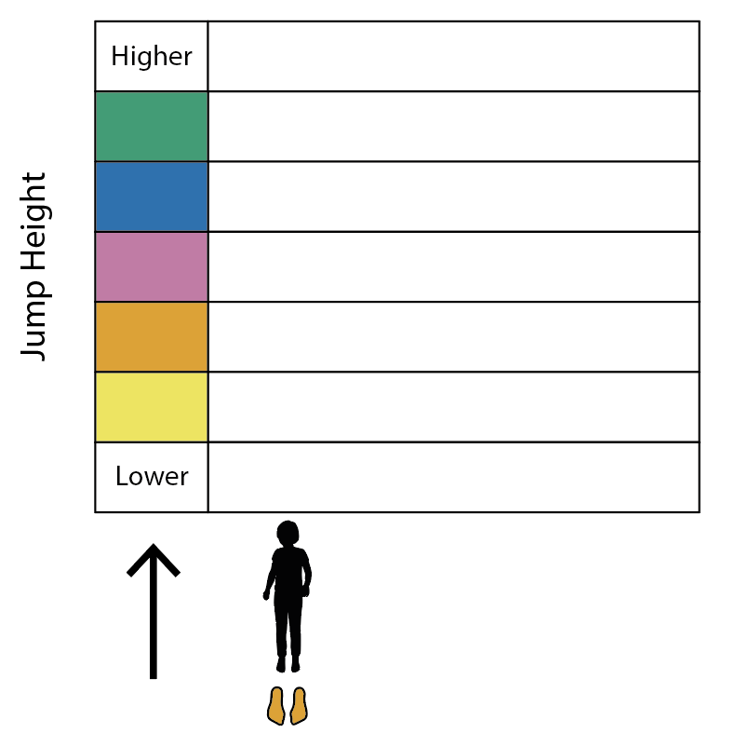
Jump Height Baseline Baseline

Slide 19
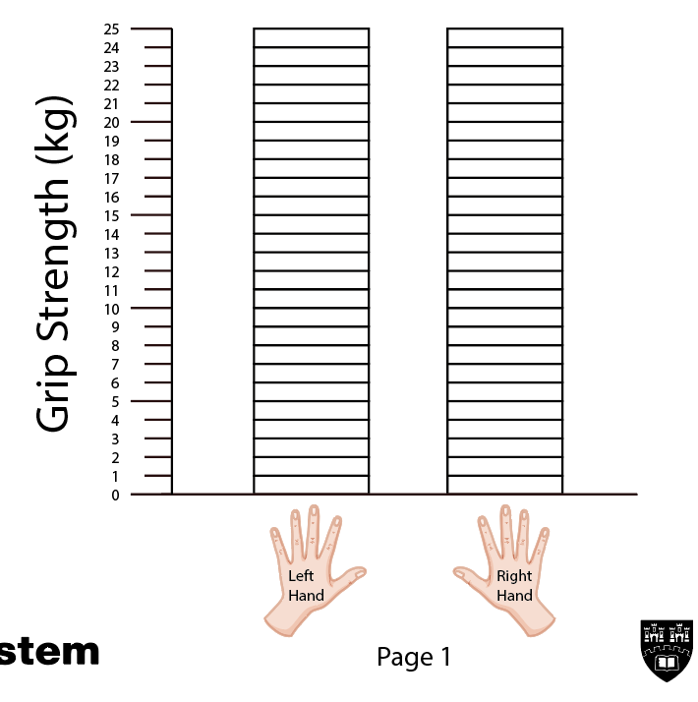
Analysis
12
14
11
13
11
10
10
11
19
11
12
Notes:
We could put some more prompts here if they are stuck like is the hand you write with stronger than the other? Which of your jumps was the highest and why do you think that was? Was your grip strength stronger at the beginning or end of the testing? Why do you think that was? Did your heart rate go back to normal within the time limit? Did it stay high for longer than you expected? Why do you think it did that? And so on…

Slide 20
Analysis
12
14
11
13
11
10
10
11
12
11
Notes:
We could put some more prompts here if they are stuck like is the hand you write with stronger than the other? Which of your jumps was the highest and why do you think that was? Was your grip strength stronger at the beginning or end of the testing? Why do you think that was? Did your heart rate go back to normal within the time limit? Did it stay high for longer than you expected? Why do you think it did that? And so on…

Slide 21
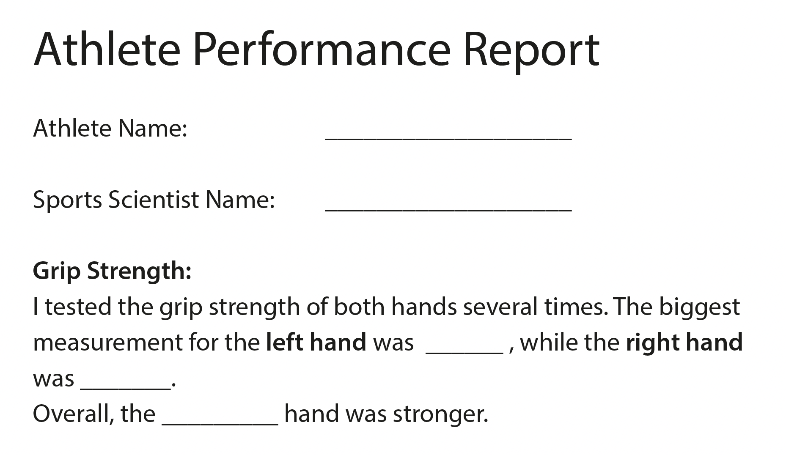

Slide 22
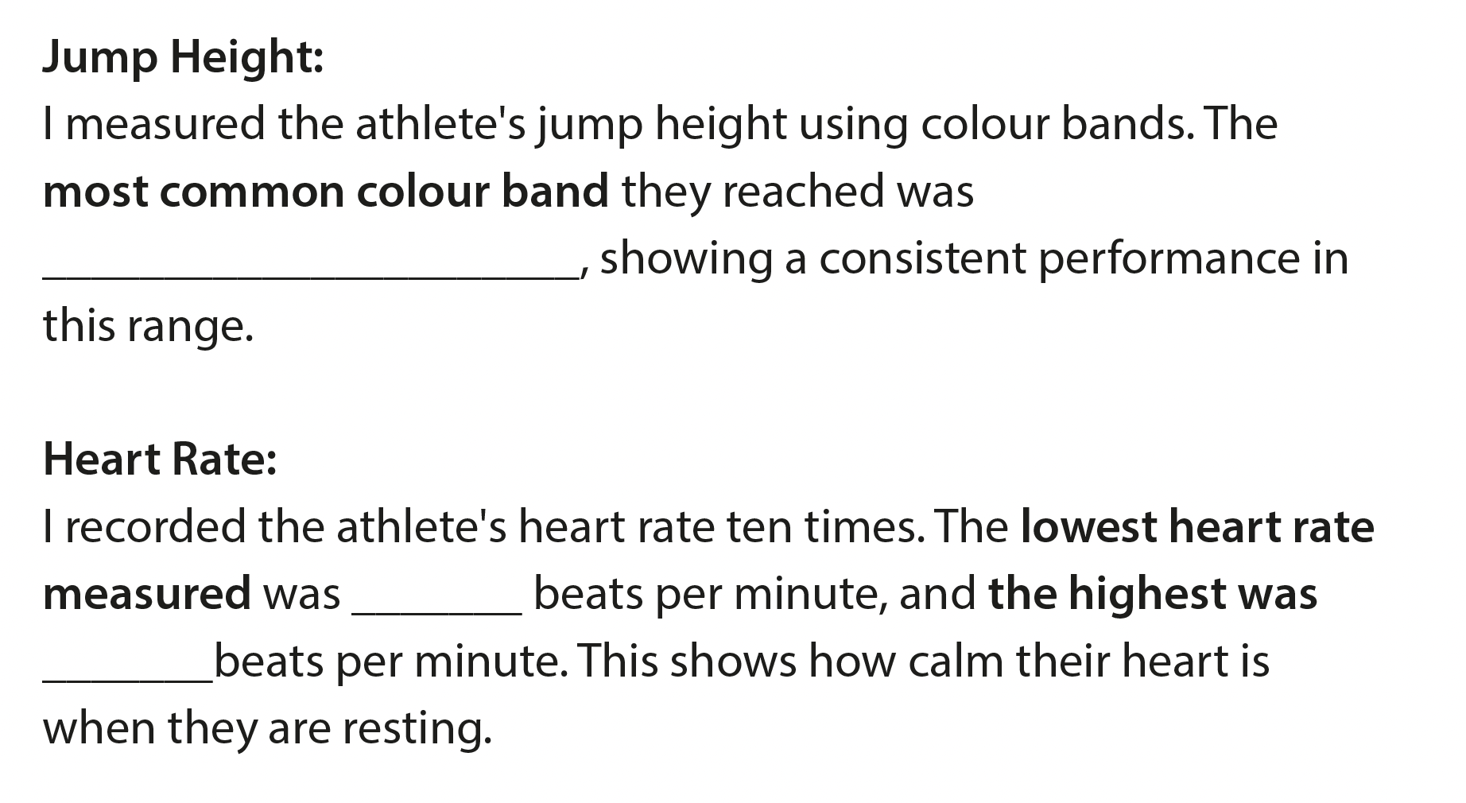

Slide 23

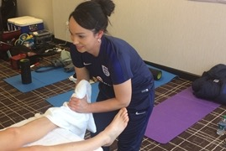
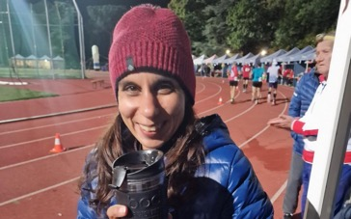

What do sports scientists do once they have the baseline?
- Eat a balanced diet to make your body strong.
- Drink plenty of water to stay hydrated while playing.
- Stretch your muscles before and after you play.
- Listen to your body and rest if something hurts.
- Practice your skills regularly to get better over time.
- Watch others play and learn from their moves.
- Imagine yourself doing well and feeling confident.
- Breathe deeply to stay calm and focused during games.
Physiotherapist
Dietician
Psychologist
Performance analyst
Notes:
Match the solutions to the job. Ask children to come up with their own ideas.
Other statements – I would advise a supplement for my client to take to increase fitness/
I would tape my client to reduce movement in my client’s muscles

Slide 24
What do sports scientists do once they have the baseline?
- Eat a balanced diet to make your body strong.
- Drink plenty of water to stay hydrated while playing.
- Stretch your muscles before and after you play.
- Listen to your body and rest if something hurts.
- Practice your skills regularly to get better over time.
- Watch others play and learn from their moves.
- Imagine yourself doing well and feeling confident.
- Breathe deeply to stay calm and focused during games.
Physiotherapist
Dietician
Psychologist
Performance analyst
Notes:
Match the solutions to the job. Ask children to come up with their own ideas.
Other statements – I would advise a supplement for my client to take to increase fitness/
I would tape my client to reduce movement in my client’s muscles

Slide 25
What do sports scientists do once they have the baseline?
- Eat a balanced diet to make your body strong.
- Drink plenty of water to stay hydrated while playing.
- Stretch your muscles before and after you play.
- Listen to your body and rest if something hurts.
- Practice your skills regularly to get better over time.
- Watch others play and learn from their moves.
- Imagine yourself doing well and feeling confident.
- Breathe deeply to stay calm and focused during games.
Physiotherapist
Dietician
Psychologist
Performance analyst
Notes:
Match the solutions to the job. Ask children to come up with their own ideas.
Other statements – I would advise a supplement for my client to take to increase fitness/
I would tape my client to reduce movement in my client’s muscles

Slide 26
What do sports scientists do once they have the baseline?
- Eat a balanced diet to make your body strong.
- Drink plenty of water to stay hydrated while playing.
- Stretch your muscles before and after you play.
- Listen to your body and rest if something hurts.
- Practice your skills regularly to get better over time.
- Watch others play and learn from their moves.
- Imagine yourself doing well and feeling confident.
- Breathe deeply to stay calm and focused during games.
Physiotherapist
Dietician
Psychologist
Performance analyst
Notes:
Match the solutions to the job. Ask children to come up with their own ideas.
Other statements – I would advise a supplement for my client to take to increase fitness/
I would tape my client to reduce movement in my client’s muscles

Slide 27
What do sports scientists do once they have the baseline?
- Eat a balanced diet to make your body strong.
- Drink plenty of water to stay hydrated while playing.
- Stretch your muscles before and after you play.
- Listen to your body and rest if something hurts.
- Practice your skills regularly to get better over time.
- Watch others play and learn from their moves.
- Imagine yourself doing well and feeling confident.
- Breathe deeply to stay calm and focused during games.
Physiotherapist
Dietician
Psychologist
Performance analyst
Notes:
Match the solutions to the job. Ask children to come up with their own ideas.
Other statements – I would advise a supplement for my client to take to increase fitness/
I would tape my client to reduce movement in my client’s muscles

Slide 28
Use your results to come up with a plan for your athlete.

Slide 29
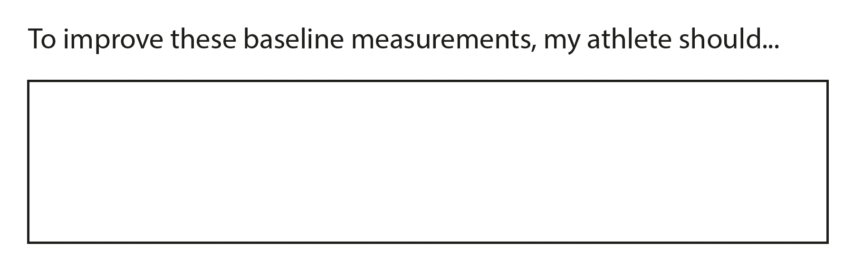

Slide 30
Attributes – where have you used them?
I was observant when I….
I was logical when I…
I was a good communicator because…

Slide 31

For more activities, scan the QR on your sticker when you get home

